Slide 1
Evaluating Suitable Locations for the Development and Preservation of Affordable Housing in Florida: The AHS Model
Andres Blanco, Ph.D.
Jeongseob Kim
Hyungchul Chung
Anne Ray
Abdulnaser Arafat, Ph.D
William O’Dell
Elizabeth Thompson
Presenter: Ruoniu Wang, Email: wrnvince@ufl.edu
UAA. 2012 – Pittsburgh, PA

Slide 2
Introduction
Housing affordability – a continuing issue despite current market crisis
Percentage of working households spending more than 50% of their income on housing costs
In the U.S. – close to 25%
In Florida – 33%
Meanwhile, more than 50,000 subsidized units have been lost in Florida (Shimberg Center, 2010)
Notes:
In spite of the decline of housing prices produced by current market crisis, housing affordability is a continuing issue in many cities of the United States with almost one quarter of …, which is considered to be in the category of severely housing cost burden.
severely housing cost burden
As owners opt-out from contracts or fail to maintain properties according to the required standards
This impacts negatively affect current efforts to expand the assisted housing stock. From 2004 to 2010, for instance, while 45,923 units were added to the stock, 30,617 units were lost.

Slide 3
Introduction
Consequently, there is need to identify and evaluate suitable sites for the development and preservation of affordable housing
The use of Florida Affordable Housing Suitability Model (AHS) to:
Show where positive attributes overlap and conflicting characteristics coincide
Evaluate and compare the sites of properties by assigning scores to sites for each location determinant
Study area – Orange County, Florida
Notes:
To this end, this study intends to … by using
… a Geographic Information Systems (GIS)-based decision tool to assess optimum locations for low-income housing.
The AHS model does not only provide a way to visualize a big amount of information by showing … but also it can …
This county is the central area of the Orlando MSA, the fastest growing urban area in the state.

Slide 4
The AHS Model
Scoring:
Each component is assigned a score between 0 and 25 where: 0 is not suitable and 25 is highly suitable. This reflects relationships among a set of spatial characteristics; the relationships are relative to local conditions, there are no thresholds or benchmarks
Notes:
In the next few slides I will briefly go over the AHS model. The ultimate goal of this model, as you can see from this conceptual structure here, is to generate an affordable housing suitability score for each parcel of the study area, which consists of four components ...
The score is a relative value associated with local conditions.

Slide 5
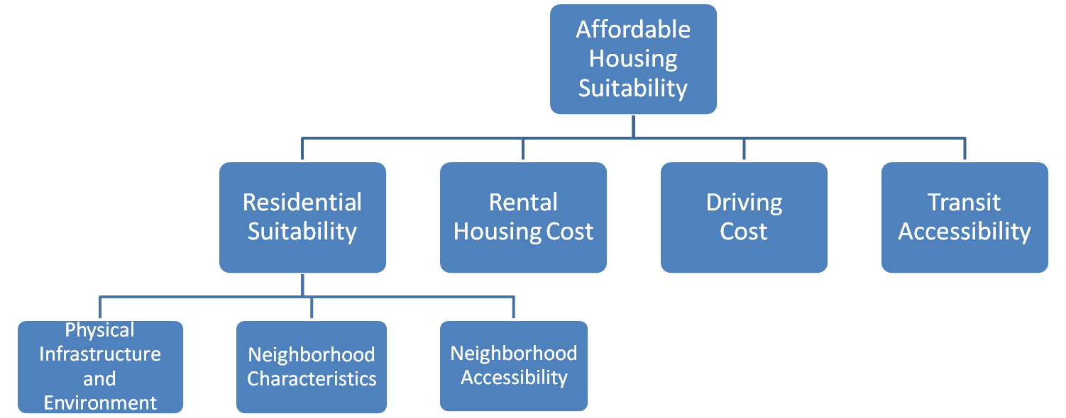
The AHS Model
Weights are assigned to each sub-component using pair-wise comparisons according to the input provided by local planners, housing experts, and the community
Selection of variables is based on an extensive literature review and the availability of data
Notes:
Each sub-component and component consist of a set of variables. Detailed descriptions of each variable are provided in the paper.

Slide 6
The AHS Model
Data source
Florida Geographic Data Library (FGDL), including:
Parcel data - Florida Department of Revenue (FDOR)
Social-economic info. – Census and American Community Survey
Transportation – National Housing Travel Survey
Local government
Geo-coded information about local characteristics, e.g. transit and crime
Notes:
Most of the data were obtained from the Florida Geographic Data Library (FGDL) warehoused and maintained by the GeoPlan Center at the University of Florida.

Slide 7
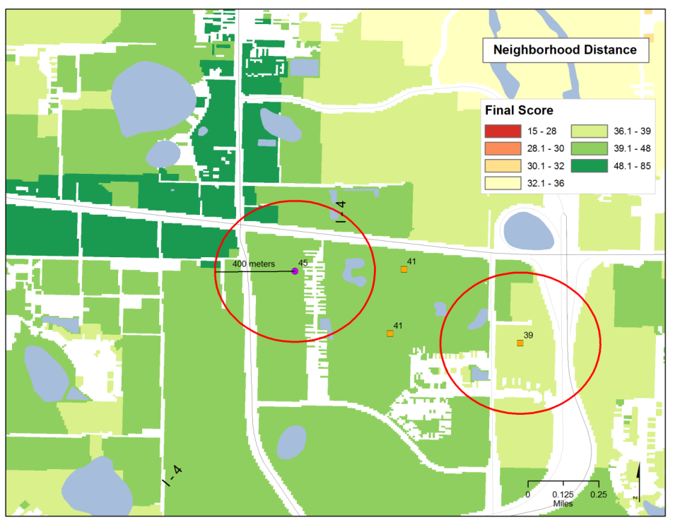
Evaluating the Assisted Housing Stock
Method:
Each property in the AHI and the LPI in Orange County was assigned a score based on the average of the AHS result in an area defined by a radius of 400 meters from the property location
Notes:
The background of the larger map shows the final score of affordable housing suitability, with green areas showing higher suitability within or nearby the municipality of Orlando, jobs and social services are located. Low suitable areas are represented in red colors and correspond mainly to low density suburban or rural areas.
formerly and currently subsidized rental housing developments
For the purpose of capturing neighborhood characteristics

Slide 8
Evaluating the Assisted Housing Stock
General comparison: total assisted vs. multifamily parcels vs. total parcels
Assisted Housing Inventory (AHI) vs. Lost Property Inventory (LPI)
Program analysis
Age analysis
Notes:
With those maps in hand, we are able to evaluate the assisted housing stock. Our analyses start by a general comparison among …
The total assisted housing stock consists of two parts
The first part - the AHI, defined as privately owned rental properties that receive public subsidies, is one of the main sources for low-income households
The second part - formerly subsidized rental housing that are no longer bound by rent and income restrictions.
Analyses will be done on total assisted housing stock by program types and decade of initial funding

Slide 9
Evaluating the Assisted Housing Stock
Table 1. Average results for total assisted housing stock, multifamily parcels, and the entire universe of parcels
 | Frequency | Infrastructure + Environmental Characteristics (I) | Neighborhood Characteristics (N) | Neighborhood Accessibility (NA) | Residential Suitability Score (I+N+NA=R1) | Rental Cost (R2) | Driving Cost (D) | Transit Accessibility (T) | Final Score = R1+R2+D+T
TOTAL ASSISTED | 202 | 3.82 | 5.47 | 5.03 | 15.18 | 16.45 | 16.14 | 9.81 | 59.05
MULTIFAMILY PARCELS | 6,987 | 4.20 | 5.20 | 5.00 | 14.40 | 15.90 | 16.30 | 8.50 | 55.10
TOTAL PARCELS | 371,314 | 3 | 6.4 | 2.9 | 12.3 | 12.6 | 13.9 | 2.9 | 41.7
General results:
“Urban premium” of suitability – in average, accessibility-related scores are higher in total assisted housing stock
There is a trade-off between accessibility and social characteristics
Notes:
In average, the final scores of total assisted housing stock is higher than the average for parcels in the county and than the average for multifamily parcels.

Slide 10
Evaluating the Assisted Housing Stock
Table 2. Average results for the AHI and LPI
 | Frequency | Infrastructure + Environmental Characteristics (I) | Neighborhood Characteristics (N) | Neighborhood Accessibility (NA) | Residential Suitability Score (I+N+NA=R1) | Rental Cost (R2) | Driving Cost (D) | Transit Accessibility (T) | Final Score = R1+R2+D+T
AHI | 168 | 3.80 | 5.39 | 4.97 | 15.04 | 16.33 | 16.29 | 9.73 | 58.85
LPI | 34 | 3.88 | 5.82 | 5.32 | 15.91 | 17.00 | 15.44 | 10.21 | 60.09
TOTAL ASSISTED | 202 | 3.82 | 5.47 | 5.03 | 15.18 | 16.45 | 16.14 | 9.81 | 59.05
AHI vs. LPI:
In average, LPI scores are higher in the final score and most components except for driving cost
Driving cost scores are better in the AHI because of closer proximity to main highways
Notes:
This pattern can be explained by the fact that the LPI properties fare better as they prepare to enter the market.
This could be because of the small sample size of the LPI. It can also suggest that a big part of the difference between those properties that remained in the assisted inventory and those that left is explained by characteristics of the property rather than by locations or characteristics of the neighborhood. In fact, different studies have concluded that the probability of staying in the assisted stock depends on some variables that are not included in the AHS.

Slide 11
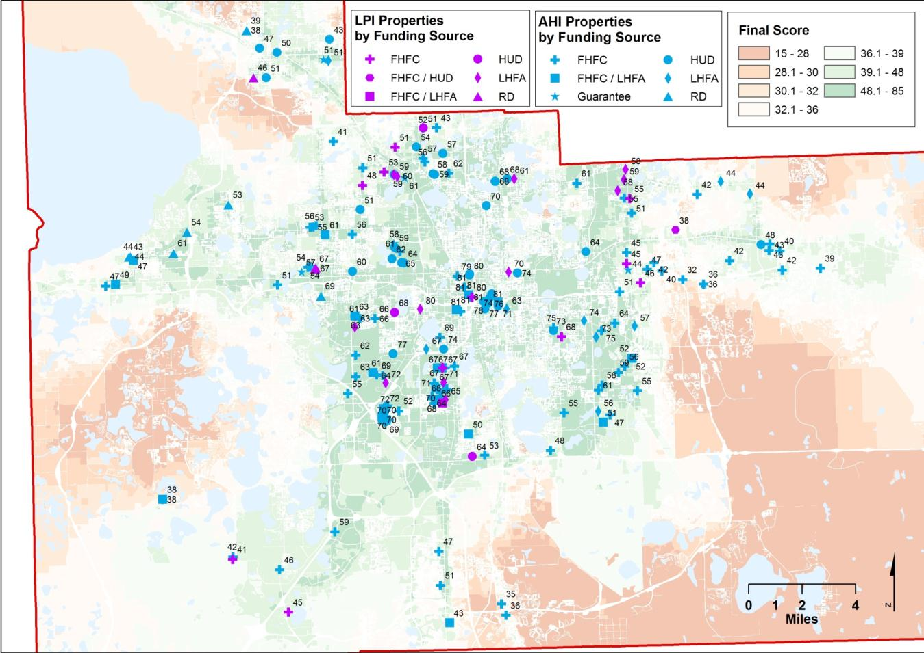
Evaluating the Assisted Housing Stock
Notes:
this map presents the scores for the AHI and LPI properties discriminated by program.

Slide 12
Evaluating the Assisted Housing Inventory
Table 3. Average results per program
 | Frequency | Infrastructure + Environmental Characteristics (I) | Neighborhood Characteristics (N) | Neighborhood Accessibility (NA) | Total Residential Suitability Score (I+N+NA=R1) | Rental Cost (R2) | Driving Cost (D) | Transit Accessibility (T) | Final Score = R1+R2+D+T
HUD | 36 | 4.61 | 4.44 | 5.86 | 15.89 | 17.83 | 16.58 | 13.14 | 64.89
LHFA | 28 | 4.18 | 5.25 | 5.61 | 15.89 | 16.86 | 17.21 | 11.89 | 63.54
FHFC+LHFA | 24 | 4.00 | 5.25 | 4.88 | 15.08 | 15.88 | 16.79 | 12.46 | 61.92
FHFC | 93 | 3.53 | 6.11 | 4.68 | 15.11 | 15.63 | 16.02 | 8.02 | 56.19
Guarantee | 8 | 3.50 | 5.88 | 4.75 | 15.00 | 17.38 | 14.38 | 6.88 | 54.88
RD | 12 | 2.83 | 4.08 | 4.50 | 12.50 | 18.42 | 13.75 | 6.08 | 52.08
FHFC+HUD | 1 | 2.00 | 7.00 | 4.00 | 13.00 | 13.00 | 9.00 | 2.00 | 38.00
Program analysis 1:
HUD properties tend to fare better in the components related to accessibility, getting the highest scores in infrastructure, neighborhood and transit accessibility
HUD have low scores in neighborhood characteristics – “urban trade-off”
Notes:
These properties include programs of rental assistance under section 8, capital advance and direct loans under section 202, below the market rates loans under section 236 and 221(d)(3), mortgage insurance under section 542, and capital advance for persons with disabilities under section 811.

Slide 13
Evaluating the Assisted Housing Stock
Table 3. Average results per program
 | Frequency | Infrastructure + Environmental Characteristics (I) | Neighborhood Characteristics (N) | Neighborhood Accessibility (NA) | Total Residential Suitability Score (I+N+NA=R1) | Rental Cost (R2) | Driving Cost (D) | Transit Accessibility (T) | Final Score = R1+R2+D+T
HUD | 36 | 4.61 | 4.44 | 5.86 | 15.89 | 17.83 | 16.58 | 13.14 | 64.89
LHFA | 28 | 4.18 | 5.25 | 5.61 | 15.89 | 16.86 | 17.21 | 11.89 | 63.54
FHFC+LHFA | 24 | 4.00 | 5.25 | 4.88 | 15.08 | 15.88 | 16.79 | 12.46 | 61.92
FHFC | 93 | 3.53 | 6.11 | 4.68 | 15.11 | 15.63 | 16.02 | 8.02 | 56.19
Guarantee | 8 | 3.50 | 5.88 | 4.75 | 15.00 | 17.38 | 14.38 | 6.88 | 54.88
RD | 12 | 2.83 | 4.08 | 4.50 | 12.50 | 18.42 | 13.75 | 6.08 | 52.08
FHFC+HUD | 1 | 2.00 | 7.00 | 4.00 | 13.00 | 13.00 | 9.00 | 2.00 | 38.00
Program analysis 2:
FHFC properties tend to have higher Neighborhood Characteristics scores but low Transit and Neighborhood Accessibility
Notes:
These properties are funded mainly by Low-Income Housing Tax Credits (LIHTC) and other programs based on low-interest loans and bonds.
This is consistent with their spatial pattern, which is more dispersed, and their location, which is more oriented to second ring suburbs
Interestingly, the group funded jointly by FHFC and HUD appear to magnify the pattern of the FHFC-only properties. Instead of being influenced by HUD’s good accessibility and bad socio-economic conditions: HUD+FHFC have the worst scores in the first dimension but the best score in the second. However, this group is composed by only one property so the case cannot be considered as representative of a general trend.

Slide 14
Evaluating the Assisted Housing Stock
Table 3. Average results per program
 | Frequency | Infrastructure + Environmental Characteristics (I) | Neighborhood Characteristics (N) | Neighborhood Accessibility (NA) | Total Residential Suitability Score (I+N+NA=R1) | Rental Cost (R2) | Driving Cost (D) | Transit Accessibility (T) | Final Score = R1+R2+D+T
HUD | 36 | 4.61 | 4.44 | 5.86 | 15.89 | 17.83 | 16.58 | 13.14 | 64.89
LHFA | 28 | 4.18 | 5.25 | 5.61 | 15.89 | 16.86 | 17.21 | 11.89 | 63.54
FHFC+LHFA | 24 | 4.00 | 5.25 | 4.88 | 15.08 | 15.88 | 16.79 | 12.46 | 61.92
FHFC | 93 | 3.53 | 6.11 | 4.68 | 15.11 | 15.63 | 16.02 | 8.02 | 56.19
Guarantee | 8 | 3.50 | 5.88 | 4.75 | 15.00 | 17.38 | 14.38 | 6.88 | 54.88
RD | 12 | 2.83 | 4.08 | 4.50 | 12.50 | 18.42 | 13.75 | 6.08 | 52.08
FHFC+HUD | 1 | 2.00 | 7.00 | 4.00 | 13.00 | 13.00 | 9.00 | 2.00 | 38.00
Program analysis 3:
LHFA properties tend to have a more balanced result in the “urban trade-off”
RD properties tend to have low Accessibility and low Neighborhood Characteristics, but high rental score
Notes:
Properties funded by Local Housing Finance Authorities (LHFA) through local bonds have the second best final score thanks to a more balanced result in the ‘urban trade-off’ being concentrated in suburban locations to the east with good accessibility provided by access to main highways and also good availability of social services at the neighborhood level.
Properties funded by the Department of Agriculture and Rural Development (RD). These results are expectable since this program is centered in providing rental assistance with stringent requirements for the development of housing in very low-income rural areas.
properties funded by guarantees (an FHFC administered credit enhancement program that works in concert with federal, state and local government financing sources)

Slide 15
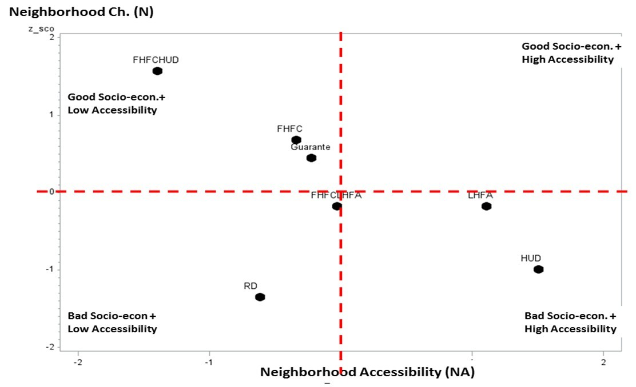
Evaluating the Assisted Housing Stock
High Socio-econ. +
High Accessibility
High Socio-econ. +
Low Accessibility
Low Socio-econ. +
Low Accessibility
Low Socio-econ. +
High Accessibility
Comparison of Z-Scores per program for neighborhood characteristics and neighborhood accessibility
Notes:
shows the ‘urban trade-off’ between accessibility and socio-economic conditions through the comparison of the z-scores per program for the components of neighborhood characteristics and neighborhood accessibility

Slide 16
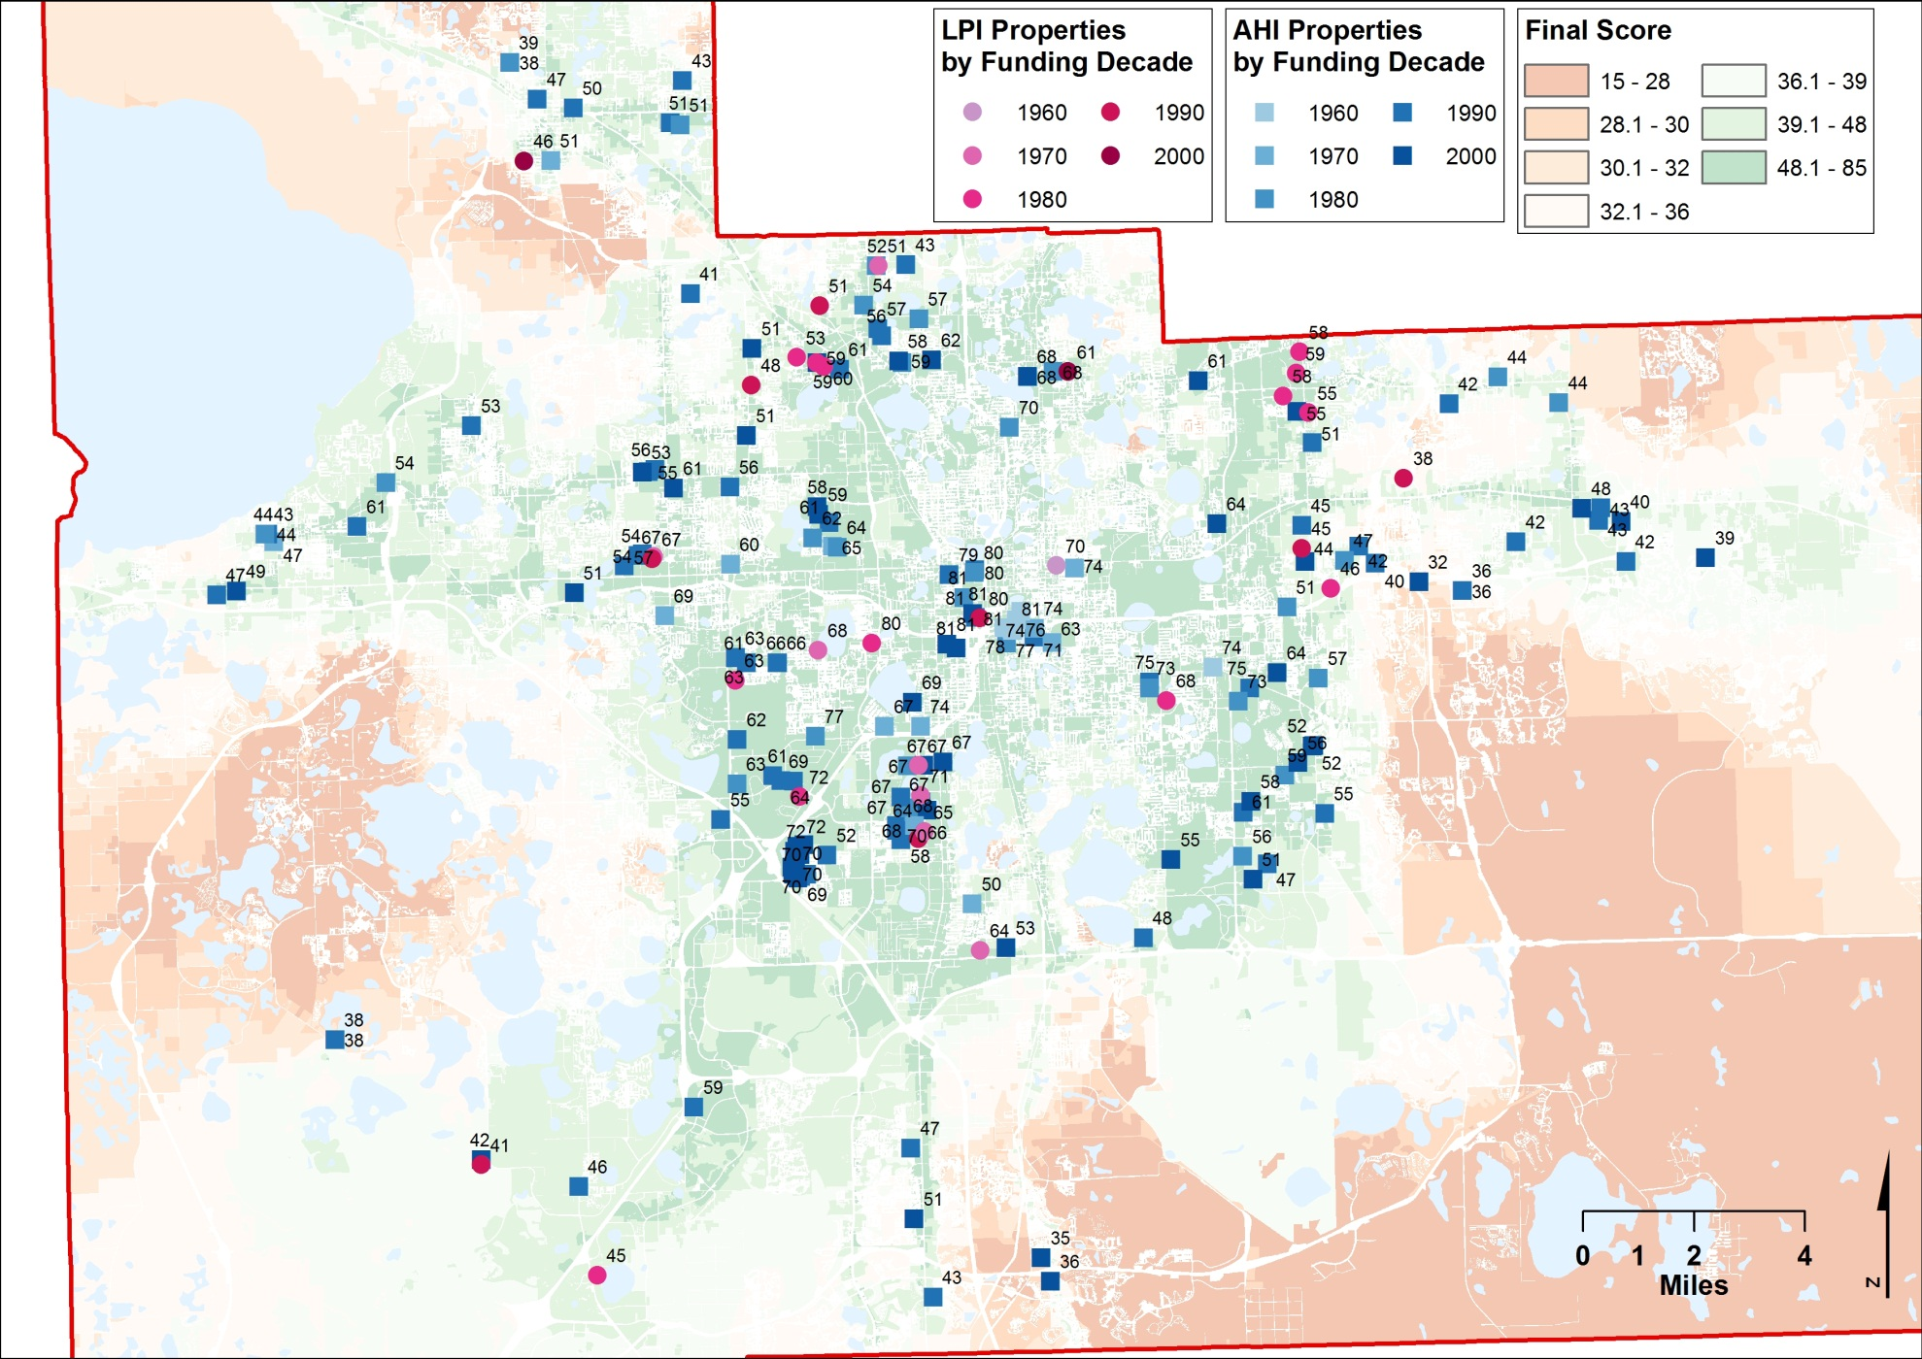
Evaluating the Assisted Housing Stock

Slide 17
Evaluating the Assisted Housing Stock
Table 4. Average results per decade of initial funding
 | Frequency | Infrastructure + Environmental Characteristics (I) | Neighborhood Characteristics (N) | Neighborhood Accessibility (NA) | Total Residential Suitability Score (I+N+NA=R1) | Rental Cost (R2) | Driving Cost (D) | Transit Accessibility (T) | Final Score = R1+R2+D+T
1960s | 7 | 7.00 | 1.86 | 6.86 | 16.43 | 15.71 | 21.00 | 21.29 | 76.29
1970s | 23 | 4.39 | 4.61 | 5.78 | 15.61 | 18.30 | 15.78 | 13.83 | 65.13
1980s | 43 | 3.65 | 5.51 | 5.28 | 15.35 | 16.93 | 16.37 | 9.47 | 59.70
1990s | 78 | 3.58 | 5.73 | 4.71 | 14.85 | 16.19 | 15.64 | 7.65 | 55.65
2000s | 51 | 3.63 | 5.90 | 4.73 | 15.20 | 15.69 | 16.22 | 10.00 | 58.61
Age analysis 1:
Every component related to accessibility fares very well for old properties. However, they have the lowest score in terms of social characteristics.

Slide 18
Evaluating the Assisted Housing Stock
Table 4. Average results per decade of initial funding
 | Frequency | Infrastructure + Environmental Characteristics (I) | Neighborhood Characteristics (N) | Neighborhood Accessibility (NA) | Total Residential Suitability Score (I+N+NA=R1) | Rental Cost (R2) | Driving Cost (D) | Transit Accessibility (T) | Final Score = R1+R2+D+T
1960s | 7 | 7.00 | 1.86 | 6.86 | 16.43 | 15.71 | 21.00 | 21.29 | 76.29
1970s | 23 | 4.39 | 4.61 | 5.78 | 15.61 | 18.30 | 15.78 | 13.83 | 65.13
1980s | 43 | 3.65 | 5.51 | 5.28 | 15.35 | 16.93 | 16.37 | 9.47 | 59.70
1990s | 78 | 3.58 | 5.73 | 4.71 | 14.85 | 16.19 | 15.64 | 7.65 | 55.65
2000s | 51 | 3.63 | 5.90 | 4.73 | 15.20 | 15.69 | 16.22 | 10.00 | 58.61
Age analysis 2:
Final scores decrease for subsequent decades reflecting lower suitability conditions. However, this trend changes in the 2000s when properties start to reflect better general suitability scores than those from the 1990s, reflecting current policy priorities.
Notes:
are associated with changes in public policy priorities as funders, particularly FHFC, have started to add points for accessibility (especially transit) in their process of evaluation.
In this regard, it is important to note that the different trends by program described in the previous section are also associated with changes in the relative composition of the assisted stock according to decade since in the 1960s and 1970s HUD properties were prevalent whereas FHFC properties are the majority in the 1990s and the 2000s.

Slide 19
Conclusions
In Orange County in general, assisted housing stock have better accessibility but worse socio-economic conditions than the average of parcels in the county
Assisted housing stock in the1960s and the 1970s (primarily HUD funded) has good accessibility but poor socio-economic characteristics, reversed pattern was found for those in the 1990s and the 2000s (primarily FHFC funded)
Assisted housing stock in the 2000s present both better accessibility and socio-economic conditions than those in the 1990s
Properties that have left the assisted inventory have better suitability conditions than those properties that stayed
Notes:
reflecting an “urban trade-off”
Future work needs to be done, possibly using correlation analysis to determine which factor – decade of initial funding, or program type, contributes to the difference
Reflecting new directions of public policy
This reflects new directions of public policy that conceptualize transportation costs as part of housing affordability
This is important because it presents additional challenges to policy makers that they need to consider preservation dimension as they try to improve the assisted housing stock.

Slide 20
Evaluating Suitable Locations for the Development and Preservations of Affordable Housing in Florida: the AHS Model
Contact information:
Ruoniu Wang wrnvince@ufl.edu

