Slide 1
Helping Put Theory into Practice for Planning Sustainable Communities A GIS tool for measuring transit accessibility
Liz Thompson
Abdulnaser Arafat, PhD
Shimberg Center for Housing Studies
Presenters email
liz.thompson@ufl.edu
20 April 2012
Ruth Steiner, PhD
Paul Zwick, PhD
Dept Urban & Regional Planning

Slide 3
Assisted Housing and Transit Accessibility
In this study:
Assisted housing refers to:
privately owned multi-family rental housing that receive subsidies from federal, state and local governments
Transit Accessibility refers to:
the ease or convenience of getting to destinations using the transit system

Slide 4
Transit Accessibility Tool - Overview
GIS raster-based tool - Small-scale, site-specific capabilities
Combines two measurements
Accessibility to transit stops
road network distance to nearest stop (0 to 25 score)
Accessibility to employment using transit
average least-cost trips (0 to 25 score)
Total accessibility measurement (0 to 50 score)

Slide 5
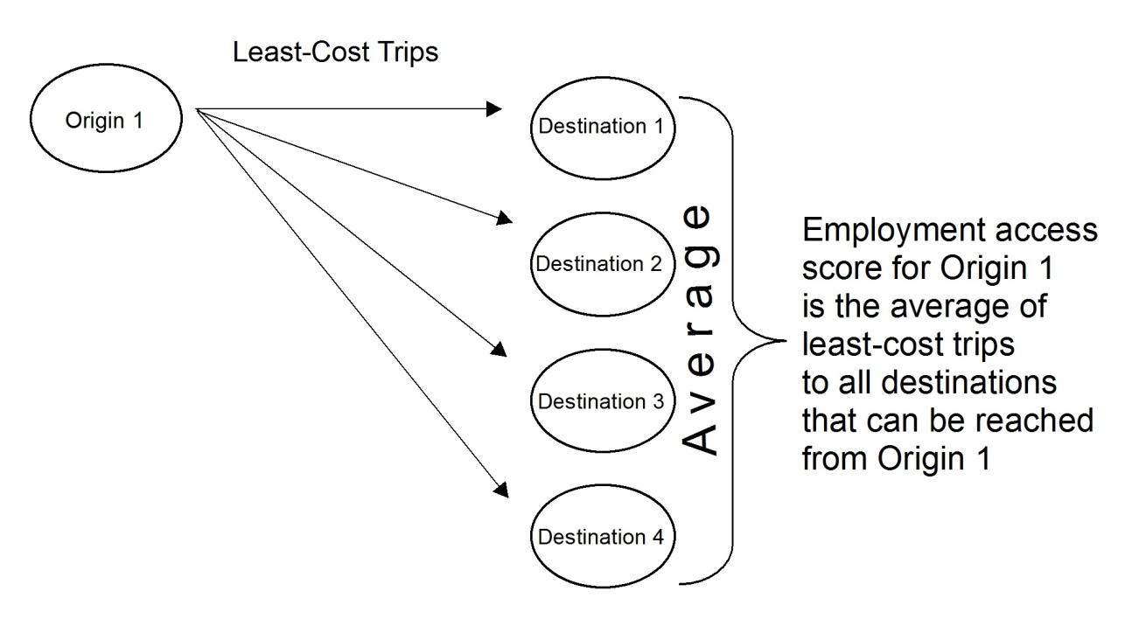
Access to employment using transit
Least Cost Trips
Employment Access Score

Slide 6
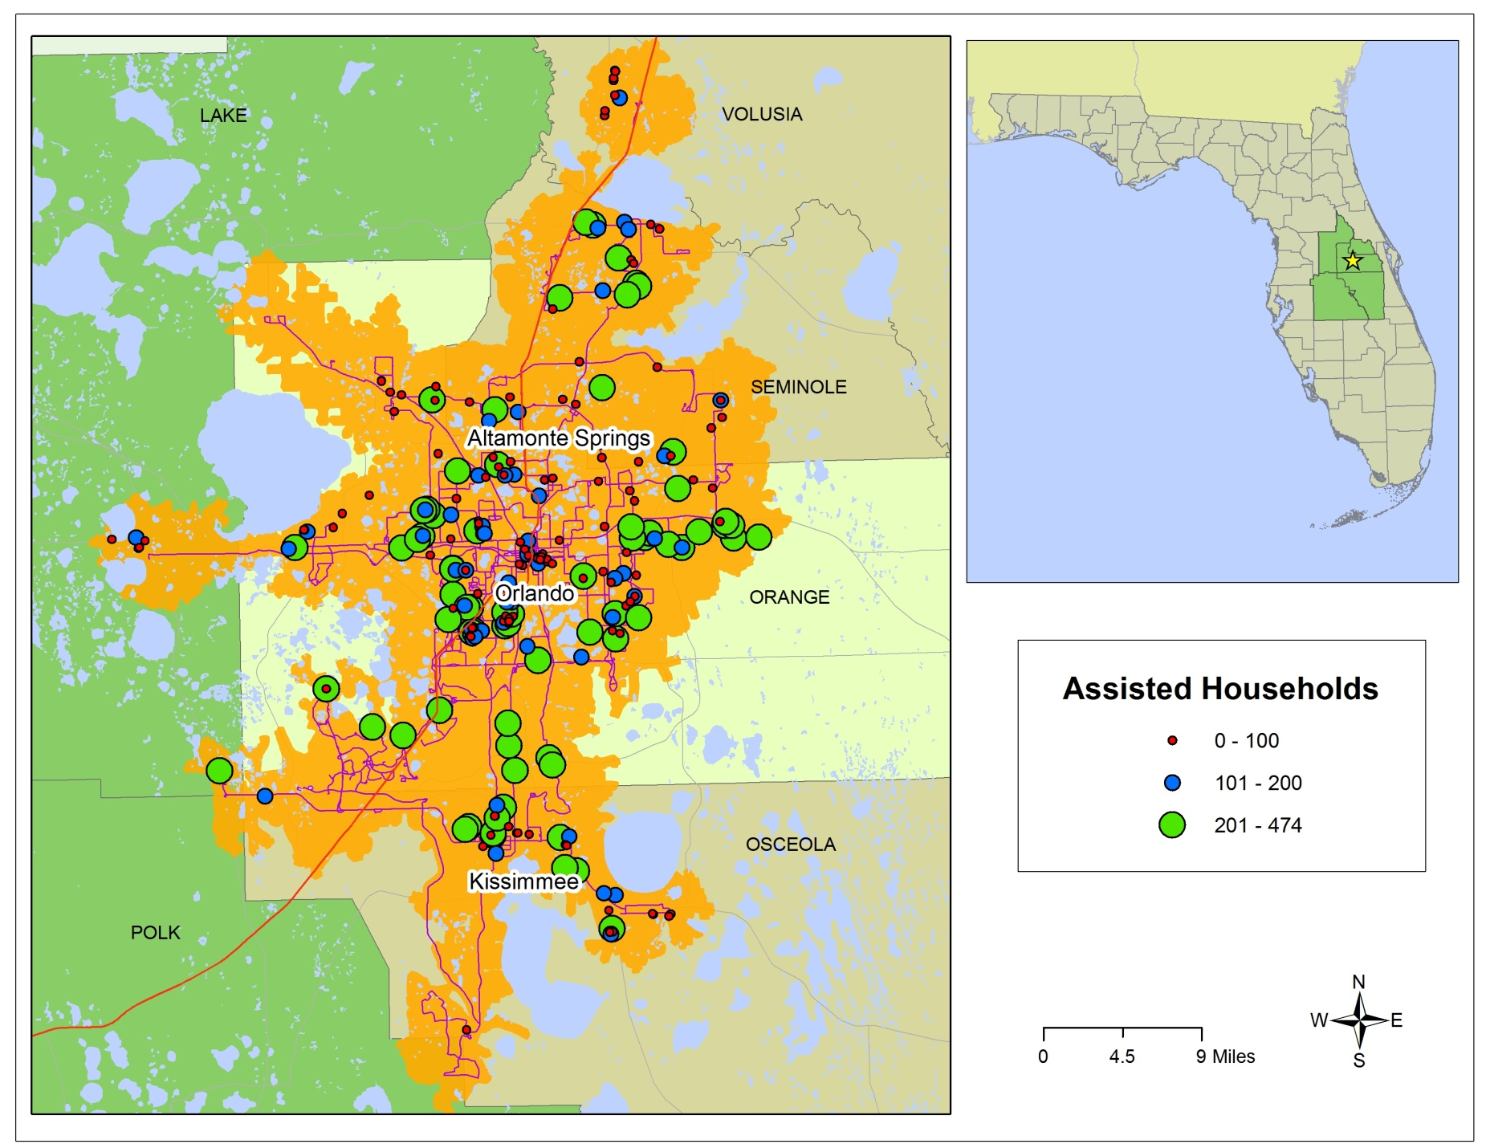
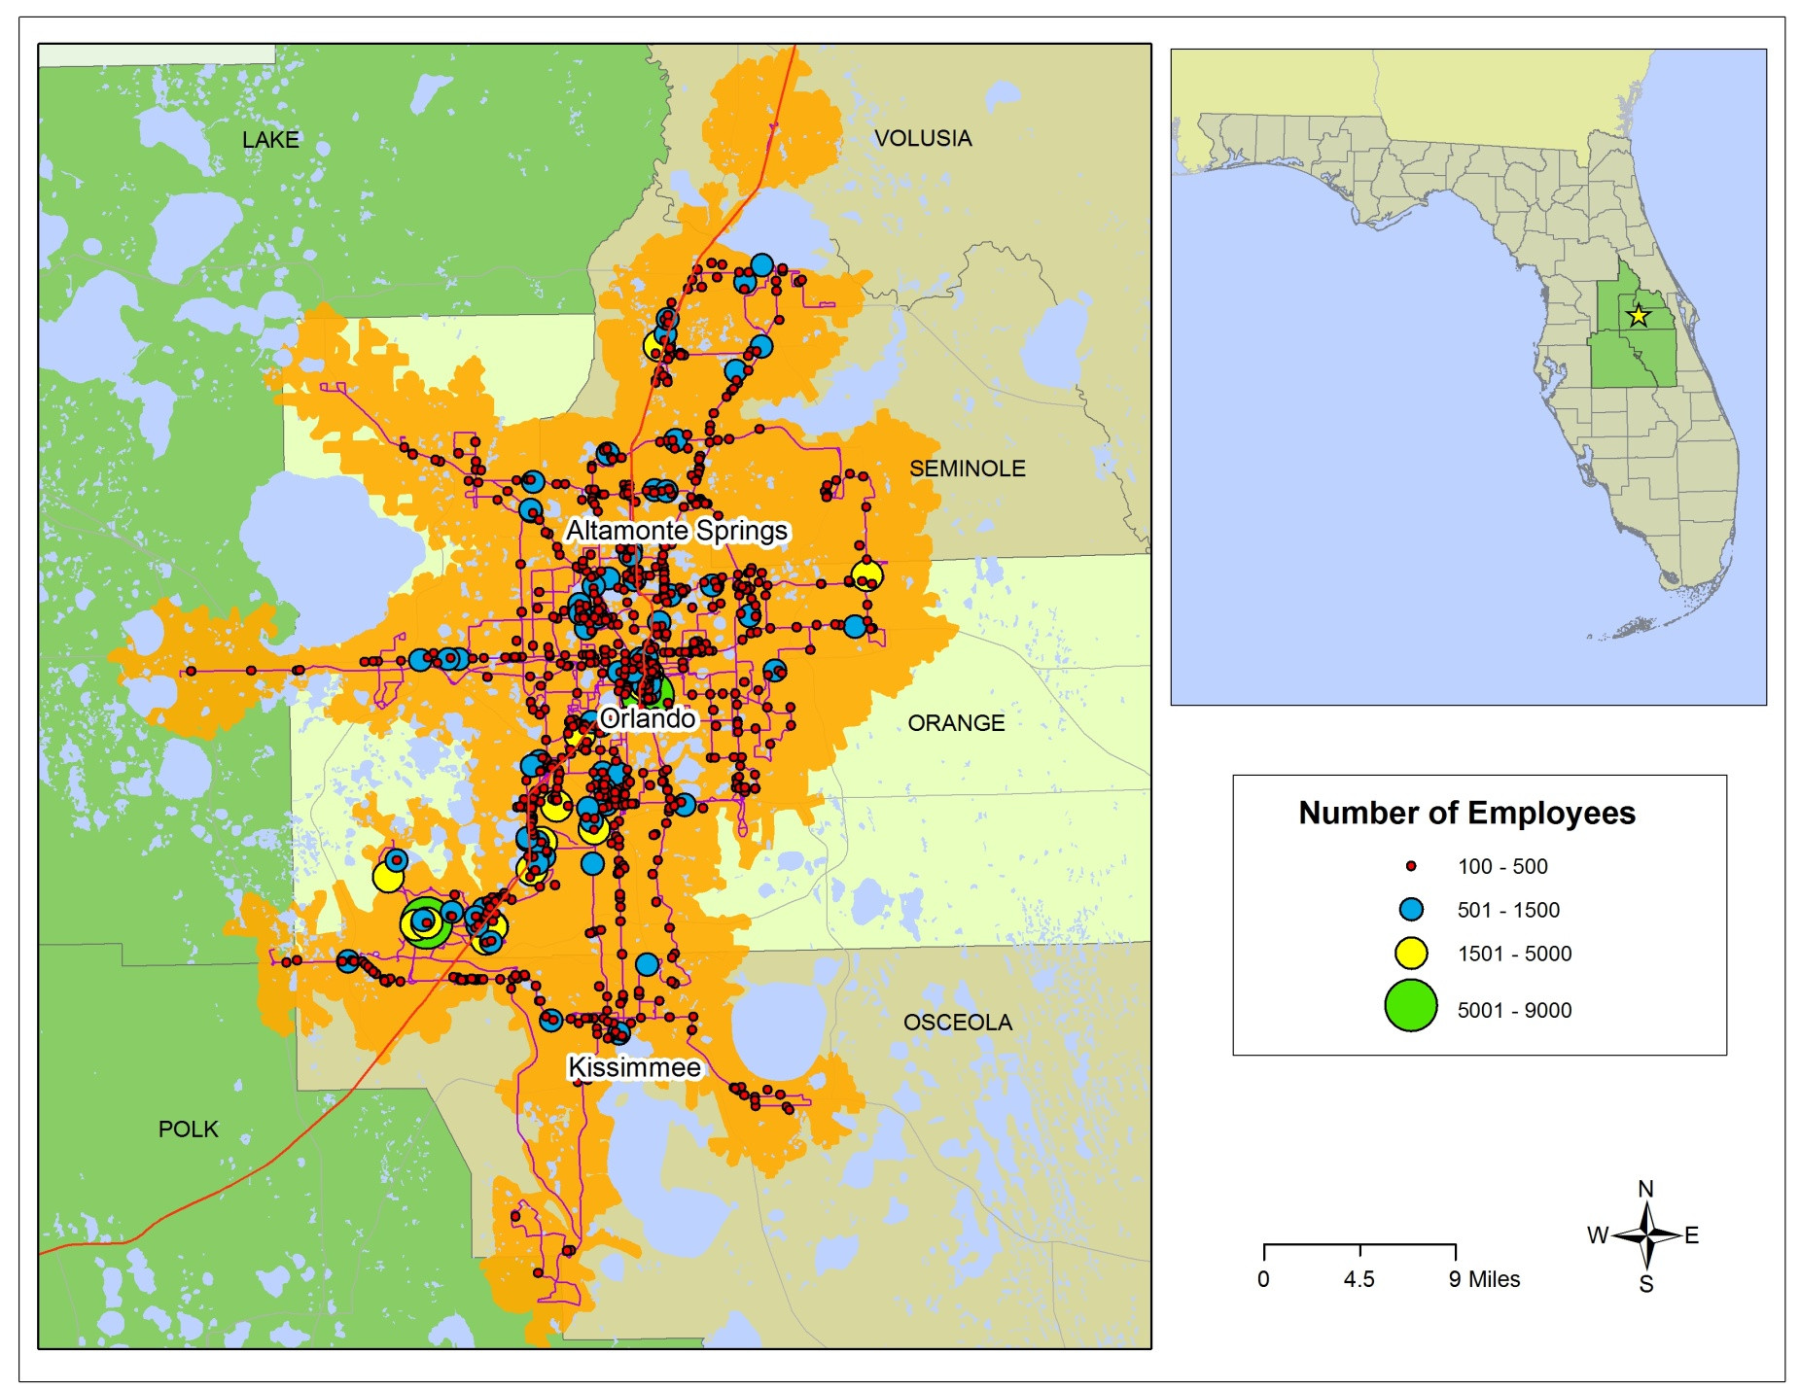

Slide 10
Study Highlights
Transit accessibility is more than being close to a transit stop – where the stop takes you is just as important
Important finding for agencies involved in funding and preserving assisted housing
Decision support tool for locating future developments and improving accessibility of existing ones
Next Steps
Statewide accessibility map –
Duval (Jacksonville), Pinellas (St. Petersburg), Hillsborough (Tampa) – completed
Miami – next in line

