Slide 1
Allocation and Preservation of Affordable Housing: A Spatially Discriminated Supply‐Demand Analysis Based on Parcel Level Employment Assignment
Abdulnaser A. Arafat, Ph.D. Yuyang Zou
Andres Blanco, Ph.D.
Ruoniu Wang
Presenter’s Email Address: naserarafat@dcp.ufl.edu
Shimberg Center for Housing Studies - University of Florida

Slide 2
Assisted Housing Supply and Demand County Level Figures – Orange County, FL
If the target population is VLI, the AHI Supply will almost cover the demand for the county.
However, statistics by Shimberg Center shows that 92% AHI units are occupied by households of <60 AMI and the target population can exceed to reach 80% AMI (Ray et al, 2009)
Affordable housing can also include affordable mortgages, rents and other assistance programs such as housing choice vouchers

Slide 3
Research Focus
This research studies the local housing supply and demand values in Orange County, FL and evaluate them with respect to the overall county values.
Therefore, this research focuses on the spatial distribution of the AHI properties and their relationship to low income employment locations.
Scale of Analysis and Neighborhood Size
0.5 mile network walking distance
4 mile network biking distance
10 mile driving trip distance

Slide 4
Supply and Demand Estimation
Random points are generated across the county (5000 pts).
Supply and demand are estimated around each random point using a neighborhood size defined by a certain driving distance/time
Inverse Distance Weighting (IDW) interpolation to create demand and supply surfaces for the whole county

Slide 5
Capturing Supply and Demand within Specific Distance Thresholds
AHI Supply for a random location is defined as the number of AHI units within a specific driving distance/time surrounding the random point.
VLI Demand is defined as the number of very low income households derived from parcel level employment within a specific driving distance/time surrounding a random point.
LI Demand is defined as the number of low income households derived from parcel level employment within a specific driving distance/time surrounding a random point.
Network Distance Buffer Area
Network Distance
Random Points
AHI Housing Units
Employment
The 5000 random points are evaluated across the county for walking, biking and driving coverage

Slide 6
OD matrix and Road Network Distance
Instead of creating a network distance buffer and performing iterations, a one step solution is performed by adopting an origin destination matrix approach.
The origins are taken as the 5000 random points.
3 Different OD matrices generated for different Destination type:
OD_ AHI units
OD_VLI employment
OD_ LI employment
Break points are specified for walking, Biking and driving distances.
GIS customized Network Opportunity Access tools are prepared to aggregate the counts of AHI, VLI, LI within the specified network distances.

Slide 7
Supply, Demand and Saturation rate
AHI had good saturation level for VLI except in the north “Winter Park” and in the south Apopka “Disney” areas

Slide 8
Spatial Mismatch

Slide 9
Supply Demand Conflict – MF/AHI
Comparable results between the multi family units and the AHI suggest the assisted housing units and multi family units are planned using similar criteria.
The small difference in mismatch between Multi family and AHI suggest that the location of multi family units is better connected to low income employment.

Slide 10
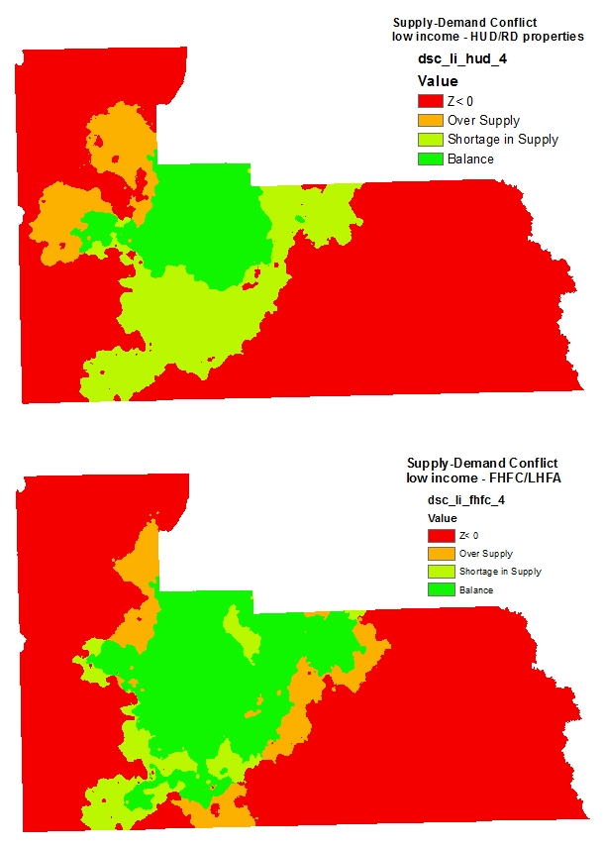
Supply Demand Conflict Funding programs
The results show a large difference in the mismatch between HUD/RD properties and FHFC/LHFA properties.
The HUD/RD focus on the north west while the FHFC/LHFA are more evenly distribution.
The supply demand conflict also shows the shortage in supply in Disney were low income jobs are concentrated while affordable housing units are not placed in the fancy hotels area.

Slide 11
Conclusions
The supply demand relationship is a multi scale relationship. Having a balance at the county level does not guarantee that that the supply and demand is balanced at the local level (0.5, 4, and 10 miles).
The increasing neighborhood size leads to more spatial matching between supply and demand but at the same time increases the travel cost which will make the units less affordable “H+T”. The “H+T” is an affordability index generated by the Center of Neighborhood Technology (CNT)(CNT, 2010).
The paper offers tools for affordable housing finance corporations for the evaluation of suggested sites for affordable housing.
The paper also gives tools for investors to identify suitable places to site affordable housing units.
The methodology will be used to create a linkage criterion for the Affordable Housing Suitability Model AHS. This criterion will be one of main criteria in the Criteria Evaluation Matrix CEM in addition to travel cost, transit access, housing cost and physical characteristics.

Slide 12
References
Bogdon, A. S., & Can, A. (1997). Indicators of local housing affordability: Comparative
and spatial approaches. Real Estate Economics, 25(1), 43-80.
Carr M., & Zwick. P. (2007). Smart land-use analysis: The LUCIS model. Redlands, CA:
ESRI press.
Center for Neigborhood Technology CNT (2010). True affordability and location
efficiency. Retrieved January 30, 2011, from http://htaindex.cnt.org/
Dacquisto, D. J., &Rodda, D. T. (2006, January). Housing Impact Analysis. Available:
http://www.huduser.org/Publications/pdf/hsgimpact.pdf (2011, November 15 )
DePillis, L. (2012,Febuary). Gray Signals Shift to “Demand Side” On Affordable
Housing. Available: http://www.washingtoncitypaper.com/blogs/housingcomplex/2012/02/22/mayor-gray-signals-shift-to-demand-side-on-affordable-housing/ (2012, March 1)
Desai, M. (2008, March). Investable Tax Credits: The Case of the Low Income Housing
Tax Credit. Available : http://www.nber.org/public_html/confer/2008/tep08/desai.pdf (2012, Febuary 2)
Florida Affordable Housing Model (2009). Affordable housing model methodology.
University of Florida: Department of Urban and Regional Planning.
Gobillon, L., Selod, H., & Zenou, Y. (2007). The mechanisms of spatial mismatch. Urban Studies, 44(12), 2401-2427.
Gyourko, J., & Saiz, A. (2004). Reinvestment in the housing stock: the role of construction costs and the supply side. Journal of Urban Economics, 55(2), 238-256.
Haffner, M., & Heylen, K. (2011). User Costs and Housing Expenses. Towards a more Comprehensive Approach to Affordability. Housing Studies, 26(4), 593-614.
Horner, M. W., & Mefford, J. N. (2007). Investigating urban spatial mismatch using job-housing indicators to model home-work separation. Environment and Planning A, 39(6), 1420-1440.
Ray, A., Nguyen, D., O’Dell, W., Roset-Zuppa, P., &White, D. (2009, June).The state of
Florida's assisted rental housing. Available: http://www.policyarchive.org/handle/10207/bitstreams/20727.pdf (2012, February 8)

