Slide 1
LEAVING THE ASSISTED HOUSING INVENTORY: PROPERTY, NEIGHBORHOOD, AND REGIONAL DETERMINANTS
Blanco, Andres G agblanco@ufl.edu
Ray, Anne L aray@ufl.edu
O’Dell, William J billo@ufl.edu
Stewart, Caleb kbs@ad.ufl.edu
Kim, Jeongseob seobi78@ufl.edu
Chung, Hyungchul lycrak08@ufl.edu

Slide 2
Presentation Plan
Introduction
Research Question
Method
Results
Analysis and discussion
Direction for future research

Slide 3
Introduction
Assisted Housing:
Privately owned, publicly subsidized, affordable rental housing
Properties funded by:
Department of Housing and Urban Development (HUD)
Department of Agriculture Rural Development (RD)
State Housing Authorities
Local Housing Finance Agencies

Slide 4
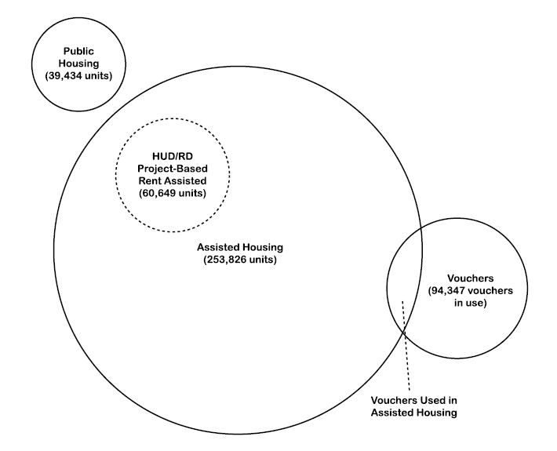
Introduction
Assisted Housing in Florida

Slide 5
Introduction
Lost Properties:
Formerly assisted housing
Properties leave the assisted inventory through:
Opt-out
Contracts are not renovated or are terminated at owner’s option
Fail-out
Poor physical or financial condition
Mortgage default, subsidy termination, code violations

Slide 6
Introduction
Lost properties in Florida:
443 properties with 55,877 units
2004 to 2009: 39,140 assisted units added but 28,214 units lost

Slide 7
Research Question
What factors affect the probability of leaving the Assisted Housing Inventory?

Slide 8
Method
Survival Analysis
Model time to an event (in this case a property leaving the assisted inventory)
Source: Duerden (2009), Gage (2004)

Slide 9
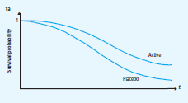
Method
Survival Analysis
Model time to an event (in this case a property leaving the assisted inventory)
Defines the probability of surviving longer than time t
Source: Duerden (2009), Gage (2004)

Slide 10
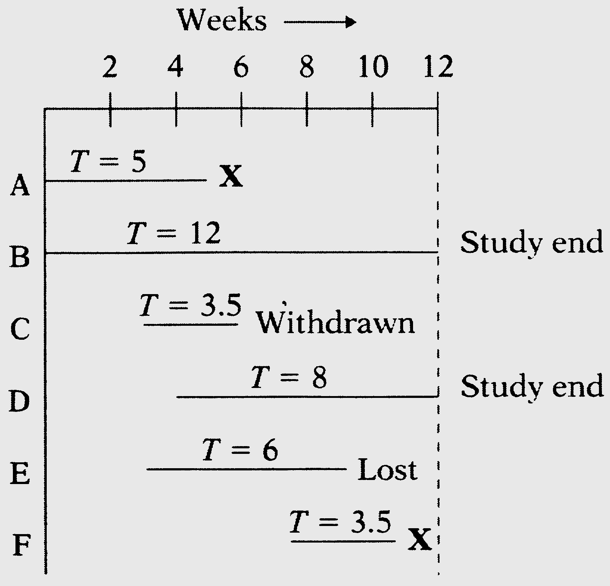
Method
Survival Analysis
Model time to an event (in this case a property leaving the assisted inventory)
Defines the probability of surviving longer than time t
Accounts for censored data (incomplete follow up)
Time
Source: Duerden (2009), Gage (2004)

Slide 11
Method
Survival Analysis
Model time to an event (in this case a property leaving the assisted inventory)
Defines the probability of surviving longer than time t
Accounts for censored data (incomplete follow up)
It allows Univariate analysis (Kaplan-Meier Curves) and Multivariate analysis (Cox Proportional Hazard Model)
Source: Duerden (2009), Gage (2004)

Slide 12
Method
Sample: HUD Assisted Housing in Florida
Subsidized rental Housing
(project base)
2,605
HUD
Other
(LIHTC, etc)
276
2,329
Remained
Left
Remained
Left
234
42
1,937
392

Slide 13
Method
Sample: HUD Assisted Housing in Florida
Subsidized rental Housing
(project base)
2,605
HUD
Other
(LIHTC, etc)
276
2,329
Remained
Left
Remained
Left
234
42
1,937
392
HUD programs are more flexible in terms of renewal or termination.
HUD can approximate better the ‘decision’ of the owner

Slide 14
Method

Slide 15
Method
Sample: HUD Assisted Housing in Florida Programs
HUD rental assistance only
Section 8
Supplement rents for households below 50% AMI
Typically renewed annually

Slide 16
Method
Sample: HUD Assisted Housing in Florida Programs
HUD rental assistance only
Section 8
Supplement rents for households below 50% AMI
Typically renewed annually
HUD rental assistance and Section 207/223:
207/223: Insurance to lenders
Now mainly for refinancing
Sometimes doesn’t impose income restrictions

Slide 17
Method
Sample: HUD Assisted Housing in Florida Programs
HUD rental assistance and Section 221:
221: Insurance to lenders or Below the Market Interest Rate (BMIR)
Restricted to incomes below 80% AMI
40 years with option to pre-pay at 20 years
HUD rental assistance only
Section 8
Supplement rents for households below 50% AMI
Typically renewed annually
HUD rental assistance and Section 207/223:
207/223: Insurance to lenders
Now mainly for refinancing
Sometimes doesn’t impose income restrictions

Slide 18
Method
Sample: HUD Assisted Housing in Florida Programs
HUD rental and section 236:
Section 236: soft loans
Restricted to incomes below 80% AMI
40 years with option to prepay at 20 years
HUD rental assistance and Section 221:
221: Insurance to lenders or Below the Market Interest Rate (BMIR)
Restricted to incomes below 80% AMI
40 years with option to pre-pay at 20 years
HUD rental assistance only
Section 8
Supplement rents for households below 50% AMI
Typically renewed annually
HUD rental assistance and Section 207/223:
207/223: Insurance to lenders
Now mainly for refinancing
Sometimes doesn’t impose income restrictions

Slide 19
Method
Sample: HUD Assisted Housing in Florida Programs
Sections 221 and 236:
Mortgage insurance or soft loans
HUD rental and section 236:
Section 236: soft loans
Restricted to incomes below 80% AMI
40 years with option to prepay at 20 years
HUD rental assistance and Section 221:
221: Insurance to lenders or Below the Market Interest Rate (BMIR)
Restricted to incomes below 80% AMI
40 years with option to pre-pay at 20 years
HUD rental assistance only
Section 8
Supplement rents for households below 50% AMI
Typically renewed annually
HUD rental assistance and Section 207/223:
207/223: Insurance to lenders
Now mainly for refinancing
Sometimes doesn’t impose income restrictions

Slide 20
Method
Sample: HUD Assisted Housing in Florida Programs
Sections 221 and 236:
Mortgage insurance or soft loans
Other:
Section 202 soft loans for the elderly with incomes below 50% AMI
HUD rental and section 236:
Section 236: soft loans
Restricted to incomes below 80% AMI
40 years with option to prepay at 20 years
HUD rental assistance and Section 221:
221: Insurance to lenders or Below the Market Interest Rate (BMIR)
Restricted to incomes below 80% AMI
40 years with option to pre-pay at 20 years
HUD rental assistance only
Section 8
Supplement rents for households below 50% AMI
Typically renewed annually
HUD rental assistance and Section 207/223:
207/223: Insurance to lenders
Now mainly for refinancing
Sometimes doesn’t impose income restrictions

Slide 21
Method
Independent variables
Property:
Size
Ratio of Assisted Housing
Housing Program
Target Population
Ownership Type
Length of initial contract
Neighborhood:
Poverty rate
Change in rent
Population growth
Region:
Population size in County
Housing market (boom and bust)
Source: Duerden (2009), Gage (2004)

Slide 22
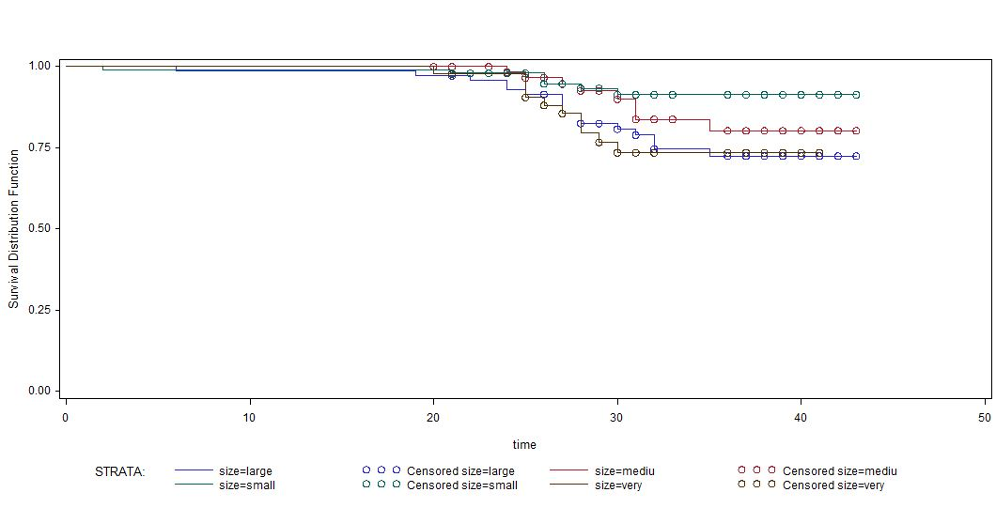
Results
Property Size (Number of Units)
Small (50-99)
Medium(100-149)
Large (>=150)
Very small (1-49)
Total Unit | total | Opt-out | Censored | Percent Censored
Large (>=150) | 71 | 17 | 54 | 76.06
Medium(100-149) | 64 | 8 | 56 | 87.50
Small(50-99) | 98 | 7 | 91 | 92.86
Very Small(1-49) | 43 | 10 | 33 | 76.74
Total | 276 | 42 | 234 | 84.78
Test of Equality over Strata | Log-Rank | Chi-Square (p-value) | 8.9848 (0.0295)
 | Wilcoxon | Chi-Square (p-value | 8.7461 (0.0329)
 | -2Log(LR) | Chi-Square (p-value | 9.8518 (0.0199)

Slide 23
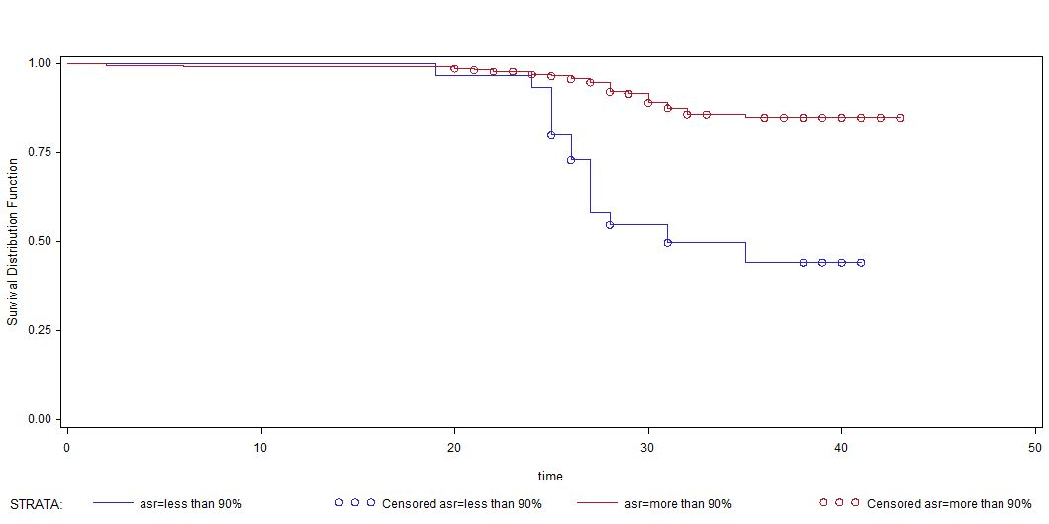
Results
Ratio of Assisted Units
More than 90%
less than 90%
Assisted Unit Ratio | total | Opt-out | Censored | Percent Censored
Less than 0.9 | 30 | 15 | 15 | 50.00
More than 0.9 | 246 | 27 | 219 | 89.02
Total | 276 | 42 | 234 | 84.78
Test of Equality over Strata | Log-Rank | Chi-Square (p-value) | 35.9869 (<.0001)
 | Wilcoxon | Chi-Square (p-value | 36.9379 (<.0001)
 | -2Log(LR) | Chi-Square (p-value | 19.1326 (<.0001)

Slide 24
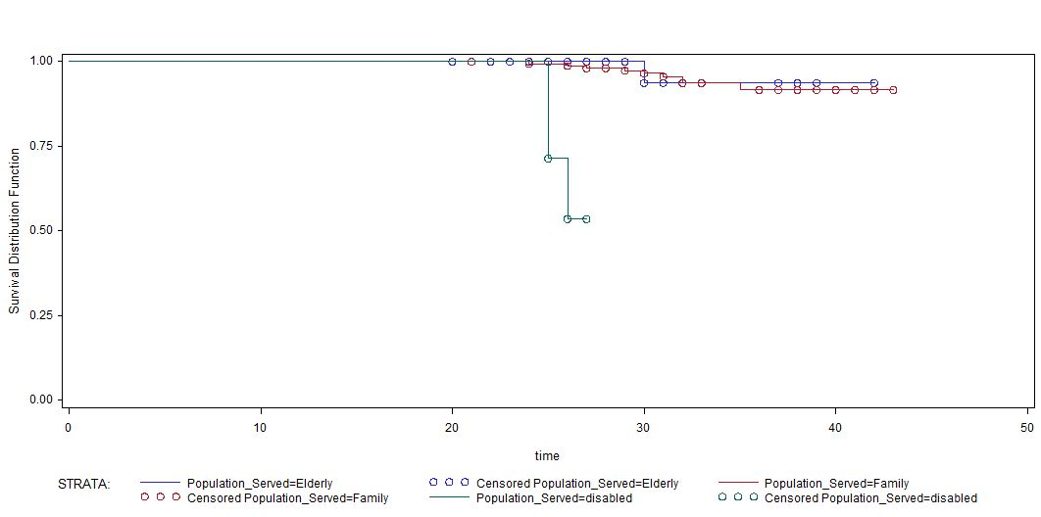
Results
Target population
Elderly
Family
Disabled persons
Very small sample
Target Population | total | Opt-out | Censored | Percent Censored
Elderly | 81 | 2 | 79 | 97.53
Family | 160 | 10 | 150 | 93.75
Disabled persons | 7 | 3 | 4 | 57.14
Total | 248 | 15 | 233 | 93.95
Test of Equality over Strata | Log-Rank | Chi-Square (p-value) | 67.7933 (<.0001)
 | Wilcoxon | Chi-Square (p-value | 65.3604 (<.0001)
 | -2Log(LR) | Chi-Square (p-value | 9.3898 (0.0091)

Slide 25
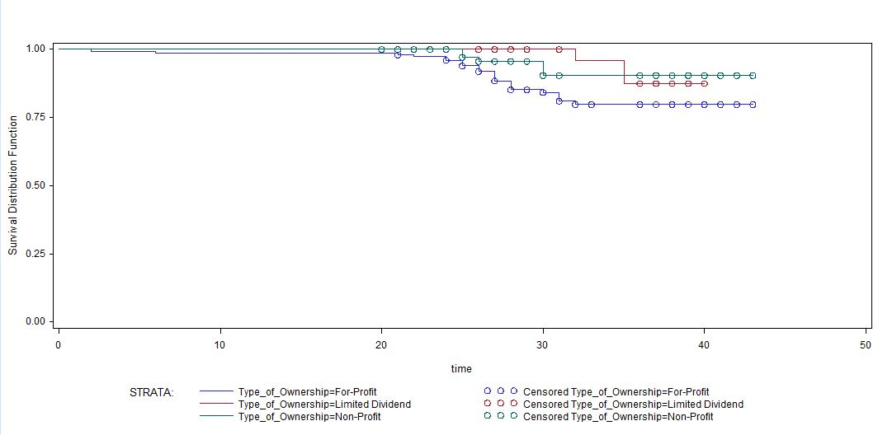
Results
Ownership type
Non-profit
Limited Dividend
For-profit
Ownership | total | Opt-out | Censored | Percent Censored
For-Profit | 150 | 26 | 124 | 82.67
Non-Profit | 81 | 5 | 76 | 93.83
Limited Dividend | 34 | 3 | 31 | 91.18
Total | 265 | 34 | 231 | 87.17
Test of Equality over Strata | Log-Rank | Chi-Square (p-value) | 4.6468 (0.0979)
 | Wilcoxon | Chi-Square (p-value | 6.8191 (0.0331)
 | -2Log(LR) | Chi-Square (p-value | 5.7172 (0.0573)

Slide 26
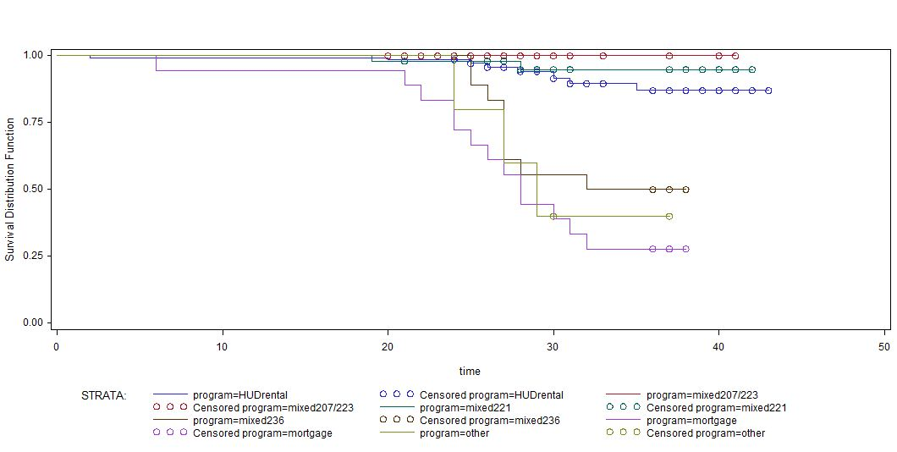
Results
S.8 + 207/223:
Rental Assistance + mortgage insurance
S.8 + 221: Rental Assistance + mortgage insurance
HUD program
S.8: Rental Assistance
S.8 + 236: Rental Assistance + soft loans
Other: soft loans for elderly
221 + 236: mortgage insurance + soft loans
Subsidizing Program | total | Opt-out | Censored | Percent Censored
HUD rental assistance | 141 | 15 | 126 | 89.36
HUD rental & Sec 207/223 | 43 | 0 | 43 | 100.00
HUD rental, & Sec 221 | 51 | 2 | 49 | 96.08
HUD rental & Sec 236 | 18 | 9 | 9 | 50.00
Mortgage (only Sec 221,236) | 18 | 13 | 5 | 27.78
Other | 5 | 3 | 2 | 40.00
Total | 276 | 42 | 234 | 84.78
Test of Equality over Strata | Log-Rank | Chi-Square (p-value) | 87.6711 (<.0001)
 | Wilcoxon | Chi-Square (p-value | 89.3425 (<.0001)
 | -2Log(LR) | Chi-Square (p-value | 55.1619 (<.0001)

Slide 27
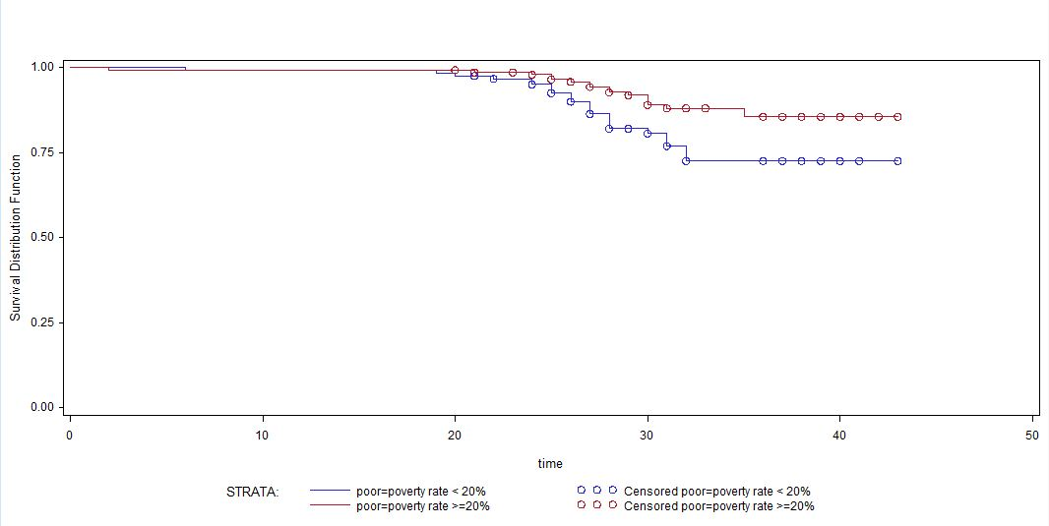
Results
Neighborhood Poverty Rate (1990)
More than 20%
less than 20%
Poor NH | total | Opt-out | Censored | Percent Censored
Poor (poverty rate 1990, over 20%) | 151 | 17 | 134 | 88.74
Non-poor | 125 | 25 | 100 | 80.00
Total | 276 | 42 | 234 | 84.78
Test of Equality over Strata | Log-Rank | Chi-Square (p-value) | 6.2059 (0.0127)
 | Wilcoxon | Chi-Square (p-value | 6.2396 (0.0125)
 | -2Log(LR) | Chi-Square (p-value | 4.6493 (0.0311)

Slide 28
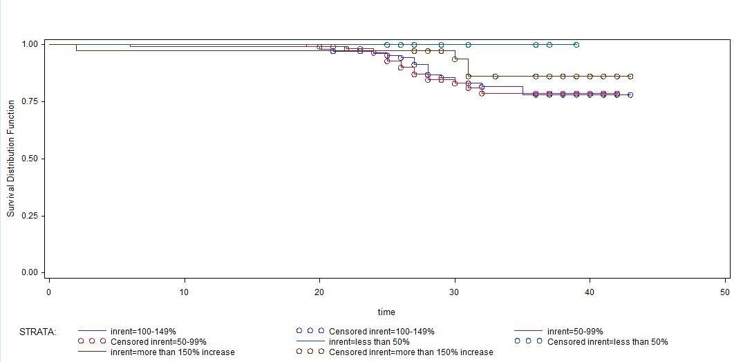
Results
Change in neighborhood rent
Less than 50%
More than 150%
100-149%
50-99%
Change in NH rent | total | Opt-out | Censored | Percent Censored
More than 150% | 37 | 4 | 33 | 89.19
100-149% | 108 | 19 | 100 | 84.03
50-99% | 119 | 19 | 89 | 82.41
Less than 50% | 12 | 0 | 33 | 89.19
Total | 276 | 42 | 234 | 84.78
Test of Equality over Strata | Log-Rank | Chi-Square (p-value) | 3.7306 (0.2921)
 | Wilcoxon | Chi-Square (p-value | 4.2606 (0.2347)
 | -2Log(LR) | Chi-Square (p-value | 4.9243 (0.1774)
Not significant

Slide 29
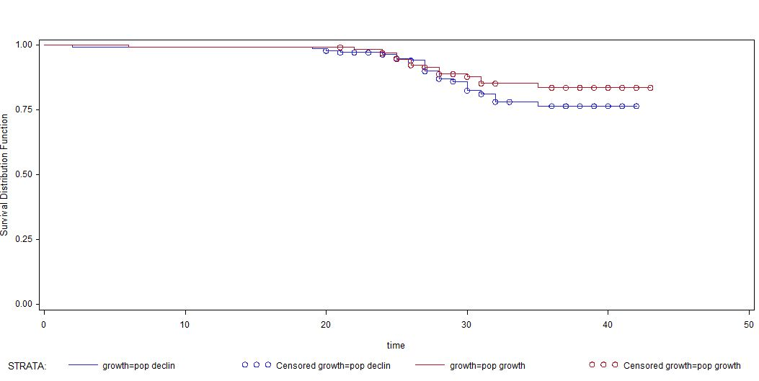
Results
Population growth in Neighborhood
Population growth
Population decline
Not significant
Population growth | total | Opt-out | Censored | Percent Censored
Increasing | 133 | 18 | 115 | 86.47
Decreasing | 143 | 24 | 119 | 83.22
Total | 276 | 42 | 234 | 84.78
Test of Equality over Strata | Log-Rank | Chi-Square (p-value) | 1.1174 (0.2905)
 | Wilcoxon | Chi-Square (p-value | 0.6859 (0.4076)
 | -2Log(LR) | Chi-Square (p-value | 0.6905 (0.4060)

Slide 30
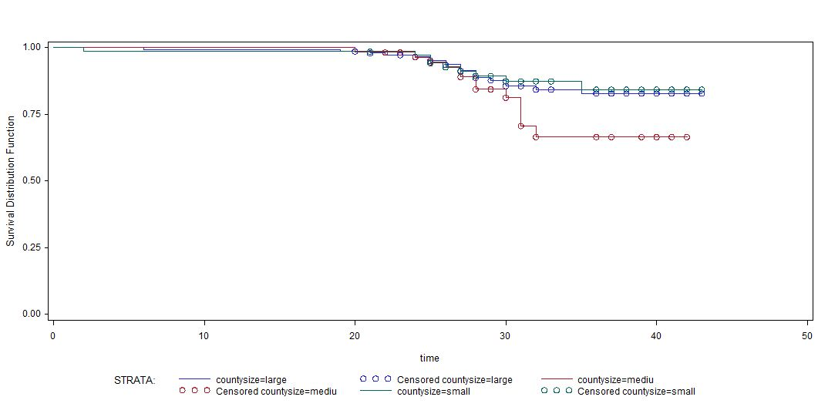
Results
County population size
Small size county
Large size county
Medium size county
County Population Size | total | Opt-out | Censored | Percent Censored
Large (more than 500,000) | 148 | 20 | 128 | 86.49
Medium (200,000-500,000) | 58 | 13 | 45 | 77.59
Small (less than 200,000) | 70 | 9 | 61 | 87.14
Total | 276 | 42 | 234 | 84.78
Test of Equality over Strata | Log-Rank | Chi-Square (p-value) | 3.5099 (0.1729)
 | Wilcoxon | Chi-Square (p-value | 1.8801 (0.3906)
 | -2Log(LR) | Chi-Square (p-value | 2.5568 (0.2785)
Not significant

Slide 31
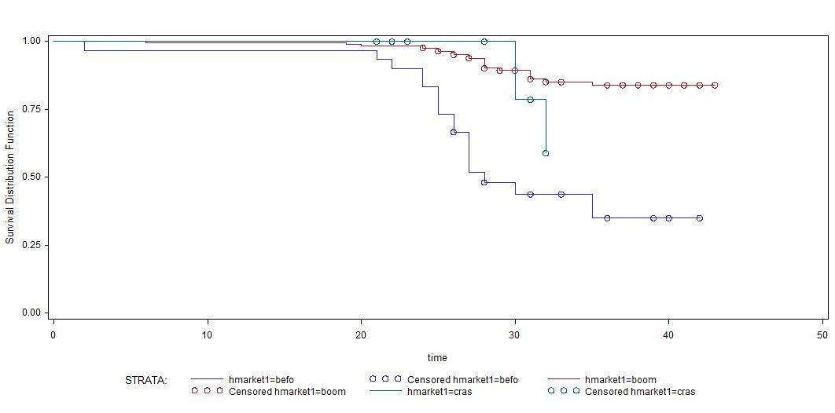
Results
Housing market
Boom(00-06)
Bust(07-10)
Before 2000
Housing Market2 | total | Opt-out | Censored | Percent Censored
Before 2000 | 30 | 17 | 13 | 43.33
Boom (2000-2006) | 170 | 21 | 149 | 87.65
Crash (2007-2009) | 22 | 4 | 18 | 81.82
Total | 222 | 42 | 180 | 81.08
Test of Equality over Strata | Log-Rank | Chi-Square (p-value) | 42.1644 (<.0001)
 | Wilcoxon | Chi-Square (p-value | 45.2716 (<.0001)
 | -2Log(LR) | Chi-Square (p-value | 22.4215 (<.0001)

Slide 32
Results
Cox Proportional Hazard Regression: Dependent variable (risk to leave the assisted inventory)
Variable | Parameter Estimator | Chi-Square | p-value | Hazard Ratio
Contract length | -0.20804 | 24.7189 | <.0001 | 0.812
Number of units | -0.00820 | 0.7894 | 0.3743 | 0.992
Number of units squared | 0.0000269 | 0.5572 | 0.4554 | 1.000
Assisted unit ratio | -2.11173 | 6.0581 | 0.0138 | 0.121
HUD rental assistance | -4.87565 | 53.4755 | <.0001 | 0.008
Mixed 207/203 | -20.73036 | 0.0003 | 0.9866 | 0.000
Mixed 236 | -1.19388 | 4.5388 | 0.0331 | 0.303
Mixed 221 | -5.33115 | 22.1554 | <.0001 | 0.005
Other program | -20.46453 | 0.0000 | 0.9963 | 0.000
For Profit | -1.28147 | 4.0731 | 0.0436 | 0.278
Limited Dividend | -3.43371 | 12.0129 | 0.0005 | 0.032
Change in NH rent | 0.80888 | 3.9264 | 0.0475 | 2.245
Testing Hypothesis (BETA =0) | Likelihood Ratio | 122.2455 | <.0001
 | Score | 178.5839 | <.0001
 | Wald | 76.0069 | <.0001
Total / Event / Censored | 265/34/231 | Percent Censored | 87.17

Slide 33
Analysis and discussion
Property size has a non-linear relationship with the probability of leaving the assisted inventory
Leaving
Size

Slide 34
Analysis and discussion
Property size has a non-linear relationship with the probability of leaving the assisted inventory
Leaving
Smaller properties more marketable: preferred by high segments of demand
Size

Slide 35
Analysis and discussion
Property size has a non-linear relationship with the probability of leaving the assisted inventory
Leaving
Smaller properties more marketable: preferred by high segments of demand
Big properties have more to gain for switching to rental market
Size

Slide 36
Analysis and discussion
Assisted ratio has a negative relationship with the probability of leaving the assisted inventory
Leaving
Assisted Ratio

Slide 37
Analysis and discussion
Assisted ratio has a negative relationship with the probability of leaving the assisted inventory
Leaving
If all units are receiving
assistance, the property owner must find more tenants who can afford unsubsidized rents after an opt-out
Assisted Ratio

Slide 38
Analysis and discussion
Assisted ratio has a negative relationship with the probability of leaving the assisted inventory
Leaving
Owners of mixed properties may
decide that the paperwork involved in complying with program requirements is not worth the
subsidies received for just a portion of the units.
If all units are receiving
assistance, the property owner must find more tenants who can afford unsubsidized rents after an opt-out
Assisted Ratio

Slide 39
Analysis and discussion
Degree of owner’s orientation to profits has a positive relationship with the probability of leaving the assisted inventory
Leaving
Orientation to profits

Slide 40
Analysis and discussion
Degree of owner’s orientation to profits has a positive relationship with the probability of leaving the assisted inventory
Leaving
For profit owners have more incentives to switch to market rents if they see a benefit in doing it.
Orientation to profits

Slide 41
Analysis and discussion
Degree of owner’s orientation to profits has a positive relationship with the probability of leaving the assisted inventory
Leaving
For profit owners have more incentives to switch to market rents if they see a benefit in doing it.
The mission of non-profit owners is more oriented to maintain affordability levels. Moreover they are often required by lenders to do so.
Orientation to profits

Slide 42
Analysis and discussion
Housing programs based on soft loans increase the probability of leaving compared with rental assistance
Leaving
Housing Program
Rental Assistance
Mortgage insurance
Soft loans

Slide 43
Analysis and discussion
Housing programs based on soft loans increase the probability of leaving compared with rental assistance
Leaving
There is an incentive to avoid affordability requirements by prepaying soft loans in contexts of low interests rates
Housing Program
Rental Assistance
Mortgage insurance
Soft loans

Slide 44
Analysis and discussion
Housing programs based on soft loans increase the probability of leaving compared with rental assistance
Leaving
There is an incentive to avoid affordability requirements by prepaying soft loans in contexts of low interests rates
Rental Assistance could impact more directly the cash flow for property owners than other mortgage based programs
Housing Program
Rental Assistance
Mortgage insurance
Soft loans

Slide 45
Analysis and discussion
The length of the initial contract has a negative relationship with the probability of leaving the assisted inventory
Leaving
Length of the initial contract

Slide 46
Analysis and discussion
The length of the initial contract has a negative relationship with the probability of leaving the assisted inventory
Leaving
Longer contracts might create ‘inertia’
Length of the initial contract

Slide 47
Analysis and discussion
Poverty rate has a negative relationship with the probability of leaving the assisted inventory
Leaving
Poverty

Slide 48
Analysis and discussion
Poverty rate has a negative relationship with the probability of leaving the assisted inventory
Leaving
Low poverty areas are more likely to attract tenants that are willing and able to pay unsubsidized rents
Poverty

Slide 49
Analysis and discussion
Change in rent has a positive relationship with the probability of leaving the assisted inventory
Leaving
Change in rent

Slide 50
Analysis and discussion
Change in rent has a positive relationship with the probability of leaving the assisted inventory
Leaving
Owners in areas where rents are increasing rapidly have more incentive to switch to market rents.
Change in rent

Slide 51
Analysis and discussion
Housing bust has increased and accelerated the probability of leaving the assisted inventory
Leaving
Overall Market Conditions
Boom (2000-2006)
Bust (2007-2009)

Slide 52
Analysis and discussion
Housing bust has increased and accelerated the probability of leaving the assisted inventory
Leaving
Housing bust and economic recession have increased the demand for low rent housing, creating an incentive to switch to market rents
Overall Market Conditions
Boom (2000-2006)
Bust (2007-2009)

Slide 53
Directions for future research
The problems:
The solutions:
Sensibility of thresholds for categorical variables
Models with continuous data (pooled data)

Slide 54
Directions for future research
The problems:
The solutions:
Sensibility of thresholds for categorical variables
Models with continuous data (pooled data)
Sample size
Include more states or MSA’s

Slide 55
Directions for future research
The problems:
The solutions:
Sensibility of thresholds for categorical variables
Models with continuous data (pooled data)
Sample size
Include more states or MSA’s
Only takes into account 10% of the assisted stock (not LIHTC for example)
Analysis ex-post: what happens with the properties after they leave the assisted inventory? Stay rental? Stay Affordable?

Slide 56
LEAVING THE ASSISTED HOUSING INVENTORY: PROPERTY, NEIGHBORHOOD, AND REGIONAL DETERMINANTS
Blanco, Andres G agblanco@ufl.edu
Ray, Anne L aray@ufl.edu
O’Dell, William J billo@ufl.edu
Stewart, Caleb kbs@ad.ufl.edu
Kim, Jeongseob seobi78@ufl.edu
Chung, Hyungchul lycrak08@ufl.edu

