Slide 1


Overview of the Market for
Affordable or Assisted Housing
Bill O’Dell, Shimberg Center for Housing Studies
February 7, 2019

Slide 2
The Affordable Housing Continuum: components of a healthy affordable housing delivery system
Supportive Housing (affordable units + services)
Homeless
Affordable rental housing
Public housing
Subsidized (Florida Housing, HUD, USDA)
Affordable home ownership
Shared equity (e.g. community land trust)
Down payment assistance
Older adults
People with disabilities
Other special needs
NOAH (Naturally Occurring Affordable Housing)
Low-interest loans
Affordable construction
Home rehab and weatherization
Vouchers

Slide 3
Basic Affordable Housing Terminology
  Conventional or typical affordable housing programs (U.S. HUD):
  Cost burdened: Paying more than 30% of income for housing costs
  Severely cost burdened: Paying more than 50% of income for housing costs
  Area median income (AMI): Used to create standard income measures across places and household sizes, expressed as % AMI
    Extremely low-income: 0-30% AMI
    Very low-income: Up to 50% AMI
    Low-income: Up to 80% AMI
Florida Housing Finance Corp and Tax Credits:
Low-income: below 60% area median income (AMI)
Cost burdened: paying more than 40% of income for rent
Affordable unit: rent does not exceed 40% of a given income threshold (% AMI), adjusted for unit size

Slide 4
Florida has added renters at all income levels since 2000, especially between 2010 and 2015.
Renter Households by Income (% AMI), Florida, Change from 2000 to 2015
  Florida added 468,737 renter households between 2010 and 2015:
    146,242 at 0-60% AMI
    113,004 at 60.01-100% AMI
    209,491 above 100% AMI
Source: U.S. Census Bureau, 2000 Census and 2005/2010/2015 American Community Survey 1-Year Public Use Microdata Sample (PUMS). Excludes student-headed households.

Slide 5
Most growth in rental supply since 2000 has been in units with rents above the 60% AMI affordability threshold.
Rental Units by Affordability Level, Florida, Change from 2000 to 2015
  Between 2000 and 2015, Florida had a net gain of 869,189 rental units.
  Only 15% of the added units were affordable at or below 60% AMI.
Source: U.S. Census Bureau, 2000 Census and 2005/2010/2015 American Community Survey 1-Year Public Use Microdata Sample (PUMS).

Slide 6
Most low-income renters are cost burdened. Fewer higher income renters are.
Source: Shimberg Center analysis of 2017 American Community Survey and UF BEBR Population Projections.

Slide 7
Statewide Affordable/Available Units
Affordable/Available Units and Renter Households by Income (% AMI), Florida, 2017
Source: Shimberg Center analysis of U.S. Census Bureau, 2017 1-Year American Community Survey PUMS. Note: An “affordable” unit has a gross rent at or below 30% of the top income in the range, adjusted by number of bedrooms. An “available” unit is either rented by a household at or below the top income in the range or vacant .

Slide 8
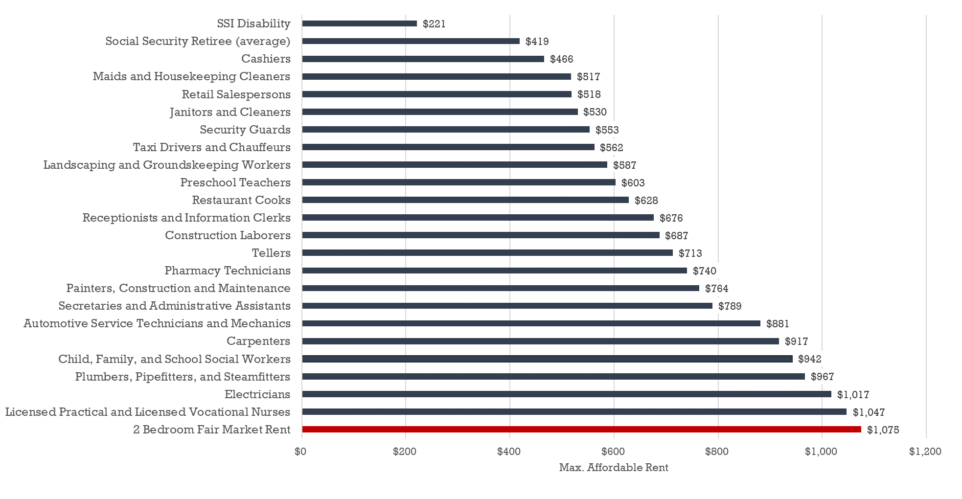
Rents outpace Social Security benefits and the median wages for many occupations Affordable Rents for Median-Wage Workers vs. 2-Bedroom Fair Market Rent State of Florida, 2017
Sources: Florida Agency for Workforce Innovation, 2017 Occupational Employment Statistics and Wages; U.S. Department of Housing and Urban Development, 2017 Fair Market Rents; U.S. Social Security Administration. Maximum rent is 30% of monthly salary.

Slide 9
Household Demographics: Size
62% of cost burdened households are 1-2 person
28% are 3-4 person
10% are 5+ person
Household Demographics: Elderly
234,231 cost burdened households (31%) headed by householder age 55+
Includes 37,759 (5%) age 75-84 and 26,561 (4%) age 85+
Highest proportions in southwest coastal regions

Slide 10
Homeless Individuals and Families
  Individuals
    32,533 homeless individuals
    16,458 transitional/permanent supportive housing beds
  Families with children
    32,304 homeless families with children
    4,200 transitional/permanent supportive housing units
Farmworkers
  Unaccompanied workers supply gap: 26,640 beds (61,091 unaccompanied workers – 34,451 beds in DOH-licensed camps)
  Accompanied workers supply gap: 25,305 units (30,896 accompanied worker households – 5,591 RD/Florida Housing multifamily units)
  Highest need counties: Miami-Dade, Hillsborough, Indian River

Slide 11
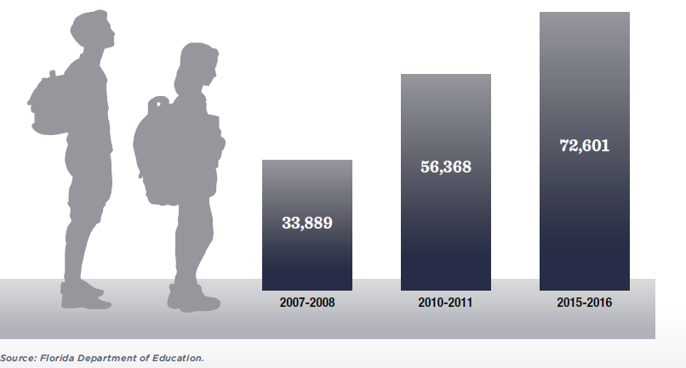
The number of students in Florida identified as homeless more than doubled in the past decade.
Homeless Students in Florida by School Year
The poverty rate for school-age children increased from 16% (2007) to 22% (2015).
School districts improved identification of homeless children.
Nearly 10% of homeless students are unaccompanied youth.
See www.shimberg.ufl.edu/children.html

Slide 12
Special Needs Household Estimates
Adults with disabilities, receiving SSDI/SSI/VA benefits
  107,856 low-income renter households
Survivors of domestic violence
  8,295 households using emergency shelter (DCF)
Youth aging out of foster care
  3,173 using post-foster care services (DCF)
Total estimate: 119,324 households
  16% of statewide total of 756,639 low-income, cost burdened renter households

Slide 13
Tenant characteristics: Income
Average Tenant Household Income, 2016
Source: Shimberg Center for Housing Studies, Assisted Housing Inventory; U.S. Census Bureau, 2015 American Community Survey 1-Year Public Use Microdata Sample (PUMS). “All Florida Renters” numbers refer to 2015.

Slide 14
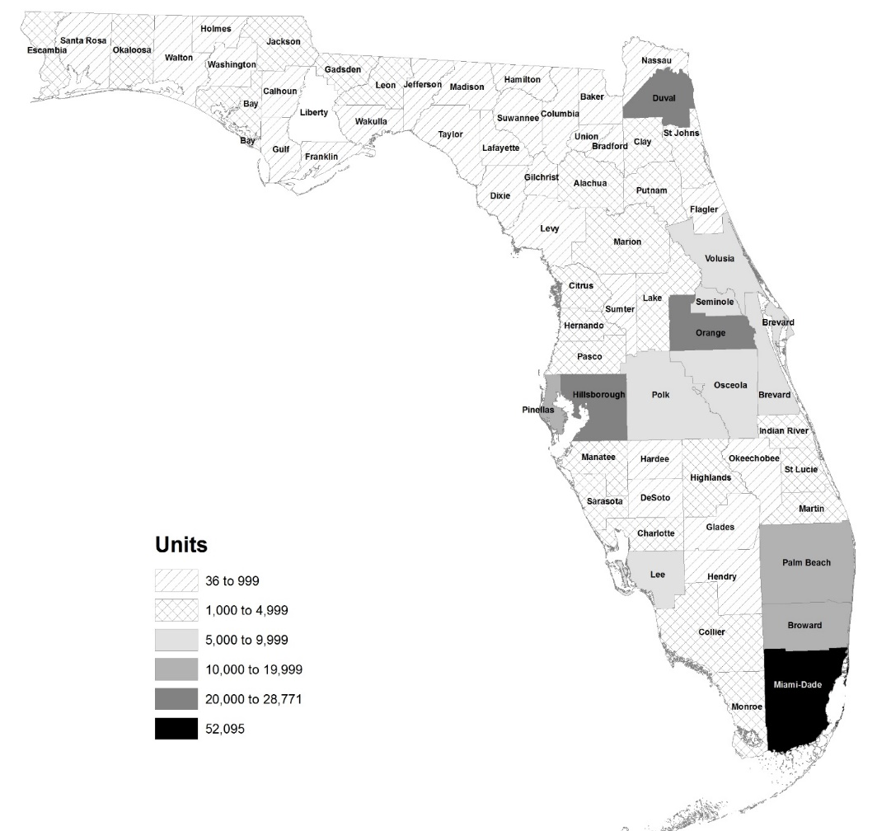
Assisted and Public Housing
  Public Housing
    225 developments, 35,340 units
  Assisted Housing
    Subsidized by Florida Housing, HUD, USDA RD, local housing finance authorities
    2,449 developments, 247,748 assisted units
    Of these, Florida Housing funded 1,474 developments, 182,523 assisted units
  Housing Choice Vouchers
    100,100 in use
    Approx. 16,000 used in Florida Housing developments
Source: Shimberg Center for Housing Studies, Assisted Housing Inventory

Slide 15
State of Florida home prices have risen since housing crash
Median Real Single Family Sale Price (2018 $), 2001-2018 (partial)
Source: Florida Department of Revenue, Sales Data File

Slide 16
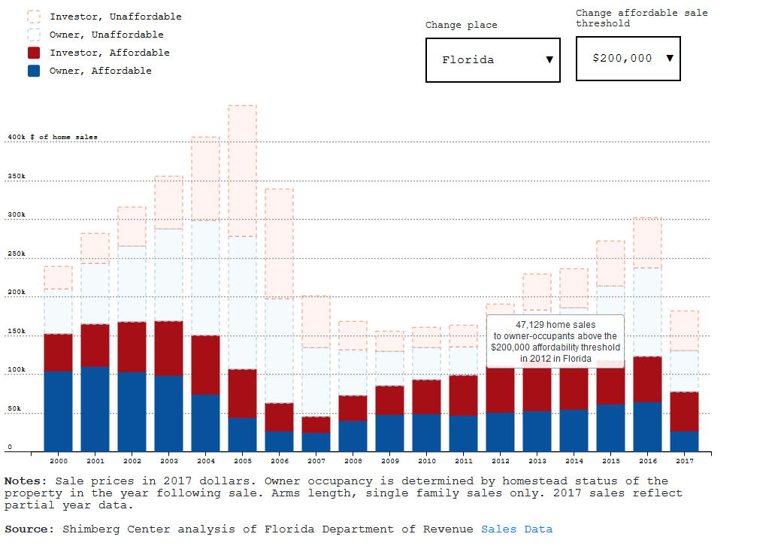
Single Family Home Sales by Affordability and Owner Occupant Status, 2000-2017

Slide 17
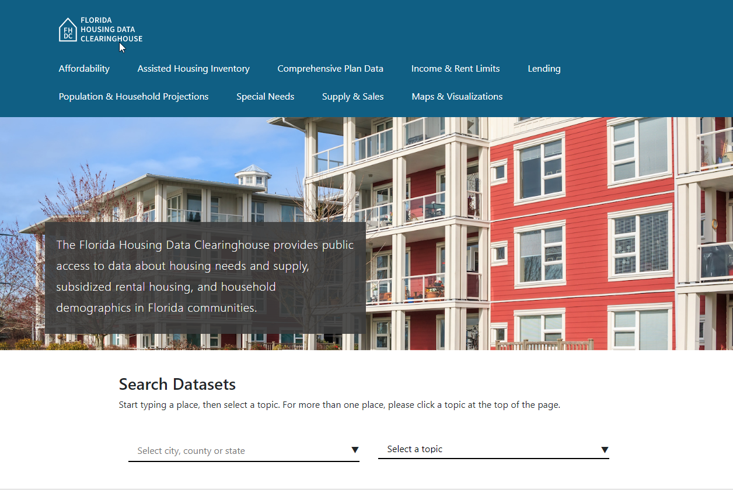
Contact: Anne Ray, Shimberg Center for Housing Studies
352-273-1195
aray@ufl.edu
Main site: www.shimberg.ufl.edu
Data site: data.shimberg.ufl.edu
Housing Florida’s Older Adults: elderdata.shimberg.ufl.edu

