Slide 1
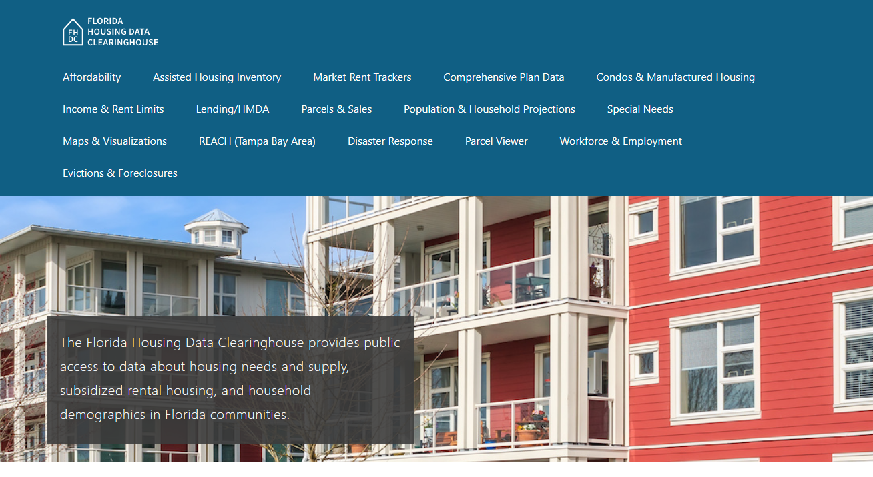

Alachua County Housing Trends
June 2024

Slide 2
Alachua County single family home prices have reached early boom-era levels.
Florida
Alachua
County
Median Single Family Home Sale Price, Gainesville, Alachua County, & Florida, 2003-2023 (2023$)
Source: Shimberg Center analysis of Florida Department of Revenue, Sales Data Files. All values in 2023 dollars to correct for inflation.

Slide 3
The county added nearly 12,000 rental units between 2012 and 2022, but all of these increase was in units renting for $1,200 or less (2022 $).
Net increase 2000-2021: 6,279 rental units
$1,200+ units grew by nearly 13,000
Change in units below $1,200 was not statistically significant.
Units by Gross Rent Above/Below $1,000 (2021 $), Alachua County, 2012 & 2022
Source: Shimberg Center tabulation of U.S. Census Bureau, 2012 and 2022 American Community Survey. Year 2012 rents adjusted to 2022 dollars using Consumer Price Index.

Slide 4
Affordable Housing Terminology
  Housing is usually considered to be affordable if it costs no more than 30% of household income.
  Cost burdened: Paying more than 30% of income for owner or renter costs
  Severely cost burdened: Paying more than 50% of income
  Area median income (AMI): Used to create standard income measures across places and household sizes, expressed as % AMI

Slide 5
Example: 2024 Alachua County Income (% AMI) and Housing Cost Limits
Income level | Annual income range (1-4 person household) | Hourly wage, 1 full-time job | Hourly wage, 2 full-time jobs | Max. affordable monthly housing cost (1-3 bedroom unit)
50% AMI | $33,350-47,650 | $16-$23 | $12 | $893-$1,239
80% AMI | $53,360-76,240 | $26-$37 | $15-$19 | $1,430-$1,983
120% AMI | $80,040-114,360 | $38-$55 | $22-$28 | $2,145-$2,974
http://flhousingdata.shimberg.ufl.edu/income-and-rent-limits

Slide 6
Very low-income renters make up the largest group of cost-burdened households in the county, even excluding student renters.
Households by Tenure, Income (% AMI), and Cost Burden, Alachua County, 2022
Notes: “Student-headed” refers to non-family renter households headed by a full-time student. Counts of cost-burdened households above 120% AMI and student-headed, owner households above 50% AMI are not statistically significant.
Source: Shimberg Center tabulation of U.S. Census Bureau, 2022 American Community Survey

Slide 7
Housing costs outpace wages for many occupations.
Alachua County housing wage: $21.81/hour
A full-time worker would need to earn this amount to rent a typical 2BR apartment (HUD Fair Market Rent 2023: $1,134/mo).
Median wage for Alachua County: $21.72/hour
Sources: National Low Income Housing Coalition, Out of Reach; Shimberg Center tabulation of Florida Department of Commerce, Occupational Employment and Wage Statistics. Median wage is 2022 annual wage in 2023 dollars.

Slide 8
How much can workers afford to pay for housing each month?
$600-799
$800-999
$1,000-1,200
Auto Techs and Mechanics
Bartenders
Security Guards
Construction Laborers
Cashiers
Childcare Workers
Restaurant Cooks
Dishwashers
Fast Food and Counter Workers
Food Preparation Workers
Hairdressers
Home Health and Personal Care Aides
Hotel, Motel, and Resort Desk Clerks
Janitors and Cleaners
Laundry and Dry-Cleaning Workers
Preschool Teachers
Receptionists
Retail Salespersons
Waitstaff
Customer Service Reps
Landscaping and Groundskeeping Workers
Light Truck Drivers
Medical Assistants
Nursing Assistants
Office Clerks
Secretaries and Administrative Assistants
Substitute Teachers
Tellers
Veterinary Techs
Carpenters
Correctional Officers
Dental Assistants
Firefighters
HVAC and Refrigeration Mechanics
Heavy and Tractor-Trailer Truck Drivers
Median, All Occupations
Mental Health and Substance Abuse Social Workers
Painters
Pharmacy Techs
Roofers
Source: Shimberg Center tabulation of Florida Department of Economic Security, Occupational Employment Statistics and Wages. Based on median wage for occupations in Alachua County. Assumes full-time worker, 30% of income spent on housing costs.

Slide 9
Eviction & foreclosure fell sharply in Q2 2020 during the state moratorium, then increased when filings were permitted again. Eviction filings have now risen above pre-pandemic levels and foreclosure filings are near pre-pandemic levels.
Eviction & Foreclosure Filings, Alachua County
Source: Shimberg Center tabulation of filing data from Florida Clerks & Comptrollers and Office of the State Courts Administrator.

Slide 10
Building a Local Housing System: The Affordable Housing Continuum
Supportive Housing (affordable units + services)
Homeless
Affordable rental housing
Public housing
Subsidized (Florida Housing, HUD, USDA)
Affordable home ownership
Shared equity (e.g. community land trust)
Down payment assistance
Older adults
People with disabilities
Other special needs
NOAH (Naturally Occurring Affordable Housing)
Low-interest loans
Affordable construction
Home rehab and weatherization
Vouchers

Slide 11
Contact
Shimberg Center for Housing Studies
352-273-1192
fhdc-comments@shimberg.ufl.edu
Main site: http://www.shimberg.ufl.edu
Data clearinghouse: http://flhousing.data.shimberg.ufl.edu

