Slide 1
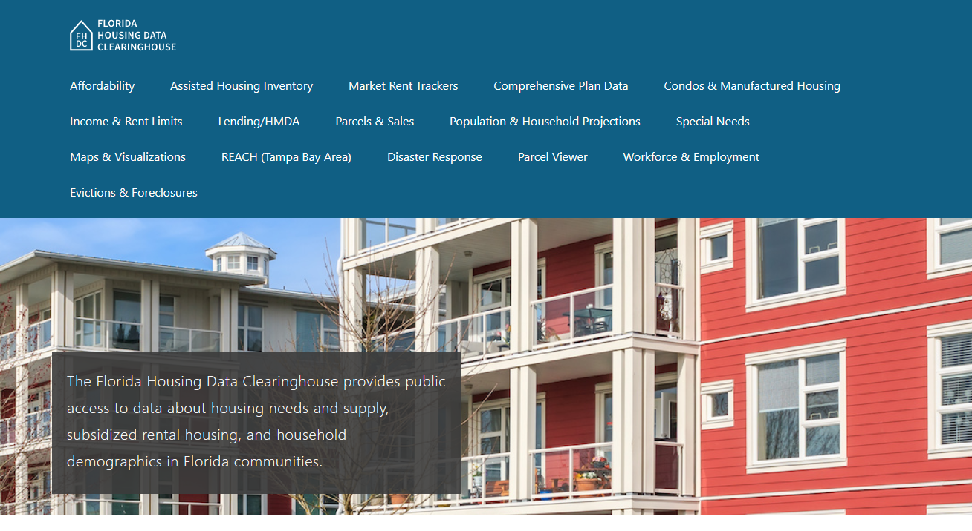

Brevard County Housing Trends
Shimberg Center for Housing Studies
June 2024

Slide 2
Changes in Brevard County’s home prices closely mirror statewide trends. The median single family price now exceeds the mid-2000s peak price.
Florida
Brevard County
Median Single Family Home Sale Price, Brevard County & Florida, 2003-2023 (2023$)
Source: Shimberg Center analysis of Florida Department of Revenue, Sales Data Files. All values in 2023 dollars to correct for inflation.

Slide 3
The county added nearly 4,100 rental units between 2012 and 2022 but lost units renting for $1,200 or less.
Net increase 2012-2022: 4,072 rental units
$1,200+ units grew by over 18,000
Units at or below $1,200 fell by over 14,000
Units by Gross Rent Above/Below $1,000 (2022 $), Brevard County, 2012 & 2022
Source: Shimberg Center tabulation of U.S. Census Bureau, 2012 and 2022 American Community Survey. Year 2012 rents adjusted to 2022 dollars using Consumer Price Index.

Slide 4
Affordable Housing Terminology
  Housing is usually considered to be affordable if it costs no more than 30% of household income.
  Cost burdened: Paying more than 30% of income for owner or renter costs
  Severely cost burdened: Paying more than 50% of income
  Area median income (AMI): Used to create standard income measures across places and household sizes, expressed as % AMI

Slide 5
2024 Brevard County Income (% AMI) and Housing Cost Limits
Income level | Annual income range (1-4 person household) | Hourly wage, 1 full-time job | Hourly wage, 2 full-time jobs | Max. affordable monthly housing cost (1-3 bedroom unit)
50% AMI | $33,100-47,300 | $16-$23 | $12 | $886-$1,229
80% AMI | $52,960-75,680 | $25-$36 | $14-$18 | $1,418-$1,967
120% AMI | $79,440-113,520 | $38-$55 | $22-$28 | $2,127-$2,950
http://flhousingdata.shimberg.ufl.edu/income-and-rent-limits

Slide 6
Very low-income owners and renters make up the largest group of cost-burdened households in Brevard County.
Cost Burdened Households by Income as a Percentage of Area Median Income (AMI), Brevard County, 2022
Source: Shimberg Center tabulation of U.S. Census Bureau, 2022 American Community Survey

Slide 7
Housing costs outpace wages for many occupations.
Brevard County housing wage: $26.44/hour
A full-time worker would need to earn this amount to rent a typical 2BR apartment (HUD Fair Market Rent 2023: $1,375/mo).
Median wage for Brevard County, 2023: $22.32/hour. A full-time, year-round worker with this wage can afford $1,161 in rent.
Sources: National Low Income Housing Coalition, Out of Reach; Shimberg Center tabulation of Florida Department of Economic Opportunity, Occupational Employment and Wage Statistics

Slide 8
How much can workers afford to pay for housing each month?
$600-799
$800-999
$1,000-1,200
Auto Techs and Mechanics
Bartenders
Construction Laborers
Carpenters
Child, Family, and School Social Workers
Dental Assistants
Firefighters
Median, All Occupations
Painters
Paramedics
Secretaries and Administrative Assistants
Cashiers
Childcare Workers
Restaurant Cooks
Dishwashers
Fast Food and Counter Workers
Food Preparation Workers
Hairdressers
Home Health and Personal Care Aides
Hotel, Motel, and Resort Desk Clerks
Janitors and Cleaners
Landscaping and Groundskeeping Workers
Laundry and Dry-Cleaning Workers
Maids and Housekeeping Cleaners
Preschool Teachers
Receptionists
Retail Salespersons
Security Guards
Substitute Teachers
Waitstaff
Customer Service Reps
Light Truck Drivers
Medical Assistants
Nursing Assistants
Office Clerks
Pharmacy Techs
Roofers
Tellers
Veterinary Techs
Source: Shimberg Center tabulation of Florida Department of Economic Security, Occupational Employment Statistics and Wages. Based on median wage for occupations in Brevard County. Assumes full-time worker, 30% of income spent on housing costs.

Slide 9
Eviction & foreclosure fell sharply in Q2 2020 during the state moratorium, then increased when filings were permitted again. Eviction filings have now risen above pre-pandemic levels, while foreclosure filings have fluctuated near pre-pandemic levels.
Eviction & Foreclosure Filings, Brevard County
Source: Shimberg Center tabulation of filing data from Florida Clerks & Comptrollers and Office of the State Courts Administrator.

Slide 10
Building a Local Housing System: The Affordable Housing Continuum
Supportive Housing (affordable units + services)
Homeless
Affordable rental housing
Public housing
Subsidized (Florida Housing, HUD, USDA)
Affordable home ownership
Shared equity (e.g. community land trust)
Down payment assistance
Older adults
People with disabilities
Other special needs
NOAH (Naturally Occurring Affordable Housing)
Low-interest loans
Affordable construction
Home rehab and weatherization
Vouchers

Slide 11
Contact
Shimberg Center for Housing Studies
352-273-1192
Main site: http://www.shimberg.ufl.edu
Data clearinghouse: http://flhousing.data.shimberg.ufl.edu

