Slide 1
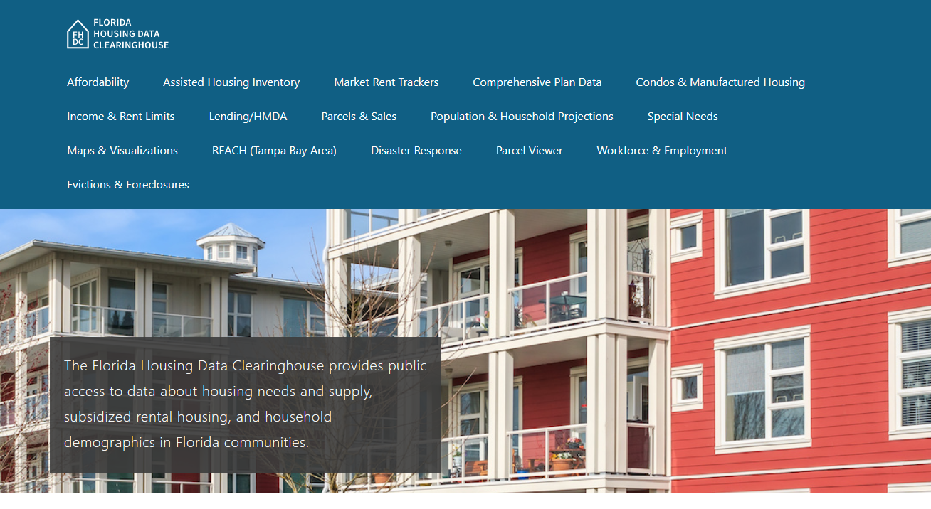

Broward County Housing Trends
Shimberg Center for Housing Studies
June 2024

Slide 2
Broward County’s median home price has surpassed mid-2000s boom levels.
Broward County
Florida
Median Single Family Home Sale Price, Broward County & Florida, 2003-2023 (2023$)
Source: Shimberg Center analysis of Florida Department of Revenue, Sales Data Files. All values in 2023 dollars to correct for inflation.

Slide 3
Broward County added over 53,000 rental units between 2012 and 2022 but lost units renting for $1,200 or less (2022 $).
Net increase 2012-2022: 53,397 rental units
$1,200+ units grew by nearly 74,000
Units at or below $1,200 fell by over 20,000
Units by Gross Rent Above/Below $1,200 (2022 $), Broward County, 2012 & 2022
Source: Shimberg Center tabulation of U.S. Census Bureau, 2012 and 2022American Community Survey. Year 2012 rents adjusted to 2022 dollars using Consumer Price Index.

Slide 4
Affordable Housing Terminology
  Housing is usually considered to be affordable if it costs no more than 30% of household income.
  Cost burdened: Paying more than 30% of income for owner or renter costs
  Severely cost burdened: Paying more than 50% of income
  Area median income (AMI): Used to create standard income measures across places and household sizes, expressed as % AMI

Slide 5
Example: 2024 Broward County Income (% AMI) and Housing Cost Limits
Income level | Annual income range (1-4 person household) | Hourly wage, 1 full-time job | Hourly wage, 2 full-time jobs | Max. affordable monthly housing cost (1-3 bedroom unit)
50% AMI | $36,950-52,800 | $18-$25 | $12-$13 | $989-$1,372
80% AMI | $59,120-84,480 | $28-$41 | $16-$21 | $1,583-$2,196
120% AMI | $88,680-126,720 | $43-$61 | $25-$31 | $2,374-$3,294
http://flhousingdata.shimberg.ufl.edu/income-and-rent-limits

Slide 6
Very low-income renters and owners make up the largest group of cost-burdened households in Broward County.
Cost Burdened Households by Income as a Percentage of Area Median Income (AMI), Broward County, 2022
Source: Shimberg Center tabulation of U.S. Census Bureau, 2022 American Community Survey

Slide 7
Housing costs outpace wages for many occupations.
Broward County housing wage: $35.53/hour
A full-time worker would need to earn this amount to rent a typical 2BR apartment (HUD Fair Market Rent 2023: $1,847/mo).
Median wage for Broward County, 2023: $22.23/hour. A full-time, year-round worker with this wage can afford $1,156 in rent.
Sources: National Low Income Housing Coalition, Out of Reach; Shimberg Center tabulation of Florida Department of Economic Opportunity, Occupational Employment and Wage Statistics

Slide 8
How much can workers afford to pay for housing each month?
$600-799
$800-999
$1,000-1,200
Dental Assistants
Bartenders
Bus Drivers
Light Truck Drivers
Median, All Occupations
Painters
Secretaries and Administrative Assistants
Cashiers
Childcare Workers
Dishwashers
Farmworkers
Fast Food and Counter Workers
Hairdressers
Home Health and Personal Care Aides
Hotel, Motel, and Resort Desk Clerks
Janitors and Cleaners
Laundry and Dry-Cleaning Workers
Maids and Housekeeping Cleaners
Preschool Teachers
Retail Salespersons
Security Guards
Substitute Teachers
Waitstaff
Construction Laborers
Restaurant Cooks
Customer Service Reps
Food Preparation Workers
Landscaping and Groundskeeping Workers
Medical Assistants
Nursing Assistants
Office Clerks
Pharmacy Techs
Receptionists
Tellers
Veterinary Techs
Source: Shimberg Center tabulation of Florida Department of Economic Security, Occupational Employment Statistics and Wages. Based on median wage for occupations in the Miami-Fort Lauderdale-West Palm Beach MSA. Assumes full-time worker, 30% of income spent on housing costs.

Slide 9
Eviction & foreclosure fell sharply in Q2 2020 during the state moratorium, then increased when filings were permitted again. Eviction filings have now risen above pre-pandemic levels and foreclosure filings are nearing pre-pandemic levels.
Eviction & Foreclosure Filings, Broward County
Source: Shimberg Center tabulation of filing data from Florida Clerks & Comptrollers and Office of the State Courts Administrator.

Slide 10
Building a Local Housing System: The Affordable Housing Continuum
Supportive Housing (affordable units + services)
Homeless
Affordable rental housing
Public housing
Subsidized (Florida Housing, HUD, USDA)
Affordable home ownership
Shared equity (e.g. community land trust)
Down payment assistance
Older adults
People with disabilities
Other special needs
NOAH (Naturally Occurring Affordable Housing)
Low-interest loans
Affordable construction
Home rehab and weatherization
Vouchers

Slide 11
Contact
Shimberg Center for Housing Studies
352-273-1192
aray@ufl.edu
Main site: http://www.shimberg.ufl.edu
Data clearinghouse: http://flhousing.data.shimberg.ufl.edu

