Slide 1
Homelessness and Education in Florida: Discussion of Findings
Anne Ray, Shimberg Center for Housing Studies
Barbara “Bobbie” Ibarra, Miami Homes for All

Slide 2
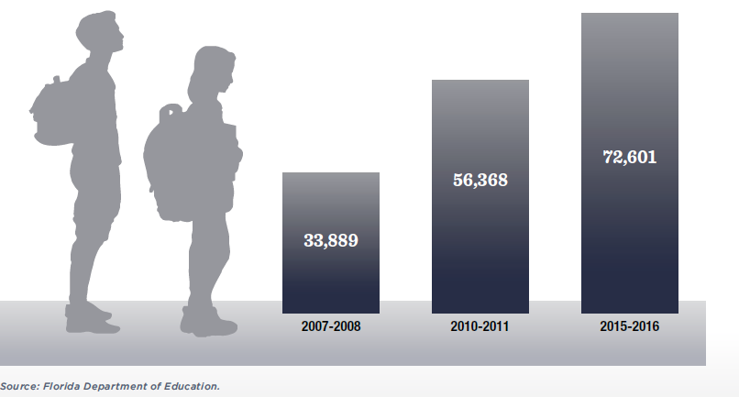
The number of students in Florida identified as homeless more than doubled in the past decade.
OVERVIEW OF STUDENT HOMELESSNESS
Homeless Students in Florida by School Year
The poverty rate for school-age children increased from 16% (2007) to 22% (2015).
School districts improved identification of homeless children.

Slide 3
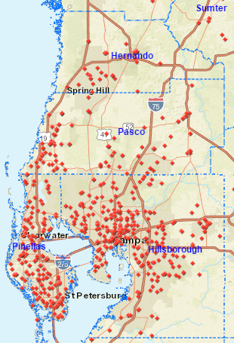
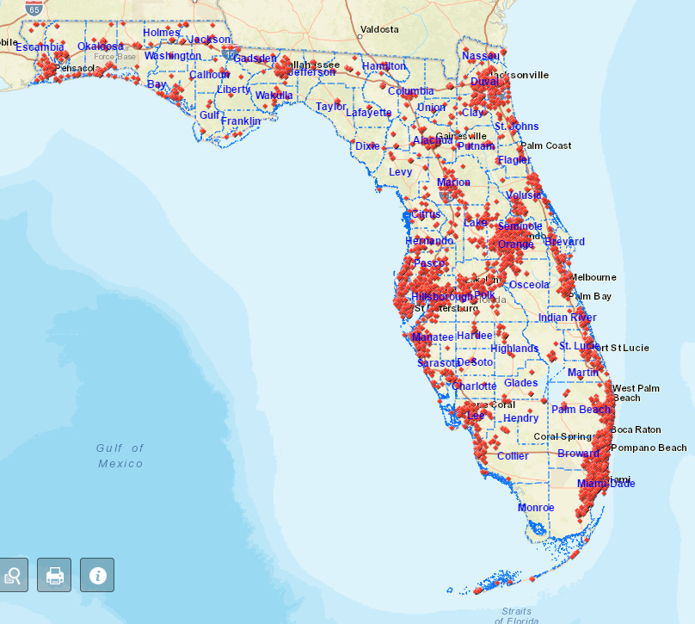
Online schools mapping tool: www.shimberg.ufl.edu/schoolmap
OVERVIEW OF STUDENT HOMELESSNESS
Tampa Bay Area
Statewide
All schools

Slide 4
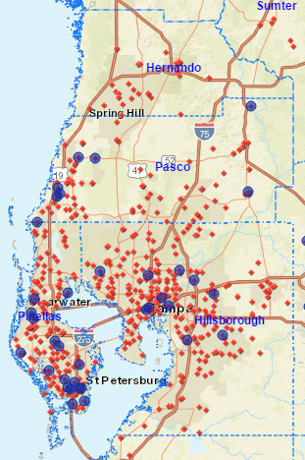
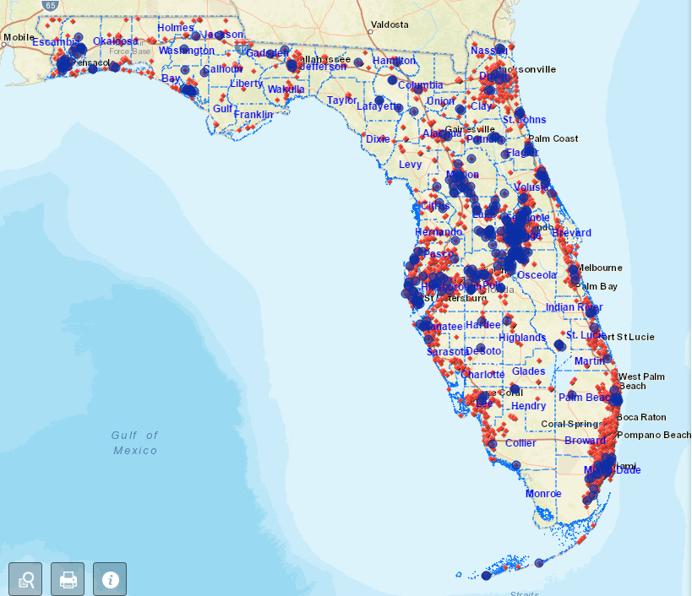
Schools with at least 50 homeless students
OVERVIEW OF STUDENT HOMELESSNESS
Tampa Bay Area
Statewide
All schools
Schools w/50+ homeless students

Slide 5
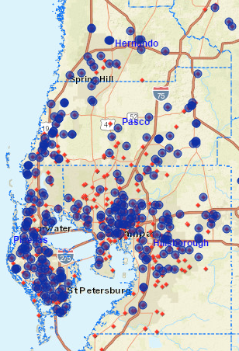
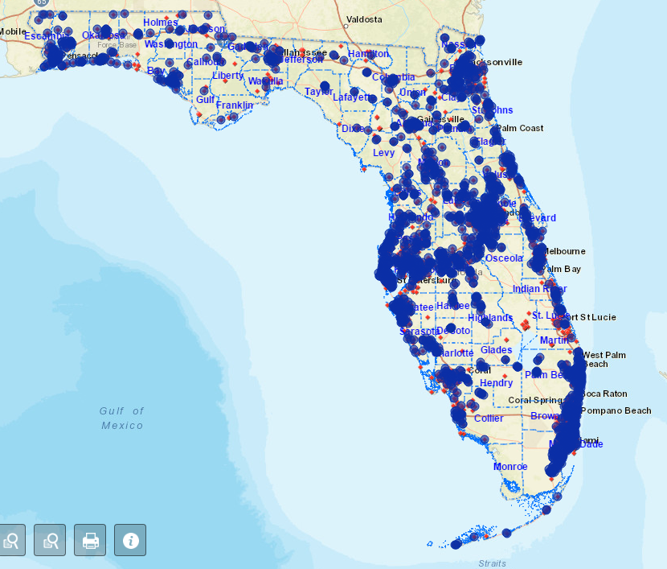
Schools with at least 10 homeless students
OVERVIEW OF STUDENT HOMELESSNESS
Tampa Bay Area
Statewide
All schools
Schools w/10+ homeless students

Slide 6
Most homeless families and youth are doubled up with others.
OVERVIEW OF STUDENT HOMELESSNESS
74% of homeless students in Florida are doubled up.
Most others are in hotels and motels (11%) and shelters and transitional housing (10%).
1,000-2,000 students per year are in places not designed for human accommodation (cars, parks, campgrounds).

Slide 7
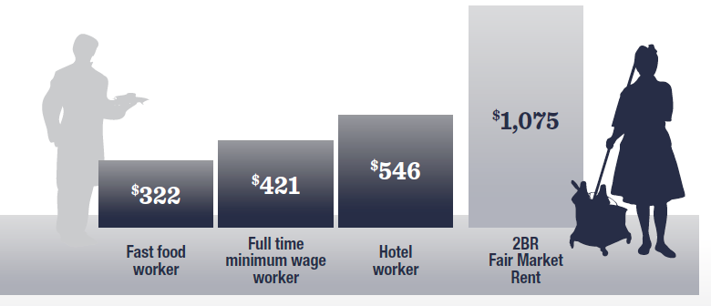
Lack of affordable rental housing is a key factor in family homelessness.
OVERVIEW OF STUDENT HOMELESSNESS
The number of families in need is growing in Florida. The number of affordable units is not.
Affordable family units (2+ bedrooms) are in short supply, and most are occupied by higher income or non-family households.
Apartments at fair market rent are far out of reach for minimum-wage and other low-wage workers.
What can Florida’s workers afford to pay in rent? (compared to market rent for 2BR unit)
Assumes fast food workers and hotel employees are part-time, average wage workers based on U.S. Bureau of Labor Statistics, December 2016 Current Employment Survey (“limited-service restaurant workers” work an average of 24 hours/week with average wage of $10.33/hour; hotel and motel workers work an average of 30 hours/ week with average wage $14.11/hour). Minimum wage workers are assumed to work 40 hours/week at Florida’s minimum wage, $8.10/hour. Statewide two-bedroom Fair Market Rent from National Low-Income Housing Coalition, Out of Reach 2017.

Slide 8
Liaisons: Complex economic and health factors for parents contribute to housing instability.
OVERVIEW OF STUDENT HOMELESSNESS
Unemployment and underemployment
Includes families moving to FL to look for work
Need for education and job skills
Lack of affordable, reliable transportation
Disability, addiction, and health problems
History of evictions and poor credit

Slide 9
Nearly 10% of homeless students are unaccompanied youth.
OVERVIEW OF STUDENT HOMELESSNESS
6,982 unaccompanied youth ID’d in 2015-2016 (undercount).
Unaccompanied youth face particular challenges and are vulnerable to victimization.
Even in counties with family shelters, there are few options for unaccompanied youth.

Slide 10
Study results: on all factors measured, homeless students struggled more than their housed peers.
EDUCATIONAL OUTCOMES
Florida Department of Education data from 2015-2016 school year
Compared homeless, housed/receiving free or reduced price lunch, housed/full price lunch

Slide 11
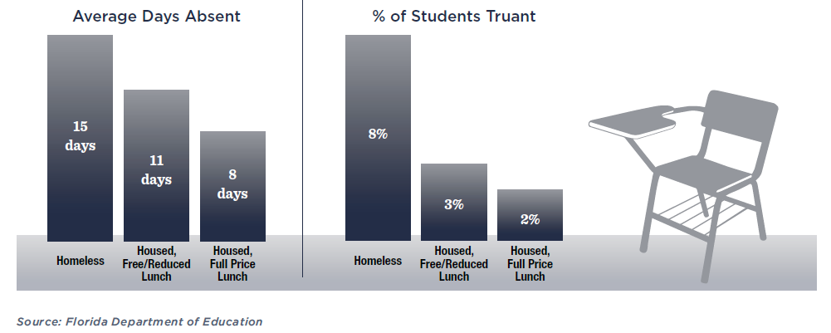
Homeless students had higher rates of absenteeism and truancy.
EDUCATIONAL OUTCOMES
Absenteeism and Truancy, 2015-16 School Year
Truancy: at least 15 unexcused absences within 90 days.

Slide 12
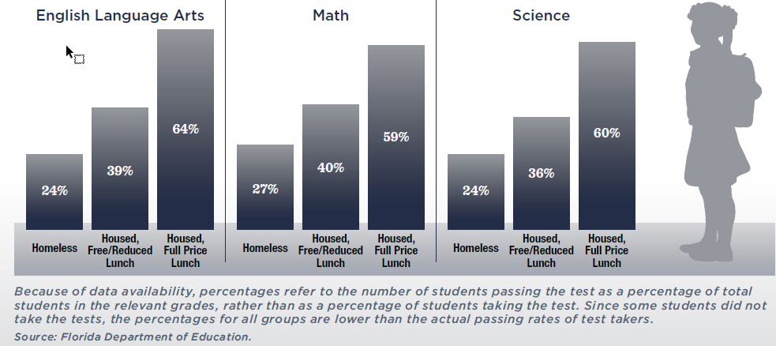
Fewer homeless students received passing scores on state tests.
EDUCATIONAL OUTCOMES
Students Passing FSA and SSA as Percentage of Grade-Eligible Students, 2015-16 School Year

Slide 13
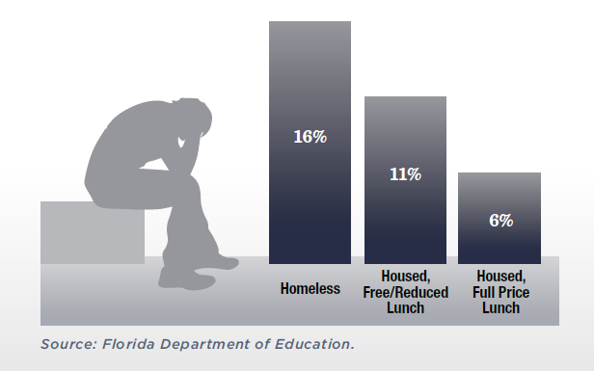
Suspension rates were higher for homeless students.
EDUCATIONAL OUTCOMES
% of Students Suspended At Least Once, 2015-16 School Year

Slide 14
These gaps might be significantly wider without the services that schools provide to homeless students.
EDUCATIONAL OUTCOMES
Enrollment
Transportation
Tutoring
Basic needs: hygiene kits, uniforms, school supplies
Financial assistance for field trips and extracurriculars
Seniors: graduation costs, FAFSA/college tours
Housing and service referrals

Slide 15
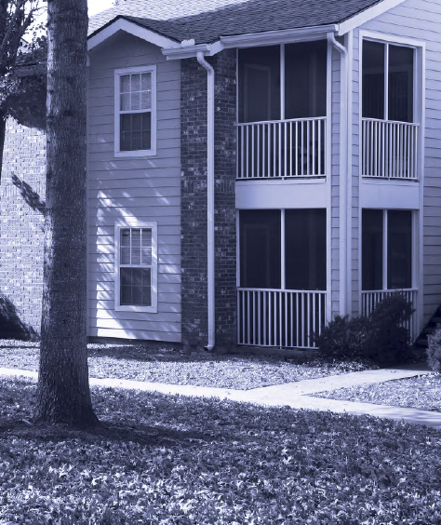
Liaisons were asked what would help youth and families become permanently housed.
SOLUTIONS
Top response: affordable housing
Temporary shelter (esp. in rural areas) so families can save money for housing
Homelessness prevention and rapid re-housing services
Services to help parents work: afterschool care, education for work skills, transportation
Case management and life/financial skills training for parents
Safe housing options for unaccompanied youth

Slide 16
RECOMMENDATION 1: Restore and Increase Federal Funding For Housing Choice Vouchers (HCV)
The Housing Choice Voucher (HCV) is the federal government's major program for assisting very low-income families, the elderly, and the disabled to afford decent, safe, and sanitary housing.
According to the Center on Budget and Policy, $19.9 billion will be needed in 2018 to renew all HCVs currently in use in the U.S.
However, the current proposed HUD budget of $17.7 billion will result in the loss of 250,000 vouchers.
In Florida, there are 99,100 HCV’s in use; the newly proposed budget will result in a loss of 8,000 HCV’s.

Slide 17
recommendation 2: Maintaining HUD Funding
Public Housing:
Congress must allocate funding to ensure that the housing units occupied remain safe and habitable.
The CDBG program provides flexible funds for affordable housing, services, and small business. Current federal budget ELIMINATES THIS PROGRAM RESULTING IN A LOSS OF $131 MILLION by FLA.
HOME is the source of HUD funding for the creation of affordable housing. The current federal budget ELIMINATES THIS PROGRAM RESULTING IN A LOSS OF $44.6 MILLION FOR FLORIDA.

Slide 18
Recommendation 3: Preserving Housing
Project-Based Rental Assistance (PBRA) provides much needed rental subsidies for housing units. Congress must fully fund the PBRA program to allow the subsidies to continue.
FHFC should continue setting aside funds for preservation of existing multifamily housing developments.
Local governments should use SHIP to preserve PBRA housing.
Despite the availability of PBRA, affordability restrictions are time-limited. When restrictions expire, owners may convert properties to market-rate housing.
16,675 units in Florida with PBRA are at risk of loss in the next decade.
Financing can be used to: 1. incentivize owners to remain in the subsidy programs, 2. help new owners acquire housing developments and maintain affordability restrictions, and 3. rehab aging facilities.

Slide 19
RECOMMENDATION 4: Tax Credit Projects - Maintain a 50-Year Affordability Term & Average Income Limits
Federal law requires tax credit projects to remain affordable for at least 30 years. FHFC requires a 50-year affordability term. This should continue!
The current tax credit statute does not allow set-aside units to serve households above 60% AMI.
Modify the Statue to allow some units to serve households at 80% AMI in exchange for restricting some units at 30% AMI, so long as the average for the building remains at 60% AMI.

Slide 20
RECOMMENDATION 5: Commit total allocation to The Sadowski Fund
The Sadowski Fund finances two affordable housing programs:
The State Housing Initiatives Partnership (SHIP) focuses on affordable ownership housing
The State Apartment Incentive Loan (SAIL) focuses on multifamily rental housing
Between 2008 and 2016, $1.8 billion were swept into the general revenue fund.
Revenue for FY 2017-2018 was $291.4 million. Only $137 million allocated a loss of housing funds of $154.4 million.
Federal subsidies lost: From 2011 to 2013, Florida forfeited a total of $1.539 billion in federal and private resources.
If the full amount of Sadowski Funds were dedicated to housing, it would result in an estimated 29,000 jobs and $3.78 billion in economic impacts for Florida.

Slide 21
Recommendation 6: Devote SHIP for Temporary Financial Assistance
Florida allows up to 25% of SHIP to be used for security and utility deposit assistance, eviction prevention subsidies up to 6 months rent, and rent subsidies up to one year.
Kissimmee
Leveraged CDBG funding with SHIP for security/utility deposits & rental assistance for up to 3 months and social services
Since 2012, City has served over 120 households
West Palm Beach
Dedicates $50,000 of SHIP to assist 25 households with security deposits
first month/last month

Slide 22
Recommendation 7: Local Governments Provide a bridge for families by allocating a Portion of SHIP for ELI Households
No state requirement for ELI households, so local governments are free to enact requirements themselves.
Set-Aside for ELI households would enable local governments to provide various sources of temporary assistance and housing.

Slide 23
RECOMMENDATION 8: Create Private-Public Loan Funds to Target ELI Families
Loan funds combine public and private dollars to offer low-interest financing to developers looking to preserve or create affordable housing.
Loan funds are a unique way to leverage dwindling government dollars with private investment!
Many other cities have seen success:
Home Funders (Boston)
Denver Transit Oriented Development Fund
NYC Acquisition Fund
Los Angeles New Generation Fund
Florida Community Loan Fund (Orlando-based)

Slide 24
RECOMMENDATION 9: Use Existing or New Housing Trust Funds to Support ELI Housing
Trust funds draw on dedicated sources of public funding to support affordable housing preservation and production. Trust funds also engage in low-interest lending for development & preservation.
Local example: Miami-Dade County recently amended its own Affordable Housing Trust Fund to allocate carryover funds from the general revenue for affordable housing.

Slide 25
National Models of Housing Trust Funds to Support ELI Housing
Chicago’s Low Income Housing Trust Fund
Funding comes from inclusionary zoning program and a portion of state funding from a real estate transaction recording fee.
In 2014, 2,813 units of housing in the City of Chicago were subsidized by the trust fund!
Kentucky’s Housing Trust Fund
Receives funding from a document recording fee, state housing finance agency, unclaimed lottery winnings, and the Governor’s Kentucky Derby Breakfast
Has created more than 3,900 rental units!

Slide 26
RECOMMENDATION 10: EXPLORE Innovative Approaches to our Housing Crisis
Inclusionary Zoning
Community Land Trusts/Land Banking
Regulatory Reform
Airbnb
Linkage Fees
Community Benefits Agreements

Slide 27
RECOMMENDATION 11: Developing alternative housing options for unaccompanied homeless youth:
Increase the number of youth-specific emergency shelter programs: Covenant House Florida
Develop host home programs particularly in rural communities: Avenues for Homeless Youth
Adopt successful transitional housing models for youth aging out of foster care: The Village
Collaborate across youth housing programs and mainstream systems to provide comprehensive services: Miami’s Youth Homelessness Initiative
Increase access to crisis shelter for minor youth (under 18) through Runaway and Homeless Act (RHY) program funding and state funds for juvenile justice respite programs. Incorporate RHY and youth crisis shelter providers into the Continuum of Care.

Slide 28
Recommendation12: Beyond Housing
Beyond the lack of affordable housing, other economic factors cause homelessness
Solution: Coordinate workforce development services for parents with housing assistance.
School Districts rely heavily on private donations to augment their limited McKinney Vento resources
Solution: Encourage local foundations and charities to donate flexible funds to schools’ assistance programs
Our goal should be to make homelessness rare, brief, and one time across our state
Solution: Implement key recommendations from Barbara Poppe/Central Florida Commission on Homelessness reports (e.g. coordinated entry, rapid rehousing, and permanent supportive housing)

Slide 29
For more information:
Download the report
http://www.shimberg.ufl.edu/children.html
Map schools in your community
http://www.shimberg.ufl.edu/schoolmap
http://arcg.is/0PrTii
Contact Anne Ray
Shimberg Center for Housing Studies
352-273-1195
aray@ufl.edu
Barbara “Bobbie” Ibarra
Miami Homes for All
786-469-2060
bibarra@miamihomesforall.org

