Slide 1
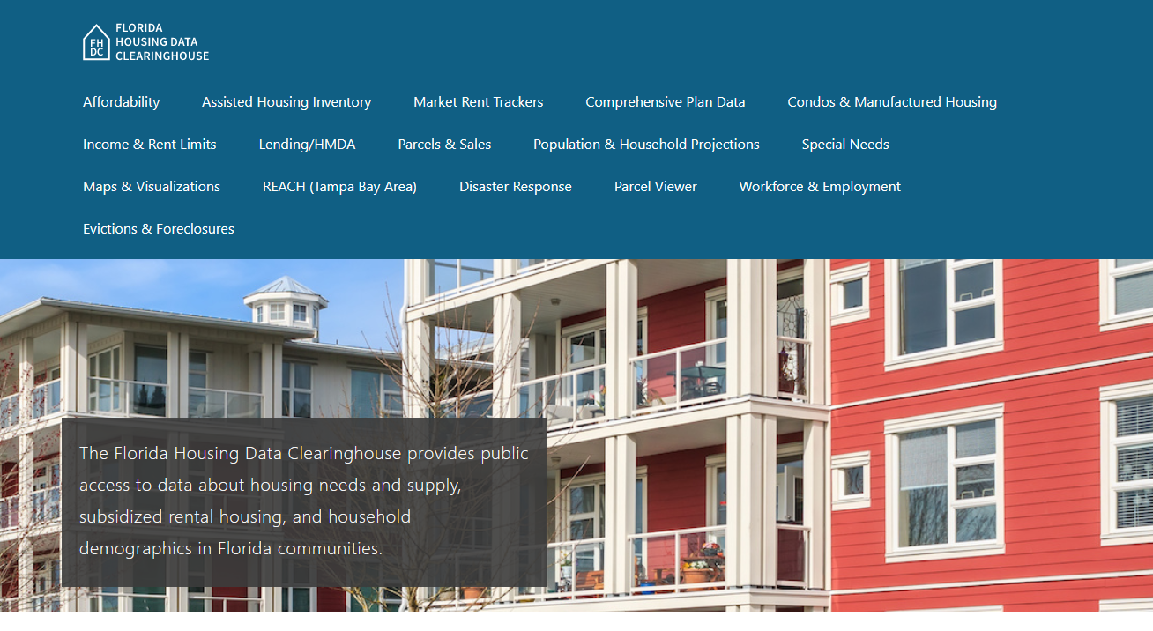
Clay County Housing Trends
June 2024

Slide 2
Clay County median home prices closely mirror statewide trends. The median home price is now close to mid-2000s boom-era levels.
Florida
Clay
County
Median Single Family Home Sale Price, Clay County & Florida, 2003-2023 (2023$)
Source: Shimberg Center analysis of Florida Department of Revenue, Sales Data Files. All values in 2023 dollars to correct for inflation.

Slide 3
Clay County added over 3,700 rental units between 2012 and 2022, but the entire increase was in units renting $1,200 or less (2022 $).
Net increase 2012-2022: 3,726 rental units
$1,200+ units grew by over 4,500
Change in units for $1,200 or less was not statistically significant.
Units by Gross Rent Above/Below $1,200 (2022 $), Clay County, 2012 & 2022
Source: Shimberg Center tabulation of U.S. Census Bureau, 2012 and 2022 American Community Survey. Year 2012 rents adjusted to 2022 dollars using Consumer Price Index.

Slide 4
Affordable Housing Terminology
Housing is usually considered to be affordable if it costs no more than 30% of household income.
Cost burdened: Paying more than 30% of income for owner or renter costs
Severely cost burdened: Paying more than 50% of income
Area median income (AMI): Used to create standard income measures across places and household sizes, expressed as % AMI

Slide 5
Example: 2024 Clay County Income (% AMI) and Housing Cost Limits
Income level | Annual income range (1-4 person household) | Hourly wage, 1 full-time job | Hourly wage, 2 full-time jobs | Max. affordable monthly housing cost (1-3 bedroom unit)
50% AMI | $34,100-48,650 | $16-$23 | $12 | $912-$1,265
80% AMI | $54,560-77,840 | $26-$37 | $15-$19 | $1,460-$2,024
120% AMI | $81,840-116,760 | $39-$56 | $22-$28 | $2,190-$3,036
http://flhousingdata.shimberg.ufl.edu/income-and-rent-limits

Slide 6
Very low-income owners and renters make up the largest groups of cost-burdened households in Clay County.
Cost Burdened Households by Income as a Percentage of Area Median Income (AMI), Clay County, 2022
Source: Shimberg Center tabulation of U.S. Census Bureau, 2022 American Community Survey

Slide 7
Housing costs outpace wages for many occupations.
Clay County housing wage: $25.06/hour
A full-time worker would need to earn this amount to rent a typical 2BR apartment (HUD Fair Market Rent 2023: $1,303/mo).
Median wage for Clay County, 2023: $21.15/hour. A full-time, year-round worker with this wage can afford $1,100 in rent.
Sources: National Low Income Housing Coalition, Out of Reach; Shimberg Center tabulation of Florida Department of Economic Opportunity, Occupational Employment and Wage Statistics

Slide 8
How much can workers afford to pay for housing each month?
$600-799
$800-999
$1,000-1,200
Auto Techs and Mechanics
Bus Drivers
Bartenders
Carpenters
Child, Family, and School Social Workers
Light Truck Drivers
Median, All Occupations
Roofers
Secretaries and Administrative Assistants
Cashiers
Childcare Workers
Restaurant Cooks
Dishwashers
Farmworkers
Fast Food and Counter Workers
Food Preparation Workers
Hairdressers
Home Health and Personal Care Aides
Hotel, Motel, and Resort Desk Clerks
Janitors and Cleaners
Laundry and Dry-Cleaning Workers
Maids and Housekeeping Cleaners
Preschool Teachers
Retail Salespersons
Security Guards
Waitstaff
Construction Laborers
Customer Service Reps
Landscaping and Groundskeeping Workers
Medical Assistants
Nursing Assistants
Office Clerks
Painters
Pharmacy Techs
Receptionists
Substitute Teachers
Tellers
Veterinary Techs
Source: Shimberg Center tabulation of Florida Department of Economic Security, Occupational Employment Statistics and Wages. Based on median wage for occupations in Clay County. Assumes full-time worker, 30% of income spent on housing costs.

Slide 9
Eviction & foreclosure fell sharply in Q2 2020 during the state moratorium, then increased when filings were permitted again. Eviction filings have now risen above pre-pandemic levels. Foreclosure filings are approaching pre-pandemic levels.
Eviction & Foreclosure Filings, Clay County
Source: Shimberg Center tabulation of filing data from Florida Clerks & Comptrollers and Office of the State Courts Administrator.

Slide 10
Building a Local Housing System: The Affordable Housing Continuum
Supportive Housing (affordable units + services)
Homeless
Affordable rental housing
Public housing
Subsidized (Florida Housing, HUD, USDA)
Affordable home ownership
Shared equity (e.g. community land trust)
Down payment assistance
Older adults
People with disabilities
Other special needs
NOAH (Naturally Occurring Affordable Housing)
Low-interest loans
Affordable construction
Home rehab and weatherization
Vouchers

Slide 11
Contact
Shimberg Center for Housing Studies
352-273-1192
Main site: http://www.shimberg.ufl.edu
Data clearinghouse: http://flhousing.data.shimberg.ufl.edu

