Slide 1
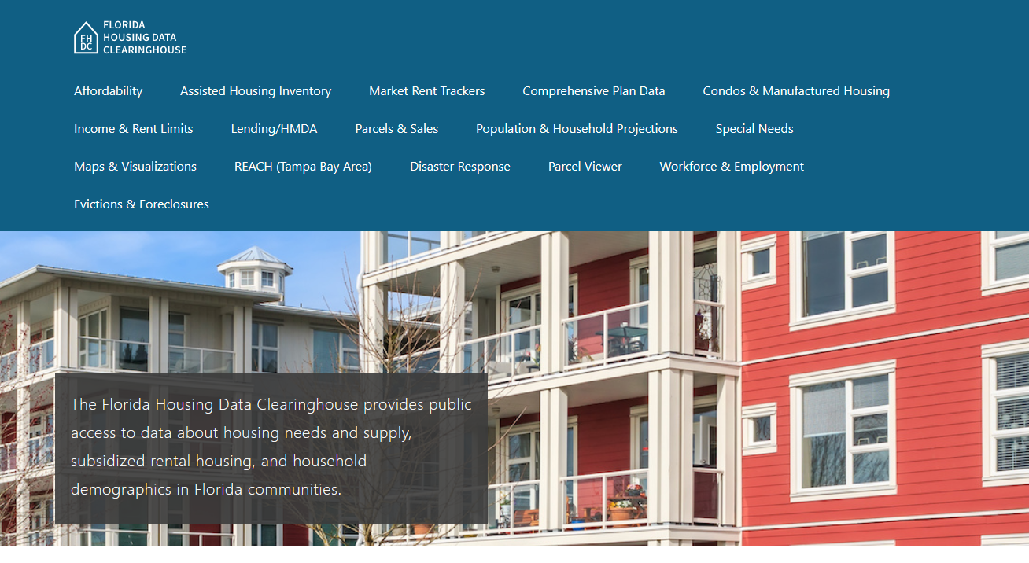
Flagler County Housing Trends
Shimberg Center for Housing Studies
June 2024

Slide 2
Home price changes in Flagler County closely mirror state trends.
Florida
Flagler County
Median Single Family Home Sale Price, Flagler County & Florida, 2003-2023 (2023$)
Source: Shimberg Center analysis of Florida Department of Revenue, Sales Data Files. All values in 2023 dollars to correct for inflation.

Slide 3
Affordable Housing Terminology
Housing is usually considered to be affordable if it costs no more than 30% of household income.
Cost burdened: Paying more than 30% of income for owner or renter costs
Severely cost burdened: Paying more than 50% of income
Area median income (AMI): Used to create standard income measures across places and household sizes, expressed as % AMI

Slide 4
2024 Flagler County Income (% AMI) and Housing Cost Limits
Income level | Annual income range (1-4 person household) | Hourly wage, 1 full-time job | Hourly wage, 2 full-time jobs | Max. affordable monthly housing cost (1-3 bedroom unit)
50% AMI | $30,400-43,450 | $15-$21 | - | $814-$1,130
80% AMI | $48,640-69,520 | $23-$33 | $13-$17 | $1,303-$1,808
120% AMI | $72,960-104,280 | $35-$50 | $20-$25 | $1,954-$2,712
http://flhousingdata.shimberg.ufl.edu/income-and-rent-limits

Slide 5
Very low-income homeowners make up the largest group of cost-burdened households in Flagler County.
Cost Burdened Households by Income as a Percentage of Area Median Income (AMI), Flagler County, 2022
Source: Shimberg Center tabulation of U.S. Census Bureau, 2022 American Community Survey
Note: Red/Underlined numbers indicate values that are not statistically significant.

Slide 6
Housing costs outpace wages for many occupations.
Flagler County housing wage: $26.94/hour
A full-time worker would need to earn this amount to rent a typical 2BR apartment (HUD Fair Market Rent 2023: $1,401/mo).
Median wage for Flagler County, 2023: $18.36/hour. A full-time, year-round worker with this wage can afford $955 in rent.
Sources: National Low Income Housing Coalition, Out of Reach; Shimberg Center tabulation of Florida Department of Economic Opportunity, Occupational Employment and Wage Statistics

Slide 7
How much can workers afford to pay for housing each month?
$600-799
$800-999
$1,000-1,200
Auto Techs and Mechanics
Construction Laborers
Bus Drivers
Carpenters
Child, Family, and School Social Workers
Correctional Officers
Dental Assistants
Electricians
HVAC and Refrigeration Mechanics
Heavy and Tractor-Trailer Truck Drivers
Middle School Teachers
Plumbers, Pipefitters, and Steamfitters
Roofers
Tellers
Cashiers
Childcare Workers
Restaurant Cooks
Farmworkers
Food Preparation Workers
Hairdressers
Home Health Aides
Hotel, Motel, and Resort Desk Clerks
Janitors and Cleaners
Landscapers
Laundry and Dry-Cleaning Workers
Maids and Housekeeping Cleaners
Nursing Assistants
Preschool Teachers
Receptionists
Retail Salespersons
Security Guards
Substitute Teachers
Waitstaff
Customer Service Reps
Firefighters
Light Truck Drivers
Median, All Occupations
Medical Assistants
Office Clerks
Painters
Pharmacy Techs
Secretaries and Administrative Assistants
Veterinary Techs
Source: Shimberg Center tabulation of Florida Department of Economic Security, Occupational Employment Statistics and Wages. Based on median wage for occupations in Flagler County. Assumes full-time worker, 30% of income spent on housing costs.

Slide 8
Eviction & foreclosure filings fell sharply in Q2 2020 during the state moratorium, then increased when filings were permitted again. Eviction filings have returned to pre-pandemic levels, while foreclosure filings have been more volatile.
Eviction & Foreclosure Filings, Flagler County
Source: Shimberg Center tabulation of filing data from Florida Clerks & Comptrollers and Office of the State Courts Administrator.

Slide 9
Building a Local Housing System: The Affordable Housing Continuum
Supportive Housing (affordable units + services)
Homeless
Affordable rental housing
Public housing
Subsidized (Florida Housing, HUD, USDA)
Affordable home ownership
Shared equity (e.g. community land trust)
Down payment assistance
Older adults
People with disabilities
Other special needs
NOAH (Naturally Occurring Affordable Housing)
Low-interest loans
Affordable construction
Home rehab and weatherization
Vouchers

Slide 10
Contact
Shimberg Center for Housing Studies
352-273-1192
aray@ufl.edu
Main site: http://www.shimberg.ufl.edu
Data clearinghouse: http://flhousing.data.shimberg.ufl.edu

