Slide 1
Contact
Florida’s Affordable Housing Needs
Graham Civic Scholars Program – Lecture 1
Anne Ray, UF Shimberg Center for Housing Studies
February 11, 2019

Slide 2
Key Points
The root of the problem: the gap between housing costs and what people can afford without skimping on other needs
A healthy local system includes a continuum of housing types: supportive housing, affordable rental, and affordable home ownership
Local government roles: make the rules, spend the money, & (sometimes) provide the housing

Slide 3
Terminology
Housing is usually considered to be affordable if it costs no more than 30% of household income.
Cost burdened: Paying more than 30% of income for owner or renter costs
Severely cost burdened: Paying more than 50% of income

Slide 4
Terminology
Area median income (AMI): Used to create standard income measures across places and household sizes, expressed as % AMI
Extremely low-income: 0-30% AMI ($14,000-24,000 for household of 3, depending on county)
Very low-income: Up to 50% AMI ($23,000-40,000)
Low-income: Up to 80% AMI ($38,000-64,000)
Moderate income: 80-120% AMI ($56,000-95,000)
60% AMI often used as limit for affordable rental housing ($28,000-48,000)
See http://flhousingdata.shimberg.ufl.edu/income-and-rent-limits and choose a county

Slide 5
More than 2.5 million low- and moderate-income households in Florida pay more than 30% of income for housing. Low-income renters are the most at risk.
Cost Burdened Households by Income as a Percentage of Area Median Income (AMI), Florida, 2017
% Cost Burdened
Source: Shimberg Center analysis of U.S. Census Bureau, 2017 American Community Survey

Slide 6
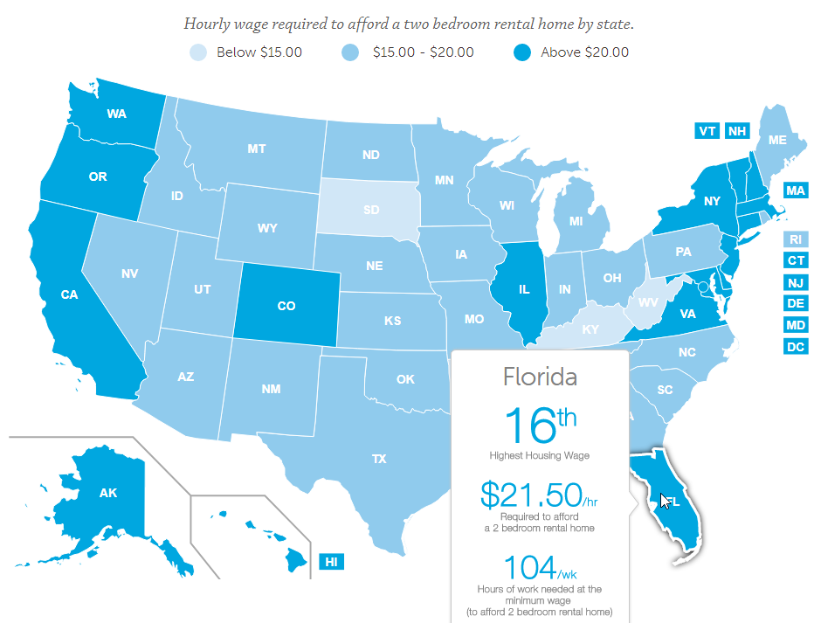
Rents outpace wages for many occupations.
Source: National Low Income Housing Coalition, Out of Reach 2018

Slide 7
Rents outpace wages for many occupations.
Affordable Rents for Median-Wage Workers vs. 2-Bedroom Fair Market Rent, Florida, 2017
Sources: Florida Agency for Workforce Innovation, 2017 Occupational Employment Statistics and Wages; U.S. Department of Housing and Urban Development, 2017 Fair Market Rents; U.S. Social Security Administration. Maximum rent is 30% of monthly salary.

Slide 8
The Affordable Housing Continuum
Supportive Housing (affordable units + services)
Homeless
Affordable rental housing
Public housing
Subsidized (Florida Housing, HUD, USDA)
Affordable home ownership
Shared equity (e.g. community land trust)
Down payment assistance
Older adults
People with disabilities
Other special needs
NOAH (Naturally Occurring Affordable Housing)
Low-interest loans
Affordable construction
Home rehab and weatherization
Vouchers

Slide 9
What counties and cities do: Make the rules
Land use and zoning
Reduce regulatory barriers (e.g. density, setbacks, parking)
Inclusionary zoning
Key department: Planning/Growth Management
Key documents: comprehensive plan, Local Housing Assistance Plan (LHAP)
Supportive Housing
Affordable rental
Affordable home ownership

Slide 10
What counties and cities do: Spend the $
Federal pass-through
State housing trust fund (“Sadowski” funds)
SHIP: State Housing Initiatives Partnership
Raise local funds through taxes or special fees
Key department: Housing
Key document: LHAP
Supportive Housing
Affordable rental
Affordable home ownership

Slide 11
What counties and cities do: Provide the housing
Public housing
Other affordable rental
Key department: Public Housing Authority
Supportive Housing
Affordable rental
Affordable home ownership

Slide 12
Suggested interview questions
Are you hearing from community members that the lack of affordable housing is a problem? From employers? Others?
How is your county addressing each segment of the continuum? What would you do if you had more funding?
Does the county raise and spend its own funds for affordable housing? If not, is it considering doing so?
Is there a model housing development or policy in your county that you’d like to share with others?

Slide 13
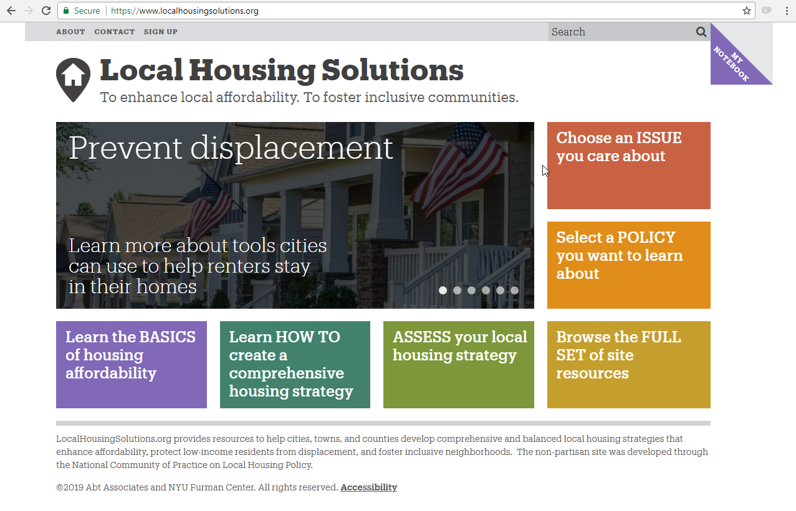
Localhousingsolutions.org: learn about local housing policies

Slide 14
Contact
Anne Ray
352-273-1195  aray@ufl.edu
Main site: http://www.shimberg.ufl.edu
Data clearinghouse: http://flhousing.data.shimberg.ufl.edu

