Slide 1


Connecting the Dots Between Housing and Health
Shimberg Center for Housing Studies
October 17, 2018

Slide 2
Healthy Housing
“Healthy housing” is a home where the physical, mental, and socioeconomic environment supports household members in making healthy choices, achieving educational and economic success, and engaging in robust social and cultural networks.
It is housing in a neighborhood connected to good employment and business opportunities in the region. It is a home free from toxins and threats from the built environment such as unsafe streets, violence, poor air quality, industrial chemical exposures, allergens, mold, or pests.
It does not impose cost burdens that divert household income away from healthy food, medical care, or educational opportunities. It is located in healthy and well-resourced neighborhoods.”
Healthy Communities of Opportunity: An Equity Blueprint to Address America’s Housing Challenges. Policy Link and the Kresge Foundation, 2016

Slide 3

5 Important Elements of Housing
New understanding of the interplay of housing factors influencing health
Affordability
Stability
Quality
Location and Portal
for healthcare delivery
Tailored to the needs of
vulnerable populations

Slide 4

What happens when a household cannot afford housing
They spend more than is affordable & become “housing cost burdened”
  17.6 million households spend more than 50% of income on housing costs
They cut back on essentials such as food, health care, educational enrichment
Rent Eats First

Slide 5
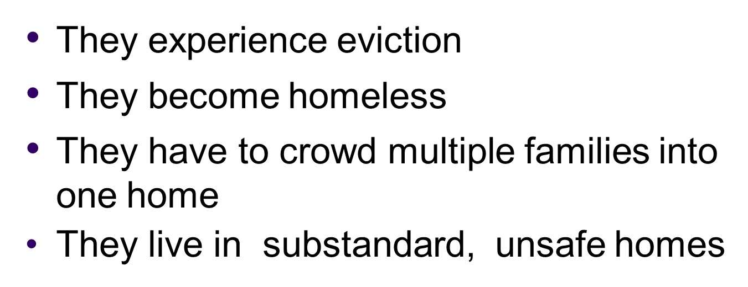

What happens when a household cannot afford housing

Slide 6
Impacts of moving into affordable housing

Slide 7


Stability: The Housing Iceberg
HOMELESS
HIDDEN HOMELESS:
HOUSING INSECURE
overcrowded
multiple moves
behind on rent
UNAFFORDABLE HOUSING

Slide 8
Housing and Child Health
How housing influences child health
  Quality
  Stability
  Affordability
How child homelessness contributes to health care spending
How affordable housing reduces infant hospitalizations

Slide 9
Evidence on Housing Quality
Accidents/Injuries – exposed wiring, needed repairs
Development and worsening asthma, allergies tied - specific housing conditions
  Pests (cockroaches and mice)
  Molds/Chronic Dampness
  Tobacco smoke
Lead exposure tied to long term effects
Anemia, developmental delay, aggression, attention deficit

Slide 10
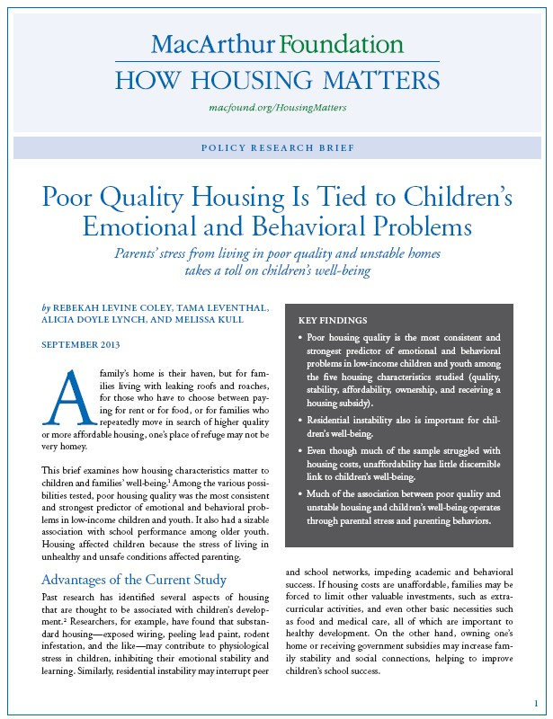
Evidence on Housing Quality
Poor housing quality strongest predictor of emotional and behavioral problems in low-income children
Much of association between poor housing quality and children’s wellbeing operates through parental stress and parenting behaviors

Slide 11
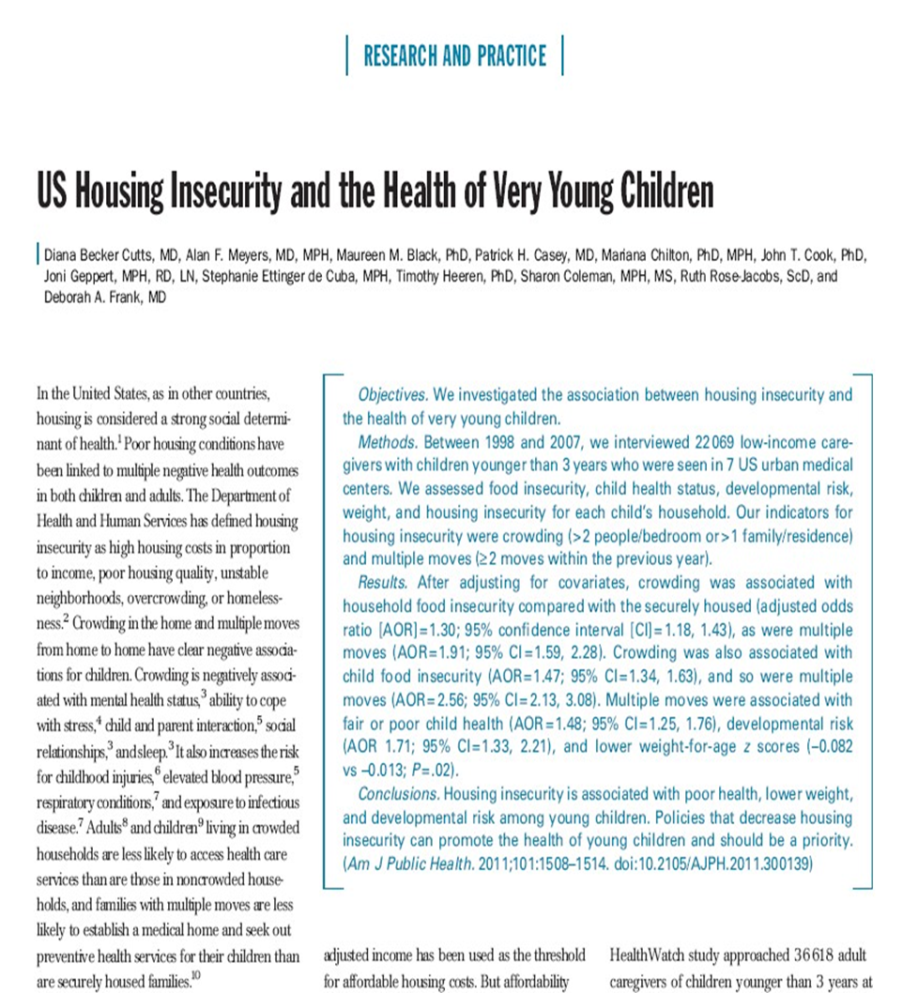
Children in housing-insecure families more likely to be
Food insecure
In fair/poor health
At risk for developmental delays
Seriously underweight
(compared to children in housing-secure families)

Slide 12
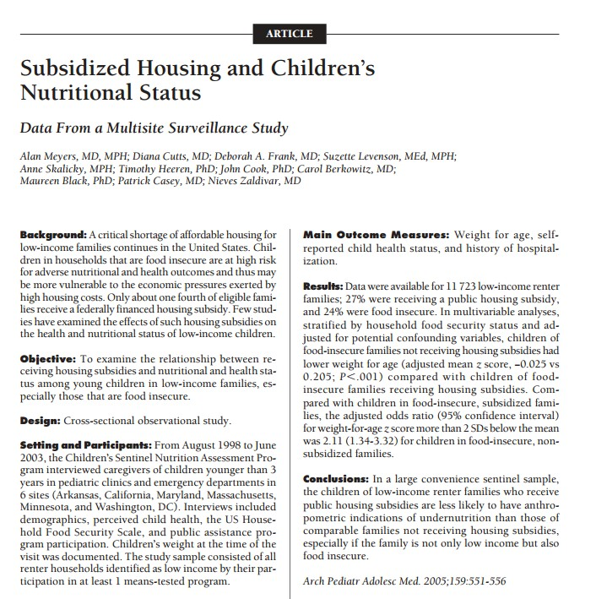
Even after controlling for food insecurity, children living in subsidized housing had healthier weights for their age, while those in food-insecure families without a subsidy were more likely to be seriously underweight.

Slide 13
Homelessness: does timing matter?
Yes!
Comparison - birth outcomes
  Consistently housed
  Homeless prenatally
  Homeless postnatally
Mothers’ characteristics or homelessness itself?
Prenatal homeless – increased
risk of
  Low birthweight
  Preterm delivery
  Lower weight at birth

Slide 14
Child Homelessness Contributes to High Health Care Spending
In 2014 an estimated 671,000 children age four or under had been homeless at some point or were born to a mother who was homeless when she was pregnant
These children, as a group, experienced 18,600 additional hospitalizations attributable to their experience of homelessness
The estimated total annual cost of hospitalizations attributable to homelessness among children age four and under in 2015 alone were over $238 million nationally, with more than half of those costs associated with hospitalizations of infants under the age of one

Slide 15
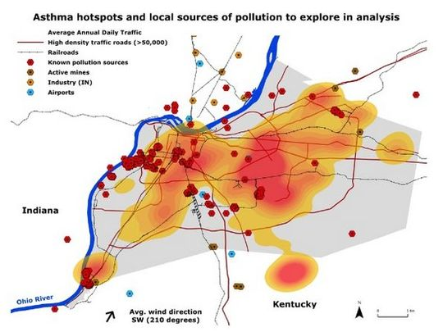

Slide 16

Housing Portal: Home Health Care

Slide 17
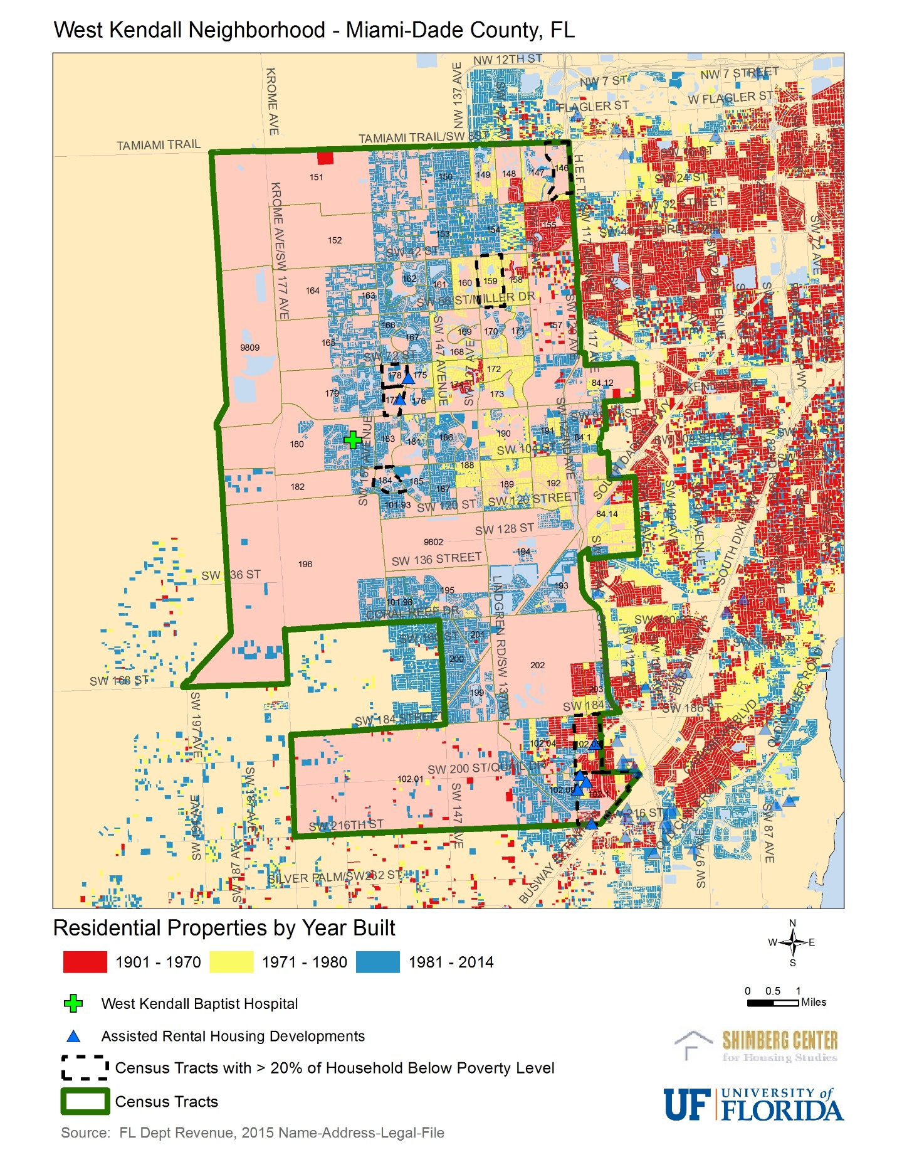
West Kendall Baptist Hospital – service area

Slide 18
Assisted/Subsidized Housing Tenant and Unit/Property Data: HUD Section 8, Housing Choice Vouchers, Public Housing and Low-income Housing Tax Credits
Basic fields:
Date of admission or move-in
Disability
Race/Ethnicity
Age of Household members
Household Size
Address
Number of bedrooms
Structure type
Income
Tenant-paid rent
Rental assistance amount
Utility allowance
Geography and Time Series:
Florida – HUD and LIHTC tenant and property characteristics at the household/unit/property level
  HUD 2000 - 2017
  LIHTC 2007 - 2017
U.S. – HUD tenant and property characteristics at the household/unit/property level
  HUD 2000 - 2017
Property location – generally parcel level

