Slide 1
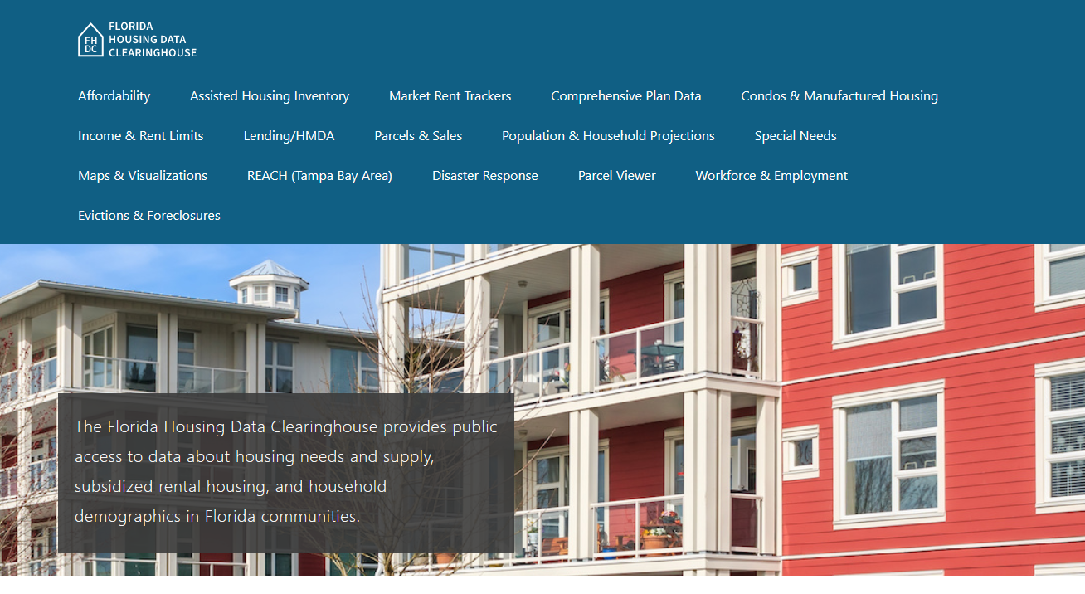

Indian River County Housing Trends
Shimberg Center for Housing Studies
June 2024

Slide 2
Historically, the median home price in Indian River County has closely tracked the statewide median. Prices at both the county and state level are now above their mid-2000s peak.
Florida
Indian River County
Median Single Family Home Sale Price, Indian River County & Florida, 2003-2023 (2023$)
Source: Shimberg Center analysis of Florida Department of Revenue, Sales Data Files. All values in 2023 dollars to correct for inflation.

Slide 3
Affordable Housing Terminology
  Housing is usually considered to be affordable if it costs no more than 30% of household income.
  Cost burdened: Paying more than 30% of income for owner or renter costs
  Severely cost burdened: Paying more than 50% of income
  Area median income (AMI): Used to create standard income measures across places and household sizes, expressed as % AMI

Slide 4
Example: 2024 Indian River County Income (% AMI) and Housing Cost Limits
Income level | Annual income range (1-4 person household) | Hourly wage, 1 full-time job | Hourly wage, 2 full-time jobs | Max. affordable monthly housing cost (1-3 bedroom unit)
50% AMI | $29,850-$42,600 | $14-$20 | - | $799-$1,108
80% AMI | $47,760-$68,160 | $23-$33 | $13-$17 | $1,279-$1,773
120% AMI | $71,640-$102,240 | $34-$49 | $19-$25 | $1,918-$2,659
http://flhousingdata.shimberg.ufl.edu/income-and-rent-limits

Slide 5
Very low-income homeowners make up the largest group of cost-burdened households in Indian River County.
Cost Burdened Households by Income as a Percentage of Area Median Income (AMI), Indian River County, 2022
Source: Shimberg Center tabulation of U.S. Census Bureau, 2022 American Community Survey
Note: Red/Underlined numbers indicate value that is not statistically significant

Slide 6
Housing costs outpace wages for many occupations.
Indian River County housing wage: $24.31/hour
A full-time worker would need to earn this amount to rent a typical 2BR apartment (HUD Fair Market Rent 2023: $1,264/mo).
Median wage for Indian River County, 2023: $19.28/hour. A full-time, year-round worker with this wage can afford $1,003 in rent.
Sources: National Low Income Housing Coalition, Out of Reach; Shimberg Center tabulation of Florida Department of Economic Opportunity, Occupational Employment and Wage Statistics

Slide 7
How much can workers afford to pay for housing each month?
$600-799
$800-999
$1,000-1,200
Auto Techs and Mechanics
Construction Laborers
Bartenders
Carpenters
Child, Family, and School Social Workers
Dental Assistants
Heavy and Tractor-Trailer Truck Drivers
Median, All Occupations
Cashiers
Childcare Workers
Dishwashers
Farmworkers
Fast Food and Counter Workers
Hairdressers
Home Health and Personal Care Aides
Hotel, Motel, and Resort Desk Clerks
Janitors and Cleaners
Maids and Housekeeping Cleaners
Preschool Teachers
Retail Salespersons
Security Guards
Substitute Teachers
Waitstaff
Restaurant Cooks
Customer Service Reps
Firefighters
Food Preparation Workers
Landscaping and Groundskeeping Workers
Light Truck Drivers
Medical Assistants
Nursing Assistants
Office Clerks
Painters
Pharmacy Techs
Receptionists
Secretaries and Administrative Assistants
Tellers
Source: Shimberg Center tabulation of Florida Department of Economic Security, Occupational Employment Statistics and Wages. Based on median wage for occupations in Indian River County. Assumes full-time worker, 30% of income spent on housing costs.

Slide 8
Eviction & foreclosure filings fell sharply in Q2 2020 during the state moratorium, then increased when filings were permitted again. Eviction filings have been volatile but generally have risen, while foreclosure filings have increased to near pre-pandemic levels.
Eviction & Foreclosure Filings, Indian River County
Source: Shimberg Center tabulation of filing data from Florida Clerks & Comptrollers and Office of the State Courts Administrator.

Slide 9
Building a Local Housing System: The Affordable Housing Continuum
Supportive Housing (affordable units + services)
Homeless
Affordable rental housing
Public housing
Subsidized (Florida Housing, HUD, USDA)
Affordable home ownership
Shared equity (e.g. community land trust)
Down payment assistance
Older adults
People with disabilities
Other special needs
NOAH (Naturally Occurring Affordable Housing)
Low-interest loans
Affordable construction
Home rehab and weatherization
Vouchers

Slide 10
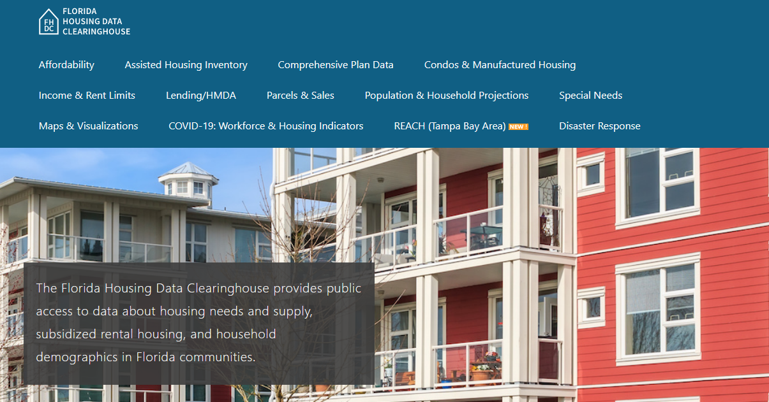
Contact
Shimberg Center for Housing Studies
352-273-1192
aray@ufl.edu
Main site: http://www.shimberg.ufl.edu
Data clearinghouse: http://flhousing.data.shimberg.ufl.edu

