Slide 1
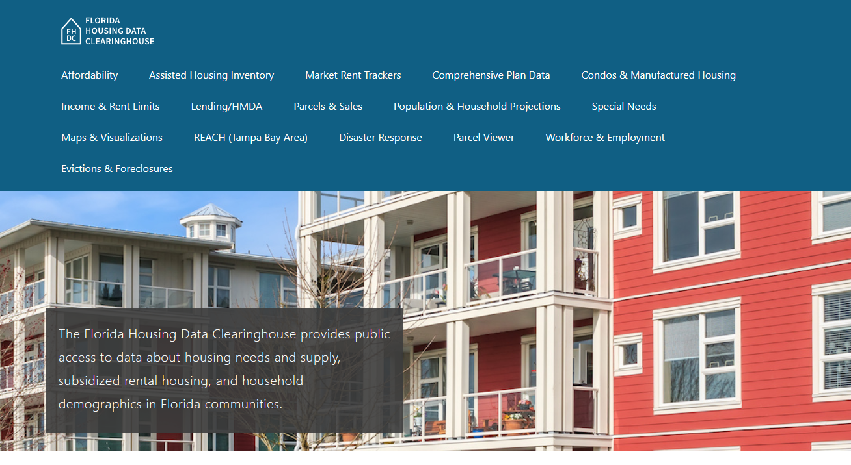
Lake County Housing Trends
Shimberg Center for Housing Studies
June 2024

Slide 2
Lake County home prices closely tracked statewide trends during the mid-2000s housing boom. While not as high as the current statewide median, the county median price is nearing its mid-2000s peak once again.
Florida
Lake County
Median Single Family Home Sale Price, Lake County & Florida, 2003-2023 (2023$)
Source: Shimberg Center analysis of Florida Department of Revenue, Sales Data Files. All values in 2023 dollars to correct for inflation.

Slide 3
Affordable Housing Terminology
Housing is usually considered to be affordable if it costs no more than 30% of household income.
Cost burdened: Paying more than 30% of income for owner or renter costs
Severely cost burdened: Paying more than 50% of income
Area median income (AMI): Used to create standard income measures across places and household sizes, expressed as % AMI

Slide 4
2024 Lake County Income (% AMI) and Housing Cost Limits
Income level | Annual income range (1-4 person household) | Hourly wage, 1 full-time job | Hourly wage, 2 full-time jobs | Max. affordable monthly housing cost (1-3 bedroom unit)
50% AMI | $33,800-$48,250 | $16-$23 | $12 | $905-$1,255
80% AMI | $54,080-$77,200 | $26-$37 | $15-$19 | $1,448-$2,008
120% AMI | $81,120-$115,800 | $39-$56 | $22-$28 | $2,172-$3,012
http://flhousingdata.shimberg.ufl.edu/income-and-rent-limits

Slide 5
Very low-income owners and renters make up the largest groups of cost-burdened households in Lake County.
Cost Burdened Households by Income as a Percentage of Area Median Income (AMI), Lake County, 2022
Source: Shimberg Center tabulation of U.S. Census Bureau, 2022 American Community Survey

Slide 6
Housing costs outpace wages for many occupations.
Lake County housing wage: $31.08/hour
A full-time worker would need to earn this amount to rent a typical 2BR apartment (HUD Fair Market Rent 2023: $1,616/mo).
Median wage for Lake County, 2023: $19.84/hour. A full-time, year-round worker with this wage can afford $1,032 in rent.
Sources: National Low Income Housing Coalition, Out of Reach; Shimberg Center tabulation of Florida Department of Economic Opportunity, Occupational Employment and Wage Statistics

Slide 7
How much can workers afford to pay for housing each month?
$600-799
$800-999
$1,000-1,200
Bus Drivers
Construction Laborers
Bartenders
Correctional Officers
Dental Assistants
Light Truck Drivers
Median, All Occupations
Mental Health and Substance Abuse Social Workers
Painters
Roofers
Cashiers
Childcare Workers
Dishwashers
Farmworkers
Fast Food and Counter Workers
Food Preparation Workers
Hairdressers
Home Health and Personal Care Aides
Janitors and Cleaners
Laundry and Dry-Cleaning Workers
Maids and Housekeeping Cleaners
Preschool Teachers
Retail Salespersons
Security Guards
Waitstaff
Restaurant Cooks
Customer Service Reps
Hotel, Motel, and Resort Desk Clerks
Landscaping and Groundskeeping Workers
Medical Assistants
Nursing Assistants
Office Clerks
Pharmacy Techs
Receptionists
Secretaries and Administrative Assistants
Tellers
Veterinary Techs
Source: Shimberg Center tabulation of Florida Department of Economic Security, Occupational Employment Statistics and Wages. Based on median wage for occupations in Orlando-Kissimmee-Sanford MSA. Assumes full-time worker, 30% of income spent on housing costs.

Slide 8
Eviction & foreclosure fell sharply in Q2 2020 during the state moratorium, then increased when filings were permitted again. Eviction filings have now risen above pre-pandemic levels, while foreclosure filings are nearing pre-pandemic levels.
Eviction & Foreclosure Filings, Lake County
Source: Shimberg Center tabulation of filing data from Florida Clerks & Comptrollers and Office of the State Courts Administrator.

Slide 9
Building a Local Housing System: The Affordable Housing Continuum
Supportive Housing (affordable units + services)
Homeless
Affordable rental housing
Public housing
Subsidized (Florida Housing, HUD, USDA)
Affordable home ownership
Shared equity (e.g. community land trust)
Down payment assistance
Older adults
People with disabilities
Other special needs
NOAH (Naturally Occurring Affordable Housing)
Low-interest loans
Affordable construction
Home rehab and weatherization
Vouchers

Slide 10
Contact
Shimberg Center for Housing Studies
352-273-1192
Main site: http://www.shimberg.ufl.edu
Data clearinghouse: http://flhousing.data.shimberg.ufl.edu

