Slide 1
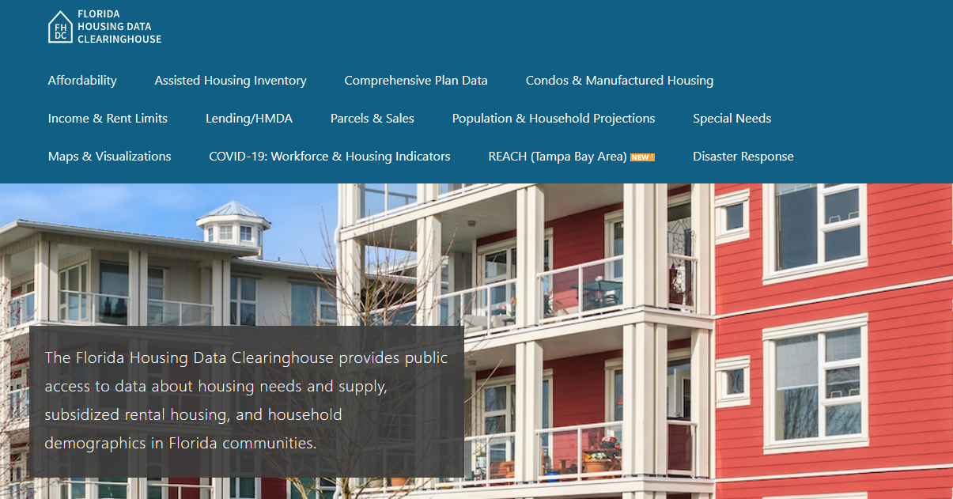
Manatee County Housing Trends
Shimberg Center for Housing Studies
June 2024

Slide 2
The median home price in Manatee County has consistently exceeded the statewide price. Home prices now exceed the height of the mid-2000s boom.
Manatee County
Florida
Median Single Family Home Sale Price, Manatee County & Florida, 2003-2023 (2023$)
Source: Shimberg Center analysis of Florida Department of Revenue, Sales Data Files. All values in 2023 dollars to correct for inflation.

Slide 3
Manatee County gained over 5,500 rental units between 2012 and 2022, but the county lost thousands of units renting for $1,200 or less.
Net increase 2012-2022: 5,529 rental units
$1,200+ units grew by over 14,000
Units at or below $1,200 fell by nearly 8,800
Units by Gross Rent Above/Below $1,200 (2022 $), Manatee County, 2012 & 2022
Source: Shimberg Center tabulation of U.S. Census Bureau, 2012 and 2022 American Community Survey. Year 2012 rents adjusted to 2022 dollars using Consumer Price Index.

Slide 4
Affordable Housing Terminology
Housing is usually considered to be affordable if it costs no more than 30% of household income.
Cost burdened: Paying more than 30% of income for owner or renter costs
Severely cost burdened: Paying more than 50% of income
Area median income (AMI): Used to create standard income measures across places and household sizes, expressed as % AMI

Slide 5
2024 Manatee County Income (% AMI) and Housing Cost Limits
Income level | Annual income range (1-4 person household) | Hourly wage, 1 full-time job | Hourly wage, 2 full-time jobs | Max. affordable monthly housing cost (1-3 bedroom unit)
50% AMI | $35,200-$50,250 | $17-$24 | $12 | $942-$1,306
80% AMI | $56,320-$80,400 | $27-$39 | $15-$20 | $1,508-$2,091
120% AMI | $84,480-$120,600 | $41-$58 | $23-$29 | $2,262-$3,136
http://flhousingdata.shimberg.ufl.edu/income-and-rent-limits

Slide 6
Very low-income renters and homeowners make up the largest group of cost-burdened households in Manatee County.
Cost Burdened Households by Income as a Percentage of Area Median Income (AMI), Manatee County, 2022
Source: Shimberg Center tabulation of U.S. Census Bureau, 2022 American Community Survey
Note: Red/Underlined numbers indicate values that are not statistically significant.

Slide 7
Housing costs outpace wages for many occupations.
Manatee County housing wage: $30.63/hour
A full-time worker would need to earn this amount to rent a typical 2BR apartment (HUD Fair Market Rent 2023: $1,593/mo).
Median wage for Manatee County, 2023: $20.08/hour. A full-time, year-round worker with this wage can afford $1,044 in rent.
Sources: National Low Income Housing Coalition, Out of Reach; Shimberg Center tabulation of Florida Department of Economic Opportunity, Occupational Employment and Wage Statistics

Slide 8
How much can workers afford to pay for housing each month?
$600-799
$800-999
$1,000-1,200
Bus Drivers
Construction Laborers
Bartenders
Child, Family, and School Social Workers
Dental Assistants
Median, All Occupations
Medical Assistants
Office Clerks
Secretaries and Administrative Assistants
Tellers
Cashiers
Childcare Workers
Dishwashers
Farmworkers
Fast Food and Counter Workers
Home Health and Personal Care Aides
Hotel, Motel, and Resort Desk Clerks
Janitors and Cleaners
Laundry and Dry-Cleaning Workers
Maids and Housekeeping Cleaners
Preschool Teachers
Retail Salespersons
Security Guards
Waitstaff
Restaurant Cooks
Customer Service Reps
Food Preparation Workers
Hairdressers
Landscaping and Groundskeeping Workers
Light Truck Drivers
Nursing Assistants
Painters
Pharmacy Techs
Receptionists
Substitute Teachers
Veterinary Techs
Source: Shimberg Center tabulation of Florida Department of Economic Security, Occupational Employment Statistics and Wages. Based on median wage for occupations in the North Port-Bradenton-Sarasota MSA. Assumes full-time worker, 30% of income spent on housing costs.

Slide 9
Eviction & foreclosure filings fell sharply in Q2 2020 during the state moratorium, then increased when filings were permitted again. Eviction filings have returned to pre-pandemic levels, while foreclosure filings are near previous levels.
Eviction & Foreclosure Filings, Manatee County
Source: Shimberg Center tabulation of filing data from Florida Clerks & Comptrollers and Office of the State Courts Administrator.

Slide 10
Building a Local Housing System: The Affordable Housing Continuum
Supportive Housing (affordable units + services)
Homeless
Affordable rental housing
Public housing
Subsidized (Florida Housing, HUD, USDA)
Affordable home ownership
Shared equity (e.g. community land trust)
Down payment assistance
Older adults
People with disabilities
Other special needs
NOAH (Naturally Occurring Affordable Housing)
Low-interest loans
Affordable construction
Home rehab and weatherization
Vouchers

Slide 11
Contact
Shimberg Center for Housing Studies
352-273-1192
aray@ufl.edu
Main site: http://www.shimberg.ufl.edu
Data clearinghouse: http://flhousing.data.shimberg.ufl.edu

