Slide 1
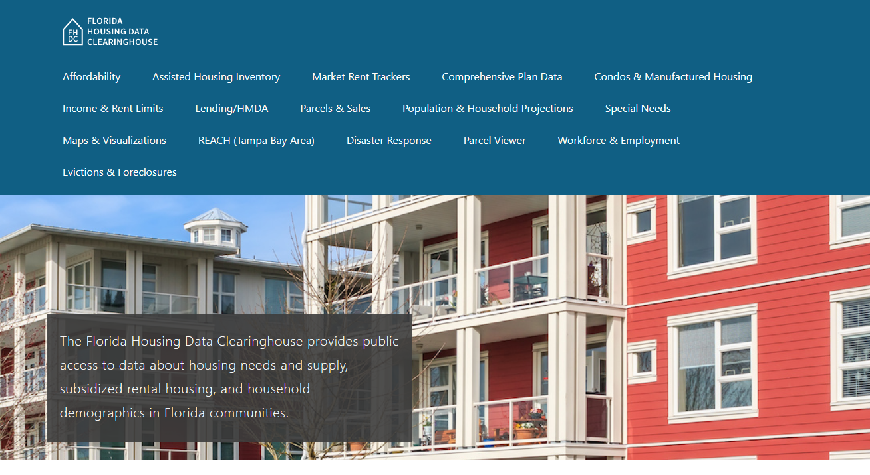
Marion County Housing Trends
Shimberg Center for Housing Studies
June 2024

Slide 2
Marion County offers relatively affordable home sale prices, but prices are approaching their mid-2000s peak level.
Florida
Marion County
Median Single Family Home Sale Price, Marion County & Florida, 2003-2022 (2023$)
Source: Shimberg Center analysis of Florida Department of Revenue, Sales Data Files. All values in 2023 dollars to correct for inflation.

Slide 3
Marion County’s rental supply stayed the same size between 2012 and 2022, but the county lost units renting for less than $1,200 and gained units renting for more than $1,200 (2022 $).
$1,200+ units grew by 4,900
Units for $1,200 or less fell by nearly 5,400
Units by Gross Rent Above/Below $1,200 (2022 $), Marion County, 2012 & 2022
Source: Shimberg Center tabulation of U.S. Census Bureau, 2012 Census and 2022 American Community Survey. Year 2012 rents adjusted to 2022 dollars using Consumer Price Index.

Slide 4
Affordable Housing Terminology
Housing is usually considered to be affordable if it costs no more than 30% of household income.
Cost burdened: Paying more than 30% of income for owner or renter costs
Severely cost burdened: Paying more than 50% of income
Area median income (AMI): Used to create standard income measures across places and household sizes, expressed as % AMI

Slide 5
2024 Marion County Income (% AMI) and Housing Cost Limits
Income level | Annual income range (1-4 person household) | Hourly wage, 1 full-time job | Hourly wage, 2 full-time jobs | Max. affordable monthly housing cost (1-3 bedroom unit)
50% AMI | $25,350-36,150 | $12-$17 | -- | $678-$940
80% AMI | $40,560-57,840 | $20-$28 | $12-$14 | $1,086-$1,504
120% AMI | $60,840-86,760 | $29-$42 | $15-$21 | $1,629-$2,256
http://flhousingdata.shimberg.ufl.edu/income-and-rent-limits/results?nid=4100

Slide 6
Very low-income homeowners and renters make up the largest groups of cost-burdened households in Marion County.
Cost Burdened Households by Income as a Percentage of Area Median Income (AMI), Marion County, 2022
Source: Shimberg Center tabulation of U.S. Census Bureau, 2022 American Community Survey

Slide 7
Housing costs outpace wages for many occupations.
Marion County housing wage: $21.75/hour
A full-time worker would need to earn this amount to rent a typical 2BR apartment (HUD Fair Market Rent 2023: $1,131/mo).
Median wage for Marion County, 2023: $18.50/hour. A full-time, year-round worker with this wage can afford $962 in rent.
Sources: National Low Income Housing Coalition, Out of Reach; Shimberg Center tabulation of Florida Department of Economic Opportunity, Occupational Employment and Wage Statistics

Slide 8
How much can workers afford to pay for housing each month?
$600-799
$800-999
$1,000-1,200
Auto Techs and Mechanics
Construction Laborers
Bartenders
Carpenters
Child, Family, and School Social Workers
Correctional Officers
Dental Assistants
Electricians
HVAC and Refrigeration Mechanics
Heavy and Tractor-Trailer Truck Drivers
Mental Health and Substance Abuse Social Workers
Paramedics
Plumbers, Pipefitters, and Steamfitters
Roofers
Tellers
Cashiers
Childcare Workers
Restaurant Cooks
Dishwashers
Food Preparation Workers
Hairdressers
Home Health and Personal Care Aides
Hotel, Motel, and Resort Desk Clerks
Janitors and Cleaners
Landscaping and Groundskeeping Workers
Laundry and Dry-Cleaning Workers
Maids and Housekeeping Cleaners
Preschool Teachers
Receptionists
Retail Salespersons
Security Guards
Waitstaff
Customer Service Reps
Light Truck Drivers
Median, All Occupations
Medical Assistants
Nursing Assistants
Office Clerks
Painters
Pharmacy Techs
Secretaries and Administrative Assistants
Substitute Teachers
Veterinary Techs
Fast Food and Counter Workers (<$600)
Source: Shimberg Center tabulation of Florida Department of Economic Security, Occupational Employment Statistics and Wages. Based on median wage for occupations in Marion County. Assumes full-time worker, 30% of income spent on housing costs.

Slide 9
Eviction & foreclosure filings fell when a statewide moratorium and household assistance were in place. Filings are now at or near historic levels.
Eviction & Foreclosure Filings, Marion County
Source: Shimberg Center tabulation of filing data from Florida Clerks & Comptrollers and Office of the State Courts Administrator.

Slide 10
Building a Local Housing System: The Affordable Housing Continuum
Supportive Housing (affordable units + services)
Homeless
Affordable rental housing
Public housing
Subsidized (Florida Housing, HUD, USDA)
Affordable home ownership
Shared equity (e.g. community land trust)
Down payment assistance
Older adults
People with disabilities
Other special needs
NOAH (Naturally Occurring Affordable Housing)
Low-interest loans
Affordable construction
Home rehab and weatherization
Vouchers

Slide 11
Contact
Shimberg Center for Housing Studies
352-273-1192
Main site: http://www.shimberg.ufl.edu
Data clearinghouse: http://flhousing.data.shimberg.ufl.edu

