Slide 1
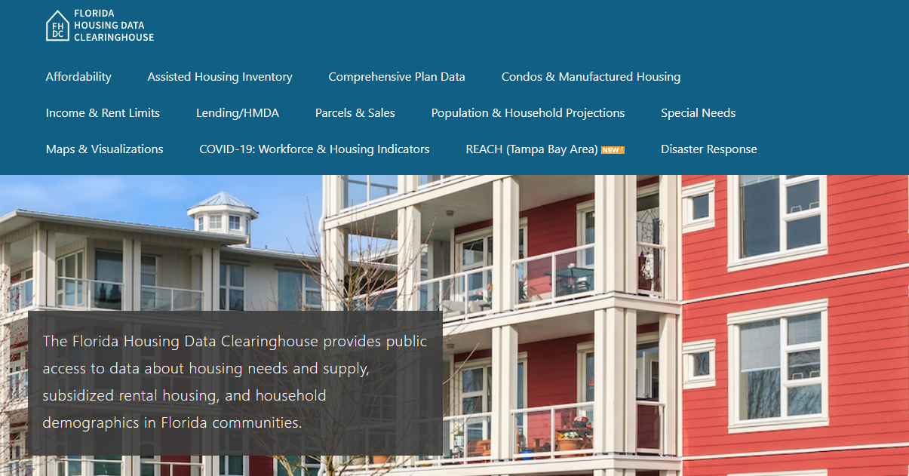
Martin County Housing Trends
Shimberg Center for Housing Studies
June 2024

Slide 2
Martin County home prices consistently exceed statewide prices. Even adjusted for inflation, home prices exceed mid-2000s boom era levels.
Martin County
Florida
Median Single Family Home Sale Price, Martin County & Florida, 2003-2023 (2023$)
Source: Shimberg Center analysis of Florida Department of Revenue, Sales Data Files. All values in 2023 dollars to correct for inflation.

Slide 3
Affordable Housing Terminology
Housing is usually considered to be affordable if it costs no more than 30% of household income.
Cost burdened: Paying more than 30% of income for owner or renter costs
Severely cost burdened: Paying more than 50% of income
Area median income (AMI): Used to create standard income measures across places and household sizes, expressed as % AMI

Slide 4
Example: 2024 Martin County Income (% AMI) and Housing Cost Limits
Income level | Annual income range (1-4 person household) | Hourly wage, 1 full-time job | Hourly wage, 2 full-time jobs | Max. affordable monthly housing cost (1-3 bedroom unit)
50% AMI | $32,100-$45,850 | $15-$22 | - | $860-$1,192
80% AMI | $51,360-$73,360 | $25-$35 | $14-$18 | $1,376-$1,908
120% AMI | $77,040-$110,040 | $37-$53 | $21-$27 | $2,064-$2,862
http://flhousingdata.shimberg.ufl.edu/income-and-rent-limits

Slide 5
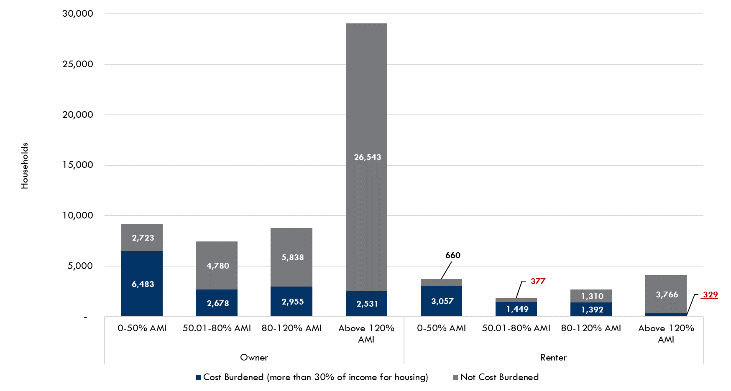
Very low-income homeowners make up the largest group of cost-burdened households in Martin County.
Cost Burdened Households by Income as a Percentage of Area Median Income (AMI), Martin County, 2022
Source: Shimberg Center tabulation of U.S. Census Bureau, 2022 American Community Survey. Values in red are not statistically significant.

Slide 6
Housing costs outpace wages for many occupations.
Martin County housing wage: $28.04/hour
A full-time worker would need to earn this amount to rent a typical 2BR apartment (HUD Fair Market Rent 2023: $1,458/mo).
Median wage for Martin County, 2023: $19.40/hour. A full-time, year-round worker with this wage can afford $1,009 in rent.
Sources: National Low Income Housing Coalition, Out of Reach; Shimberg Center tabulation of Florida Department of Economic Opportunity, Occupational Employment and Wage Statistics

Slide 7
How much can workers afford to pay for housing each month?
$600-799
$800-999
$1,000-1,200
Carpenters
Construction Laborers
Bartenders
Child, Family, and School Social Workers
Correctional Officers
Dental Assistants
Light Truck Drivers
Median, All Occupations
Mental Health and Substance Abuse Social Workers
Roofers
Cashiers
Childcare Workers
Dishwashers
Farmworkers
Fast Food and Counter Workers
Food Preparation Workers
Hairdressers
Home Health and Personal Care Aides
Hotel, Motel, and Resort Desk Clerks
Janitors and Cleaners
Laundry and Dry-Cleaning Workers
Maids and Housekeeping Cleaners
Preschool Teachers
Retail Salespersons
Security Guards
Waitstaff
Restaurant Cooks
Customer Service Reps
Landscaping and Groundskeeping Workers
Medical Assistants
Nursing Assistants
Office Clerks
Painters
Pharmacy Techs
Receptionists
Secretaries and Administrative Assistants
Substitute Teachers
Tellers
Veterinary Techs
Source: Shimberg Center tabulation of Florida Department of Economic Security, Occupational Employment Statistics and Wages. Based on median wage for occupations in Port St. Lucie MSA. Assumes full-time worker, 30% of income spent on housing costs.

Slide 8
Building a Local Housing System: The Affordable Housing Continuum
Supportive Housing (affordable units + services)
Homeless
Affordable rental housing
Public housing
Subsidized (Florida Housing, HUD, USDA)
Affordable home ownership
Shared equity (e.g. community land trust)
Down payment assistance
Older adults
People with disabilities
Other special needs
NOAH (Naturally Occurring Affordable Housing)
Low-interest loans
Affordable construction
Home rehab and weatherization
Vouchers

Slide 9
Contact
Shimberg Center for Housing Studies
352-273-1192
aray@ufl.edu
Main site: http://www.shimberg.ufl.edu
Data clearinghouse: http://flhousing.data.shimberg.ufl.edu

