Slide 1
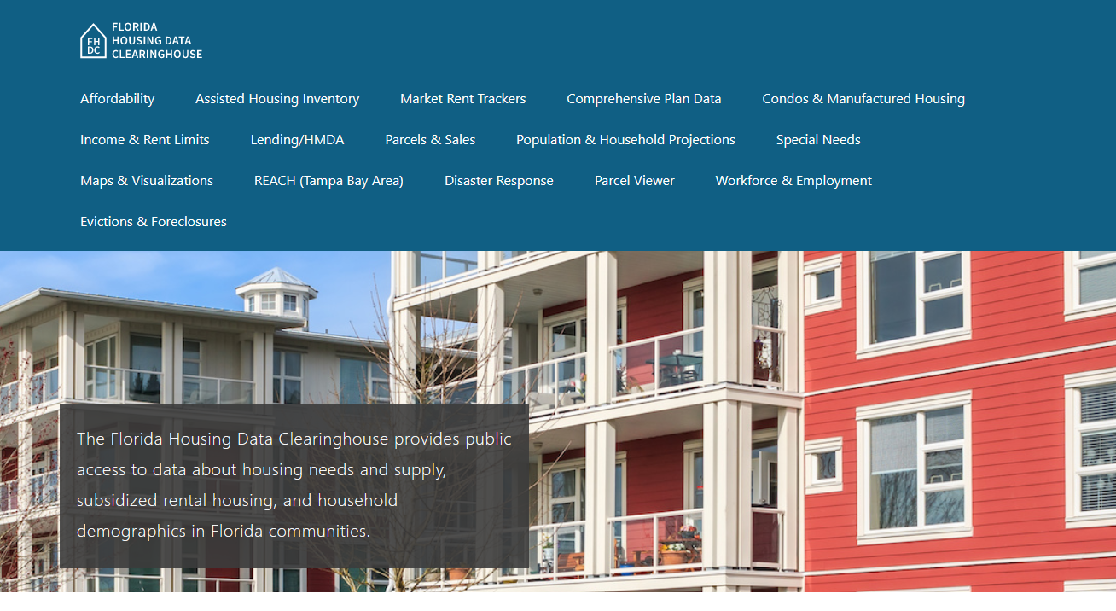
Miami-Dade County Housing Trends
Shimberg Center for Housing Studies
June 2024

Slide 2
Miami-Dade County’s median single family home price reached $585,000 in the first half of 2023, well above the mid-2000s housing boom price.
Miami-Dade County
Florida
Median Single Family Home Sale Price, Miami-Dade County & Florida, 2003-2023 (2023$)
Source: Shimberg Center analysis of Florida Department of Revenue, Sales Data Files. All values in 2022 dollars to correct for inflation.

Slide 3
Miami-Dade and Monroe Counties added more than 92,000 rental units 2012-2022, but the entire increase was in units renting for more than $1,200 (2022 $).
Net increase 2012-2022: 92,224 rental units
$1,200+ units grew by 128,000
Units at or below $1,200 fell by nearly 36,000
Units by Gross Rent Above/Below $1,200 (2022 $), Miami-Dade & Monroe Counties, 2012 & 2022
Source: Shimberg Center tabulation of U.S. Census Bureau, 2012 and 2022 American Community Survey. Year 2012 rents adjusted to 2022 dollars using Consumer Price Index.

Slide 4
Affordable Housing Terminology
Housing is usually considered to be affordable if it costs no more than 30% of household income.
Cost burdened: Paying more than 30% of income for owner or renter costs
Severely cost burdened: Paying more than 50% of income
Area median income (AMI): Used to create standard income measures across places and household sizes, expressed as % AMI

Slide 5
2024 Miami-Dade County Income (% AMI) and Housing Cost Limits
Income level | Annual income range (1-4 person household) | Hourly wage, 1 full-time job | Hourly wage, 2 full-time jobs | Max. affordable monthly housing cost (1-3 bedroom unit)
50% AMI | $39,750-56,750 | $19-$27 | $12-$14 | $1,064-$1,475
80% AMI | $63,600-90,800 | $31-$44 | $18-$22 | $1,703-$2,361
120% AMI | $95,400-136,200 | $46-$65 | $26-$33 | $2,554-$3,541
http://flhousingdata.shimberg.ufl.edu/income-and-rent-limits

Slide 6
Very low-income renters make up the largest group of cost-burdened households in Miami-Dade and Monroe Counties.
Cost Burdened Households by Income as a Percentage of Area Median Income (AMI), Miami-Dade and Monroe Counties, 2022
Source: Shimberg Center tabulation of U.S. Census Bureau, 2022 American Community Survey

Slide 7
Housing costs outpace wages for many occupations.
Miami-Dade County housing wage: $36.98/hour
A full-time worker would need to earn this amount to rent a typical 2BR apartment (HUD Fair Market Rent 2023: $1,923/mo).
Median wage for Miami-Dade County, 2023: $22.23/hour. A full-time, year-round worker with this wage can afford $1,156 in rent.
Sources: National Low Income Housing Coalition, Out of Reach; Shimberg Center tabulation of Florida Department of Economic Opportunity, Occupational Employment and Wage Statistics

Slide 8
How much can workers afford to pay for housing each month?
$600-799
$800-999
$1,000-1,200
Dental Assistants
Bus Drivers
Bartenders
Light Truck Drivers
Median, All Occupations
Painters
Secretaries and Administrative Assistants
Cashiers
Childcare Workers
Dishwashers
Farmworkers
Fast Food and Counter Workers
Hairdressers
Home Health and Personal Care Aides
Hotel, Motel, and Resort Desk Clerks
Janitors and Cleaners
Laundry and Dry-Cleaning Workers
Maids and Housekeeping Cleaners
Preschool Teachers
Retail Salespersons
Security Guards
Substitute Teachers
Waitstaff
Construction Laborers
Restaurant Cooks
Customer Service Reps
Food Preparation Workers
Landscaping and Groundskeeping Workers
Medical Assistants
Nursing Assistants
Office Clerks
Pharmacy Techs
Receptionists
Tellers
Veterinary Techs
Source: Shimberg Center tabulation of Florida Department of Economic Security, Occupational Employment Statistics and Wages. Based on median wage for occupations in the Miami-Fort Lauderdale-West Palm Beach MSA. Assumes full-time worker, 30% of income spent on housing costs.

Slide 9
Eviction & foreclosure filings fell sharply in Q2 2020 during state moratorium, then increased when filings were permitted again. Eviction filings have returned to pre-pandemic levels. Foreclosures increased in 2022-2023 but remain below historic levels.
Eviction & Foreclosure Filings, Miami-Dade County
Source: Shimberg Center tabulation of filing data from Florida Clerks & Comptrollers and Office of the State Courts Administrator.

Slide 10
Building a Local Housing System: The Affordable Housing Continuum
Supportive Housing (affordable units + services)
Homeless
Affordable rental housing
Public housing
Subsidized (Florida Housing, HUD, USDA)
Affordable home ownership
Shared equity (e.g. community land trust)
Down payment assistance
Older adults
People with disabilities
Other special needs
NOAH (Naturally Occurring Affordable Housing)
Low-interest loans
Affordable construction
Home rehab and weatherization
Vouchers

Slide 11
Contact
Shimberg Center for Housing Studies
352-273-1192
Main site: http://www.shimberg.ufl.edu
Data clearinghouse: http://flhousing.data.shimberg.ufl.edu

