Slide 1


Interagency Bankers Roundtable:
Northeast Florida’s Affordable Housing Needs
Anne Ray
June 27, 2017

Slide 2
Renting is on the rise.
2007-2015
The 7-county region LOST 16,036 owners and GAINED 45,190 renters.
+45,190
(+27%)
-16,036
(-4%)
Owners
Renters
Source: U.S. Census Bureau, 2007 & 2015 1-Year American Community Survey

Slide 3
Rents outpace wages for many occupations in the Jacksonville metro area
Affordable Rents for Median-Wage Workers vs. 2-Bedroom Fair Market Rent, Jacksonville MSA, 2016
Based on median wage for occupation. Maximum rent calculated as 30% of monthly salary; compared to HUD Fair Market Rent for 2-bedroom unit. Sources: Florida Agency for Workforce Innovation, 2016 Occupational Employment Statistics and Wages; U.S. Department of Housing and Urban Development, 2016 Fair Market Rents; U.S. Social Security Administration

Slide 4
Most low-income households are cost-burdened; few higher income households are. Renters below 50% AMI face the greatest needs.
Households by Tenure and Cost Burden Status (Paying >30% of Income for Housing Costs), 7-County Region, 2010-2014
Source: U.S. Department of Housing and Urban Development, 2000 and 2010-2014 Comprehensive Housing Affordability Strategy (CHAS) data. A “cost burdened” household pays more than 30 percent of income for housing costs, including utilities.

Slide 5
These patterns generally hold across the region. Cost burden is more prevalent for 50-80% AMI renters in more expensive counties (Flagler, St. Johns).
Households by Tenure and Cost Burden Status (Paying >30% of Income for Housing Costs) by County, 2010-2014
Source: U.S. Department of Housing and Urban Development, 2000 and 2010-2014 Comprehensive Housing Affordability Strategy (CHAS) data. A “cost burdened” household pays more than 30 percent of income for housing costs, including utilities. Baker County figures are unavailable because small sample size does not allow statistical significance.

Slide 6
The region had a net gain of 41,456 rental units since 2000, but a net loss of 21,760 units affordable at 50% AMI.
Rental Units by Affordability Level, 7-County Region, 2000 and 2010-2014
42%
21%
Source: U.S. Department of Housing and Urban Development, 2000 and 2010-2014 Comprehensive Housing Affordability Strategy (CHAS) data.

Slide 7
The share of rental units that are affordable at 50% AMI varies by county.
Rental Units by Affordability Level, Counties, 2010-2014
Source: U.S. Department of Housing and Urban Development, 2010-2014 Comprehensive Housing Affordability Strategy (CHAS) data.

Slide 8
NE FL’s sales price boom and bust were gentler than the state’s, but there are differences within the region.
Median Real Single Family Sale Price (2016 $), 7-County Region, 2000-2016 (partial)
Source: Florida Department of Revenue, Sales Data File

Slide 9
Clay and Flagler Counties track state changes.
Median Real Single Family Sale Price (2016 $), Clay/Flagler Counties, 2000-2016 (partial)
Source: Florida Department of Revenue, Sales Data File

Slide 10
St. Johns and Nassau Counties stay consistently higher.
Median Real Single Family Sale Price (2016 $), St. Johns/Nassau Counties, 2000-2016 (partial)
Source: Florida Department of Revenue, Sales Data File

Slide 11
Baker and Putnam Counties are consistently lower.
Median Real Single Family Sale Price (2016 $), Baker/Putnam Counties, 2000-2016 (partial)
Source: Florida Department of Revenue, Sales Data File

Slide 12
Duval County experienced less volatility.
Median Real Single Family Sale Price (2016 $) Duval County, 2000-2016 (partial)
Source: Florida Department of Revenue, Sales Data File

Slide 13
Sales under $200K to owners are far below pre-recession levels.
Single Family Home Sales by Price (2016 $) and Owner Status, 7-County Region, 2000-2015
Sales price breakpoint is $200,000 in 2016 dollars, Owner status is determined by homestead status of property in year following sale. Arms length, single family sales only.
Source: Florida Department of Revenue, Sales Data File

Slide 14
Least expensive market: Most Putnam County sales are still are below $200K.
Single Family Home Sales by Price (2016 $) and Owner Status, Putnam County, 2000-2015
Sales price breakpoint is $200,000 in 2016 dollars, Owner status is determined by homestead status of property in year following sale. Arms length, single family sales only.
Source: Florida Department of Revenue, Sales Data File

Slide 15
Most expensive: St. John’s County has had few affordable sales since market peak, but >$200K sales are returning.
Single Family Home Sales by Price (2016 $) and Owner Status, St. Johns County, 2000-2015
Sales price breakpoint is $200,000 in 2016 dollars, Owner status is determined by homestead status of property in year following sale. Arms length, single family sales only.
Source: Florida Department of Revenue, Sales Data File

Slide 16
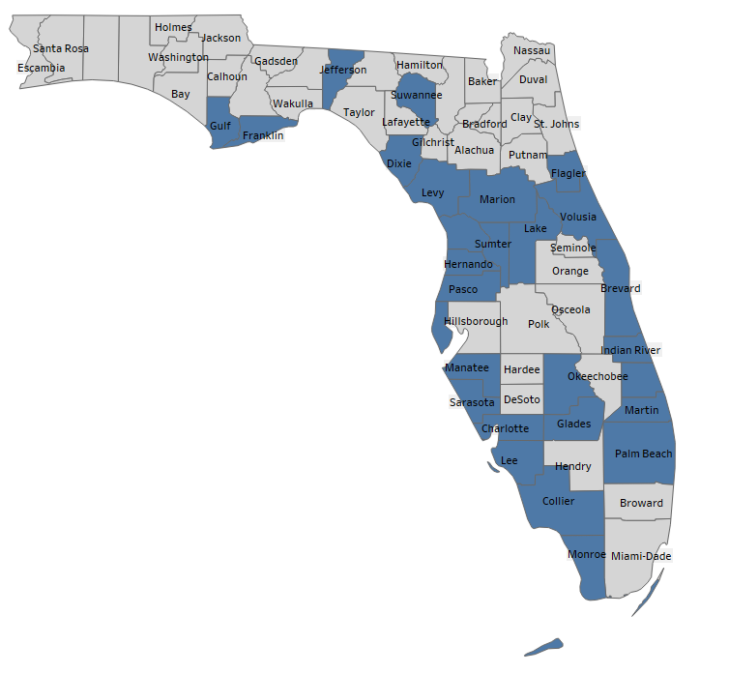
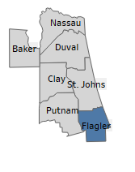
The senior population is growing in the state and region.
Counties with More Older Adults (65+) than Youth (0-19), 2010
Source: Estimates and projections by Shimberg Center, based on 2000 and 2010 U.S. Census data and population projections by the Bureau of Economic and Business Research, University of Florida

Slide 17
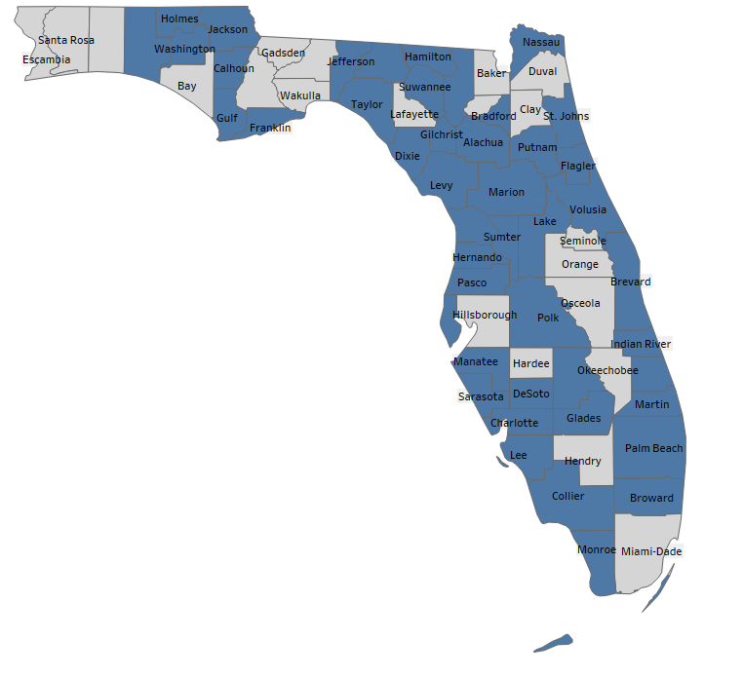
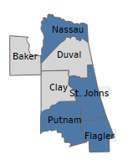
The senior population is growing in the state and region.
Counties with More Older Adults (65+) than Youth (0-19), 2020
Source: Estimates and projections by Shimberg Center, based on 2000 and 2010 U.S. Census data and population projections by the Bureau of Economic and Business Research, University of Florida

Slide 18
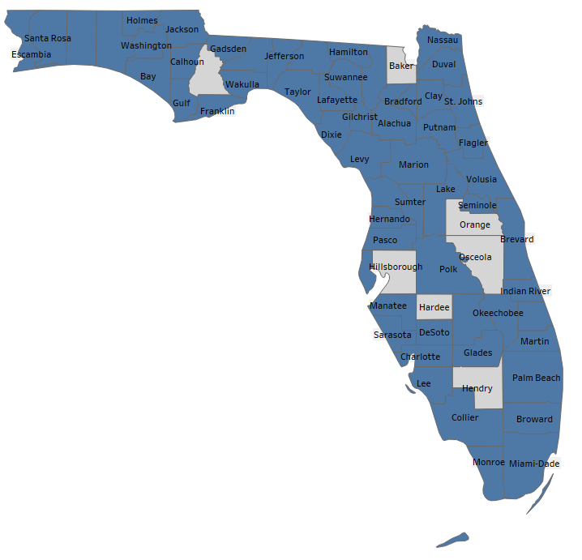
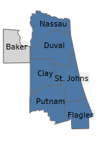
The senior population is growing in the state and region.
Counties with More Older Adults (65+) than Youth (0-19), 2030
Source: Estimates and projections by Shimberg Center, based on 2000 and 2010 U.S. Census data and population projections by the Bureau of Economic and Business Research, University of Florida

Slide 19
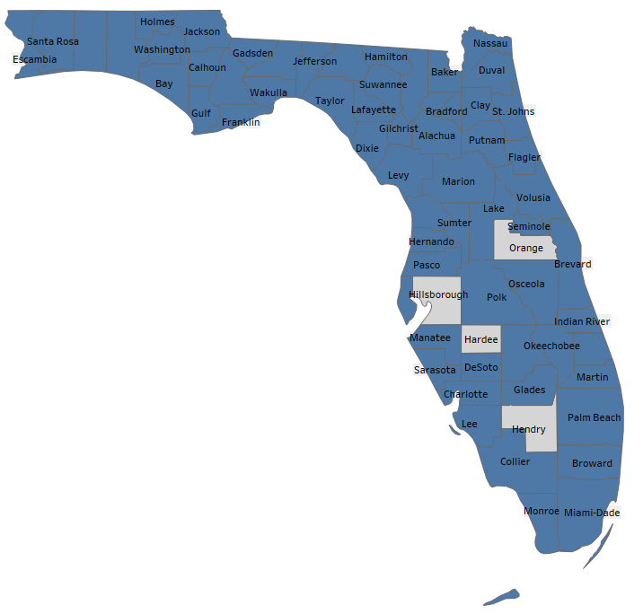
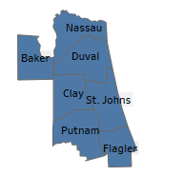
The senior population is growing in the state and region.
Counties with More Older Adults (65+) than Youth (0-19), 2040
Source: Estimates and projections by Shimberg Center, based on 2000 and 2010 U.S. Census data and population projections by the Bureau of Economic and Business Research, University of Florida

Slide 20
Links and Contact
Shimberg Center for Housing Studies
http://www.shimberg.ufl.edu
Florida Housing Data Clearinghouse
http://flhousingdata.shimberg.ufl.edu
2016 Rental Market Study
http://www.shimberg.ufl.edu/publications/Full_RMS_final_2016.pdf
Anne Ray
352-273-1195
aray@ufl.edu

