Slide 1
Contact
Interagency Metro Orlando Affordable Housing Bankers Roundtable
Anne Ray
July 24, 2019

Slide 2
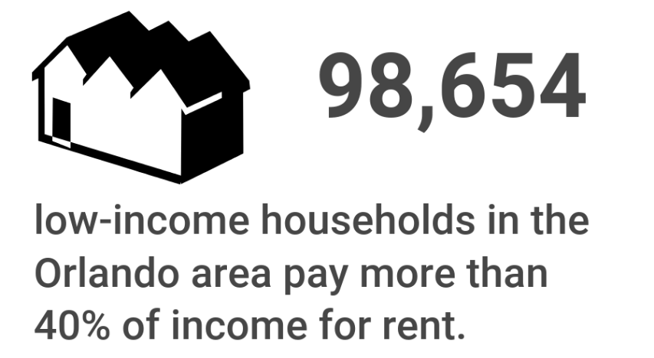
Low-income: below 60% area median income (AMI)
Cost burdened: paying more than 40% of income for rent
Excludes student-headed, non-family households

Slide 3
Renting has risen continually since 2000. Ownership fell during the recession but has rebounded.
Households by Tenure, Orange/Osceola/Seminole Counties, 2000-2017
65%
60%
Source: Shimberg Center analysis of U.S. Census Bureau, 2000 Census and 2000/2012/2017 American Community Survey.

Slide 4
Recent growth has come from age 55+ homeowners and renters of all ages.
Change in Households by Householder Age & Tenure, Orlando/Osceola/Seminole Counties, 2000 & 2017
Source: Shimberg Center analysis of U.S. Census Bureau, 2000 Census and 2017 American Community Survey

Slide 5
The Orlando area added over 104,000 rental units 2000-2017, mostly with rents above $1,000 (2017 $).
Units by Gross Rent Above/Below $1,000 (2017 $), Orange/Osceola/Seminole Counties, 2000 & 2017
In 2000, 44% of units rented for $1,000 or less.
In 2017, only 31% did.
Source: Shimberg Center analysis of U.S. Census Bureau, 2000 Census and 2017 American Community Survey. 2000 rents adjusted for inflation using Consumer Price Index.

Slide 6
More renters of all incomes are cost burdened, but most of the increase has been among low-income renters.
Cost Burdened Renters by Income (% AMI), Orange/Osceola/Seminole Counties, 2000 & 2019
The region added 59,266 low-income, cost burdened households 2000-2019.
Cost burden also rose for 60-80% AMI renters (12,629 added households)
Only 5% of cost burdened renters have incomes above 80% AMI
Sources: Shimberg Center analysis of U.S. Census Bureau, 2000 Census and 2013-2017 5-Year American Community Survey; University of Florida Bureau of Economic and Business Research, 2017 Population Projections

Slide 7
Renters at all income levels participate in the workforce.
Renter Households by Age/Disability, Work Status and Income (% AMI), Orange/Osceola/Seminole Counties, 2017
81% of renter households include at least one person employed outside the home.
Most of the rest are elder or disabled households.
Source: Shimberg Center analysis of U.S. Census Bureau, 2017 American Community Survey.

Slide 8
Service jobs are the most common occupations for Orlando area renters.
Top Ten Occupations for Renters, Orlando/Osceola/Seminole Counties, 2017
 | Median hourly wage
Customer service representatives | $14.36
Managers, all other | $47.66
Driver/sales workers and truck drivers | $11.10-19.27
Maids and housekeeping cleaners | $10.63
Retail salespersons | $10.24
Janitors and building cleaners | $10.76
First-line supervisors of retail sales workers | $19.61
Cashiers | $9.77
Waiters and waitresses | $11.44
Cooks | $9.95-12.71
Sources: Shimberg Center analysis of U.S. Census Bureau, 2017 American Community Survey and Florida Department of Economic Opportunity, 2017 Occupational Employment Statistics and Wages

Slide 9
Subsidized Rental Housing Supply
274 developments in Orange/Osceola/Seminole Counties
43,286 affordable units ($1/7$ of Florida’s supply)
Funded by HUD, Florida Housing Finance Corporation, USDA Rural Development, and local housing finance authorities
Tenant characteristics:
Average income: $24,297
57% of households include children
20% of households include member age 62+

Slide 10
Preservation Risks: Expiring Subsidies
Subsidized Units by Expiration Year, Orange/Osceola/Seminole Counties, 2012-2030
7,041 affordable units are at risk of subsidy expiration between 2020 and 2030
¼ of state’s at-risk units
Sources: Shimberg Center for Housing Studies, Assisted Housing Inventory

Slide 11
Building a Local Housing System: The Affordable Housing Continuum
Supportive Housing (affordable units + services)
Homeless
Affordable rental housing
Public housing
Subsidized (Florida Housing, HUD, USDA)
Affordable home ownership
Shared equity (e.g. community land trust)
Down payment assistance
Older adults
People with disabilities
Other special needs
NOAH (Naturally Occurring Affordable Housing)
Low-interest loans
Affordable construction
Home rehab and weatherization
Vouchers

Slide 12
Contact
Contact: Anne Ray
352-273-1195  aray@ufl.edu
Main site: http://www.shimberg.ufl.edu
Data clearinghouse: http://flhousing.data.shimberg.ufl.edu

