Slide 1
An Interagency Forum:
Rural and Affordable Housing Opportunities in North Florida
Anne Ray
August 29, 2017

Slide 2
Renting is on the rise.
2007-2015
The 7-county region LOST 16,036 owners and GAINED 45,190 renters.
+45,190
(+27%)
-16,036
(-4%)
Owners
Renters
Source: U.S. Census Bureau, 2007 & 2015 1-Year American Community Survey

Slide 3
Rents outpace wages for many occupations in NW Florida.
Affordable Rents for Median-Wage Workers vs. 2-Bedroom Fair Market Rent, Panama City-Lynn Haven MSA, 2016
Based on median wage for occupation. Maximum rent calculated as 30% of monthly salary; compared to HUD Fair Market Rent for 2-bedroom unit. Sources: Florida Agency for Workforce Innovation, 2016 Occupational Employment Statistics and Wages; U.S. Department of Housing and Urban Development, 2016 Fair Market Rents; U.S. Social Security Administration

Slide 4
Most low-income households are cost-burdened; few higher income households are. Renters below 60% AMI face the greatest needs.
Households by Tenure and Cost Burden Status (Paying >30% of Income for Housing Costs), 16-County Region, 2015
Source: U.S. Census Bureau, 2015 American Community Survey 1-Year Public Use Microdata Sample (PUMS).

Slide 5
These patterns generally hold across the region. A larger share of renters above 60% AMI are cost burdened in most of the counties in the western half of the region.
Households by Tenure and Cost Burden Status (Paying >30% of Income for Housing Costs) by Subregion, 2015
Source: U.S. Census Bureau, 2015 American Community Survey 1-Year Public Use Microdata Sample (PUMS).

Slide 6
The region had a net gain of 41,456 rental units since 2000, but a net loss of 21,760 units affordable at 50% AMI.
Rental Units by Affordability Level, 7-County Region, 2000 and 2010-2014
42%
21%
Source: U.S. Department of Housing and Urban Development, 2000 and 2010-2014 Comprehensive Housing Affordability Strategy (CHAS) data.

Slide 7
The share of rental units that are affordable at 60% AMI varies by county.
Rental Units by Affordability Level, Subregions, 2015
31%
68%
44%
Source: U.S. Census Bureau, 2015 American Community Survey 1-Year Public Use Microdata Sample (PUMS).

Slide 8
NW FL’s sales price rise and fall was gentler than the state’s, but there are large differences within the region.
Median Real Single Family Sale Price (2016 $), Statewide and 15-County Region, 2000-2016 (partial)
Source: Florida Department of Revenue, Sales Data File

Slide 9
Prices in rural counties remained well below the regional median.
Median Real Single Family Sale Price (2016 $), Calhoun/Holmes/Jackson/Liberty/Washington Counties, 2000-2016 (partial)
Source: Florida Department of Revenue, Sales Data File

Slide 10
Leon County closely tracked regional prices, while Gadsden and Wakulla Counties had similar or lower median prices.
Median Real Single Family Sale Price (2016 $), Gadsden/Leon/Wakulla Counties, 2000-2016 (partial)
Source: Florida Department of Revenue, Sales Data File

Slide 11
Franklin and Walton Counties had consistently higher prices than the region, and higher peaks during the housing boom. Gulf also often exceeded the regional median.
Median Real Single Family Sale Price (2016 $), Franklin/Gulf/Walton Counties, 2000-2016 (partial)
Source: Florida Department of Revenue, Sales Data File

Slide 12
Other coastal counties were less volatile during the boom/bust, but they also generally have had higher prices than the regional median.
Median Real Single Family Sale Price (2016 $) Bay/Escambia/Okaloosa/Santa Rosa Counties, 2000-2016 (partial)
Source: Florida Department of Revenue, Sales Data File

Slide 13
Sales under $200K to owners are far below pre-recession levels.
Single Family Home Sales by Price (2016 $) and Owner Status, 15-County Region, 2000-2015
Sales price breakpoint is $200,000 in 2016 dollars, Owner status is determined by homestead status of property in year following sale. Arms length, single family sales only.
Source: Florida Department of Revenue, Sales Data File

Slide 14
In coastal counties, sales under $200K became much less common post-boom.
Single Family Home Sales by Price (2016 $) and Owner Status, Bay/Escambia/Franklin/Gulf/Okaloosa/Santa Rosa/Walton Counties, 2000-2015
Sales price breakpoint is $200,000 in 2016 dollars, Owner status is determined by homestead status of property in year following sale. Arms length, single family sales only.
Source: Florida Department of Revenue, Sales Data File

Slide 15
In rural counties, nearly all sales have been below $200K, but many are to investors/2nd home buyers.
Single Family Home Sales by Price (2016 $) and Owner Status, Calhoun/Holmes/Jackson/Liberty/Washington Counties, 2000-2015
Sales price breakpoint is $200,000 in 2016 dollars, Owner status is determined by homestead status of property in year following sale. Arms length, single family sales only.
Source: Florida Department of Revenue, Sales Data File

Slide 16
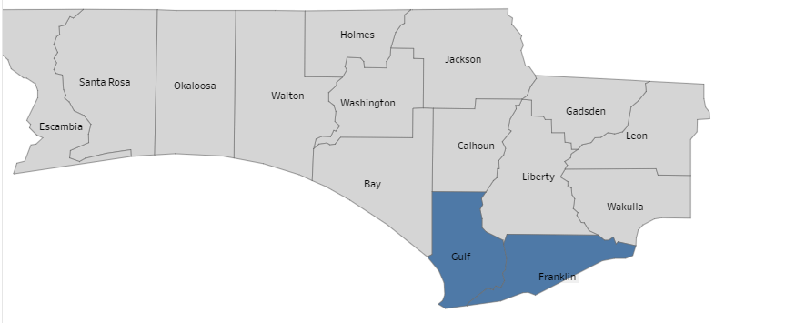
The senior population is growing in the region.
Counties with More Older Adults (65+) than Youth (0-19), 2010
Source: Estimates and projections by Shimberg Center, based on 2000 and 2010 U.S. Census data and population projections by the Bureau of Economic and Business Research, University of Florida

Slide 17
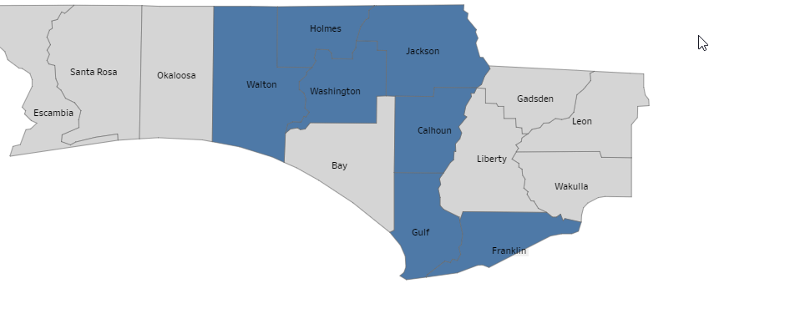
The senior population is growing in the region.
Counties with More Older Adults (65+) than Youth (0-19), 2020
Source: Estimates and projections by Shimberg Center, based on 2000 and 2010 U.S. Census data and population projections by the Bureau of Economic and Business Research, University of Florida

Slide 18
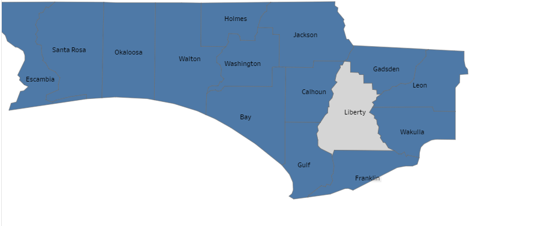
The senior population is growing in the region.
Counties with More Older Adults (65+) than Youth (0-19), 2030
Source: Estimates and projections by Shimberg Center, based on 2000 and 2010 U.S. Census data and population projections by the Bureau of Economic and Business Research, University of Florida

Slide 19
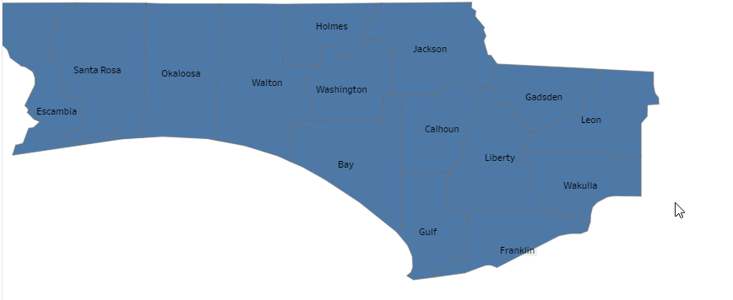
The senior population is growing in the region.
Counties with More Older Adults (65+) than Youth (0-19), 2040
Source: Estimates and projections by Shimberg Center, based on 2000 and 2010 U.S. Census data and population projections by the Bureau of Economic and Business Research, University of Florida

Slide 20
Links and Contact
Shimberg Center for Housing Studies
http://www.shimberg.ufl.edu
Florida Housing Data Clearinghouse
http://flhousingdata.shimberg.ufl.edu
2016 Rental Market Study
http://www.shimberg.ufl.edu/publications/Full_RMS_final_2016.pdf
Anne Ray
352-273-1195
aray@ufl.edu

