Slide 1
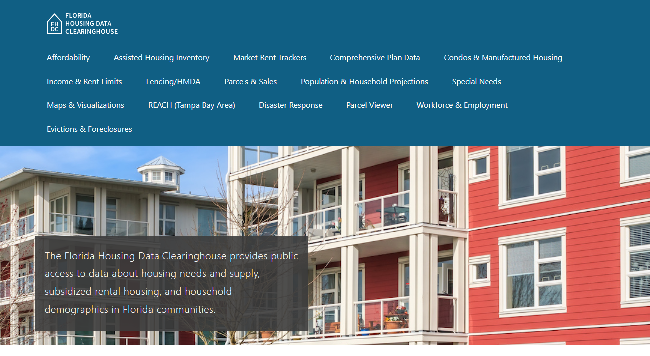
Pinellas County Housing Trends
Shimberg Center for Housing Studies
June 2024

Slide 2
Pinellas County single family home prices are well above mid-2000s boom-era levels.
Pinellas
County
Florida
Median Single Family Home Sale Price, St. Petersburg, Pinellas County & Florida, 2003-2023 (2023$)
Source: Shimberg Center analysis of Florida Department of Revenue, Sales Data Files. All values in 2023 dollars to correct for inflation.

Slide 3
Pinellas County lost nearly half of its units renting for $1,200 or less (2022 $) between 2012 and 2022.
Net decline in rental units, 2012-2021: 10,600
$1,200+ units grew by nearly 27,000
Units at or below $1,200 fell by over 37,000
Units by Gross Rent Above/Below $1,200 (2022 $), Pinellas County, 2012 & 2022
Source: Shimberg Center tabulation of U.S. Census Bureau, 2012 and 2022 American Community Survey. Year 2012 rents adjusted to 2022 dollars using Consumer Price Index.

Slide 4
Affordable Housing Terminology
Housing is usually considered to be affordable if it costs no more than 30% of household income.
Cost burdened: Paying more than 30% of income for owner or renter costs
Severely cost burdened: Paying more than 50% of income
Area median income (AMI): Used to create standard income measures across places and household sizes, expressed as % AMI

Slide 5
Example: 2024 Pinellas County Income (% AMI) and Housing Cost Limits
Income level | Annual income range (1-4 person household) | Hourly wage, 1 full-time job | Hourly wage, 2 full-time jobs | Max. affordable monthly housing cost (1-3 bedroom unit)
50% AMI | $33,450-47,750 | $16-$23 | $12 | $895-$1,241
80% AMI | $53,520-76,400 | $26-$37 | $15-$19 | $1,433-$1,987
120% AMI | $80,280-114,600 | $39-$55 | $22-$28 | $2,149-$2,980
http://flhousingdata.shimberg.ufl.edu/income-and-rent-limits

Slide 6
Very low-income owners and renters make up the largest group of cost-burdened households in Pinellas County.
Cost Burdened Households by Income as a Percentage of Area Median Income (AMI), Pinellas County, 2022
Source: Shimberg Center tabulation of U.S. Census Bureau, 2022 American Community Survey

Slide 7
Housing costs outpace wages for many occupations.
Pinellas County housing wage: $31.90/hour
A full-time worker would need to earn this amount to rent a typical 2BR apartment (HUD Fair Market Rent 2023: $1,659/mo).
Median wage for Pinellas County, 2023: $22.01hour. A full-time, year-round worker with this wage can afford $1,145 in rent.
Sources: National Low Income Housing Coalition, Out of Reach; Shimberg Center tabulation of Florida Department of Economic Opportunity, Occupational Employment and Wage Statistics

Slide 8
How much can workers afford to pay for housing each month?
$600-799
$800-999
$1,000-1,200
Auto Techs and Mechanics
Construction Laborers
Bartenders
Bus Drivers
Dental Assistants
Median, All Occupations
Painters
Roofers
Tellers
Cashiers
Childcare Workers
Dishwashers
Farmworkers
Fast Food and Counter Workers
Food Preparation Workers
Hairdressers
Home Health and Personal Care Aides
Hotel, Motel, and Resort Desk Clerks
Janitors and Cleaners
Laundry and Dry-Cleaning Workers
Maids and Housekeeping Cleaners
Preschool Teachers
Retail Salespersons
Security Guards
Substitute Teachers
Waitstaff
Restaurant Cooks
Customer Service Reps
Landscaping and Groundskeeping Workers
Light Truck Drivers
Medical Assistants
Nursing Assistants
Office Clerks
Pharmacy Techs
Receptionists
Secretaries and Administrative Assistants
Veterinary Techs
Source: Shimberg Center tabulation of Florida Department of Economic Security, Occupational Employment Statistics and Wages. Based on median wage for occupations in the Tampa-St. Petersburg-Clearwater MSA. Assumes full-time worker, 30% of income spent on housing costs.

Slide 9
Eviction & foreclosure filings fell sharply in Q2 2020 during the state moratorium, then increased when filings were permitted again. Eviction filings have returned to pre-pandemic levels. Foreclosure filings have increased but are still below historic levels.
Eviction & Foreclosure Filings, Pinellas County
Source: Shimberg Center tabulation of filing data from Florida Clerks & Comptrollers and Office of the State Courts Administrator.

Slide 10
Building a Local Housing System: The Affordable Housing Continuum
Supportive Housing (affordable units + services)
Homeless
Affordable rental housing
Public housing
Subsidized (Florida Housing, HUD, USDA)
Affordable home ownership
Shared equity (e.g. community land trust)
Down payment assistance
Older adults
People with disabilities
Other special needs
NOAH (Naturally Occurring Affordable Housing)
Low-interest loans
Affordable construction
Home rehab and weatherization
Vouchers

Slide 11
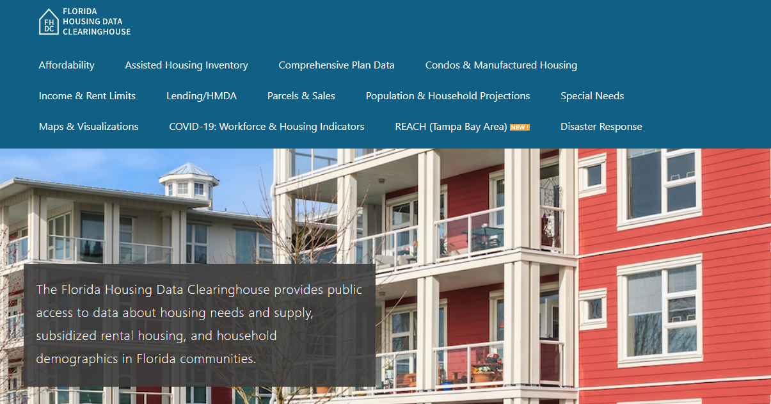
Contact
Shimberg Center for Housing Studies
352-273-1192
aray@ufl.edu
Main site: http://www.shimberg.ufl.edu
Data clearinghouse: http://flhousing.data.shimberg.ufl.edu

