Slide 1


Preserving Affordable Rental Housing
Research and Data from Florida
Anne Ray
June 28, 2013

Slide 2
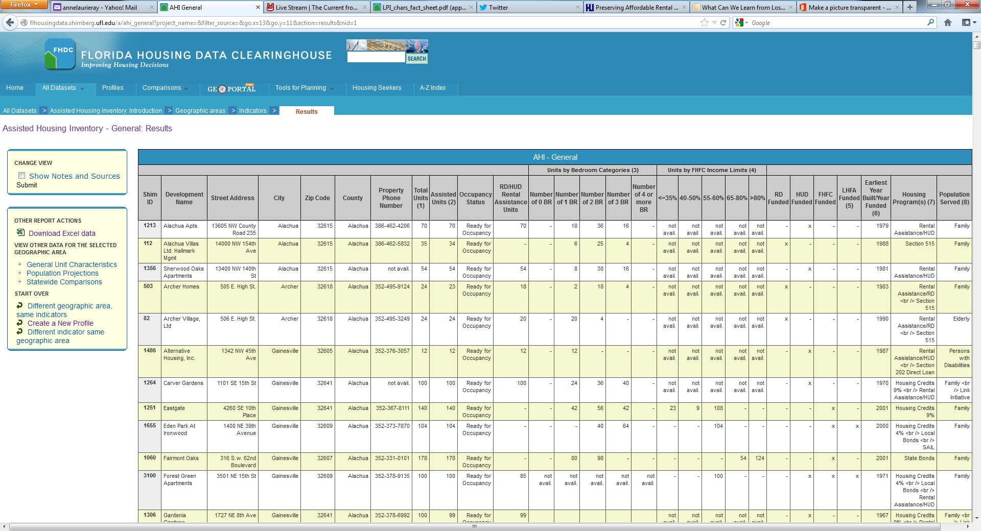
Assisted Housing Inventory (AHI)
2,266 developments with 246,577 assisted units
Active funding from HUD, USDA, Florida Housing, local housing finance agency
Data re: location, subsidies, target population, ownership, tenant characteristics

Slide 3
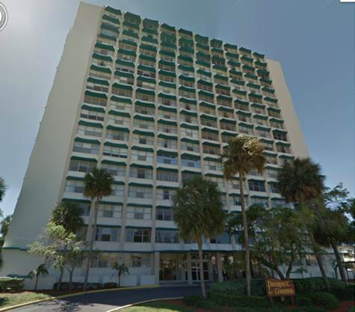
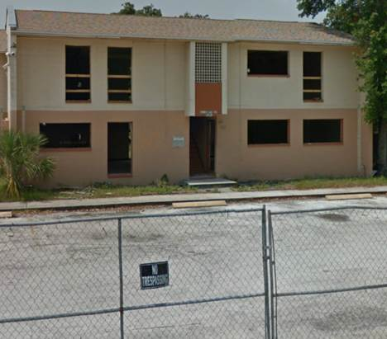
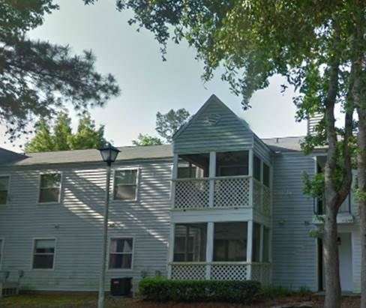
Lost Properties Inventory (LPI)
Developments that have left the assisted inventory since 1993
600 developments with over 52,000 affordable units
Annual survey of rents, vacancies and voucher acceptance

Slide 4
LPI: Tracking Losses Over Time
Assisted Units in Florida by Year of Loss, 1993-2012
Source: Shimberg Center for Housing Studies, Lost Properties Inventory

Slide 5
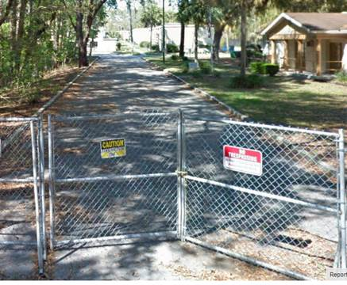
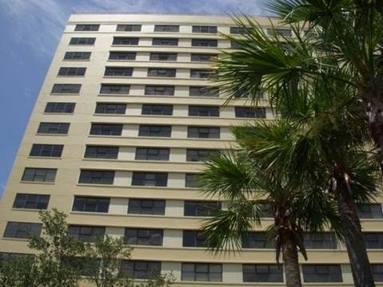
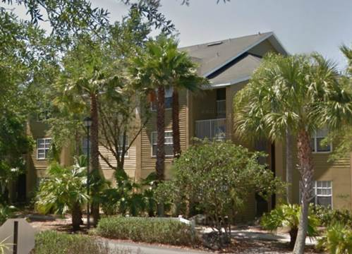
LPI: What happens after subsidies are gone?
Most (70%) developments continue as rentals; 20% converted to condos, some vacant/demolished
Of rentals, 61% affordable at 60% AMI and nearly all affordable at 80% AMI; none affordable at 30% AMI
More than half don’t accept vouchers, although most former HUD and LIHTC properties do

Slide 6
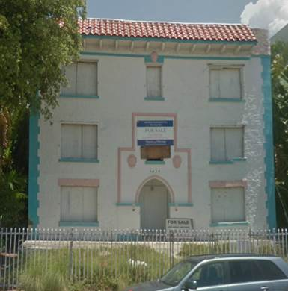
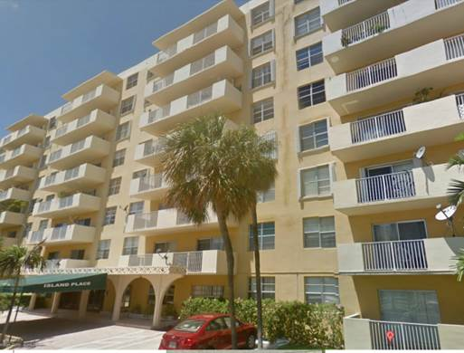
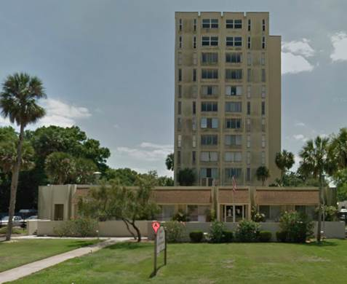
LPI: Other lessons learned
Preservation comes in waves: early LIHTC/bond projects, condo conversion, foreclosure/distress, maturing loans
Non-profit owned, elderly/disabled housing can be at risk too
Property loss and preservation are not all-or-nothing phenomena

Slide 7
Florida’s Preservation Initiative
52 developments, 5,121 assisted units, including 3,117 with HUD or RD project-based rental assistance
Most target special populations or add ELI/special needs units

Slide 8
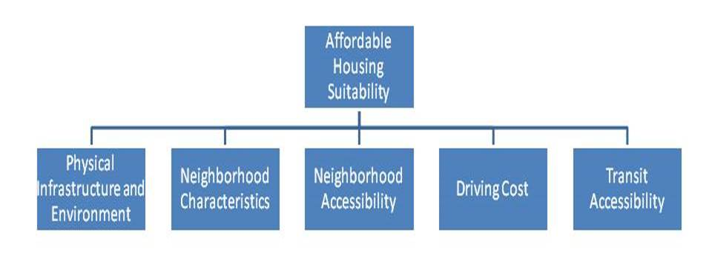
Affordable Housing Suitability Model
GIS-based model to evaluate suitability of parcels for affordable housing development, preservation

Slide 9
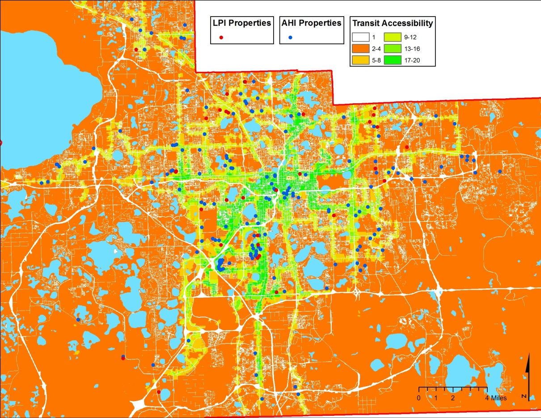
Affordable Housing Suitability Model
LPI and AHI Properties by Transit Accessibility, Orange County

Slide 10
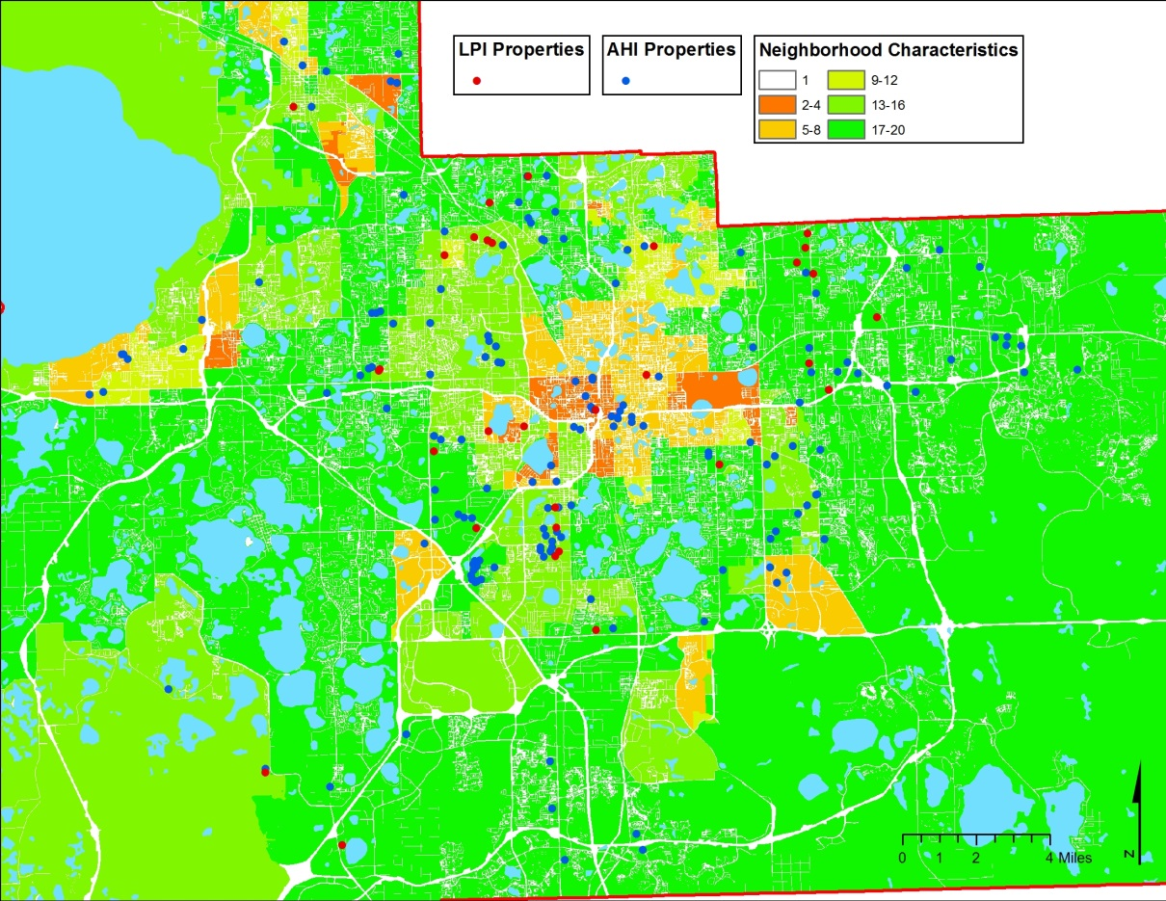
Affordable Housing Suitability Model
LPI and AHI Properties by Neighborhood Characteristics, Orange County

Slide 11
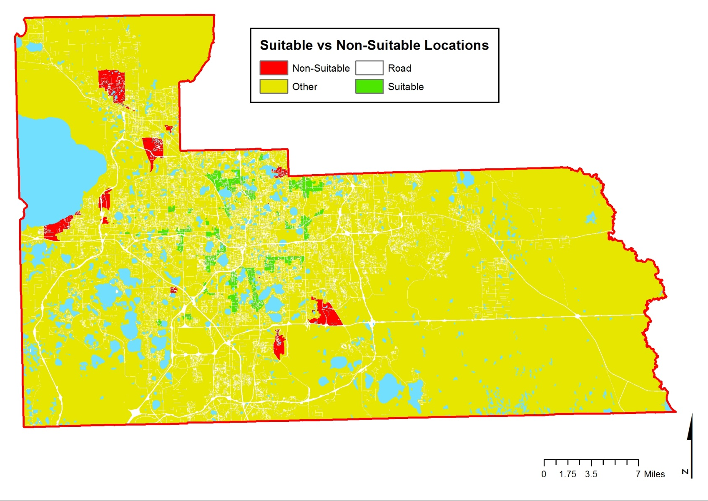
Affordable Housing Suitability Model
Transit Accessibility + Neighborhood Characteristics, Orange County

Slide 12
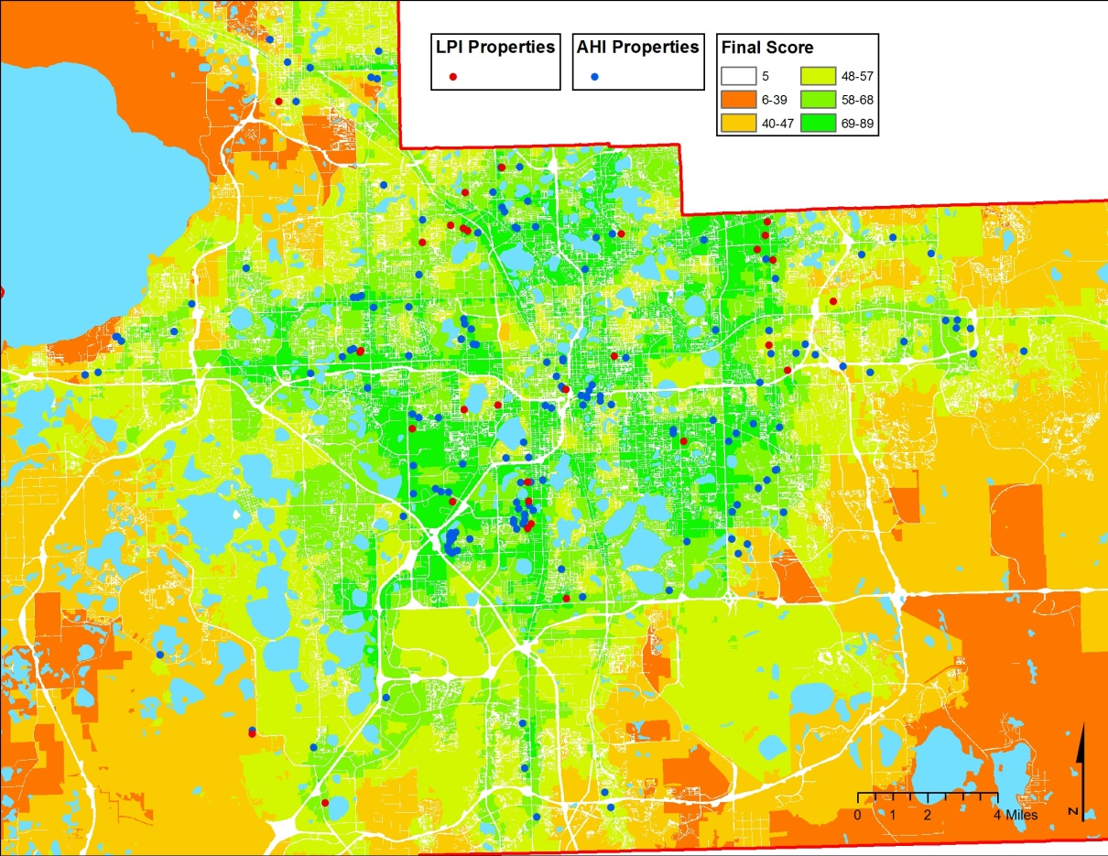
Affordable Housing Suitability Model
LPI and AHI Properties, All Layers, Orange County

Slide 13
Contact Information
Anne Ray
aray@ufl.edu
352-273-1995
Main Shimberg site: http://www.shimberg.edu
Data Clearinghouse: http://flhousingdata.shimberg.edu

