Slide 1
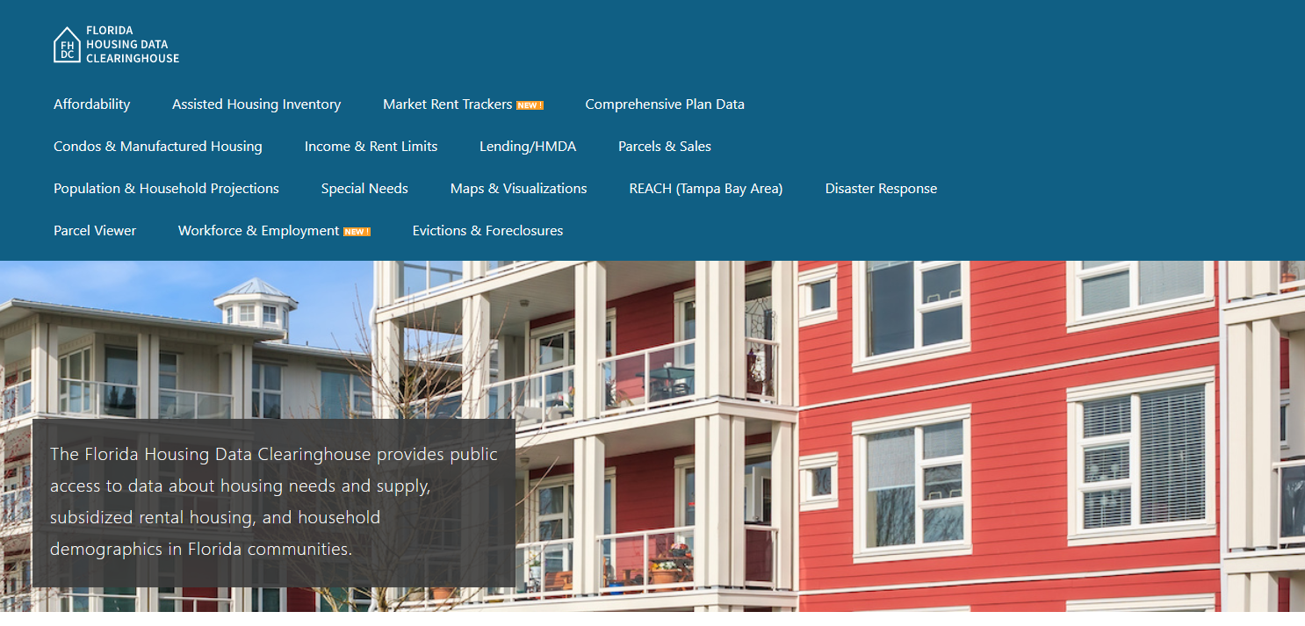

Data for Housing Action
Shimberg Center for Housing Studies
June 5, 2023

Slide 2
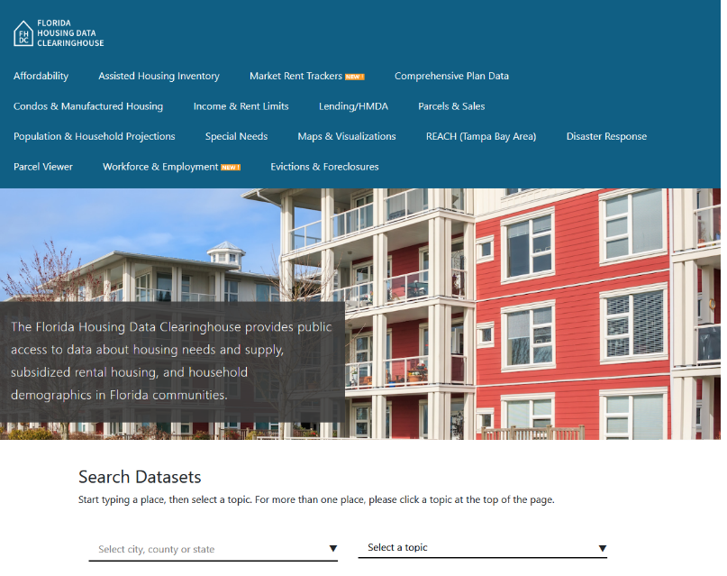
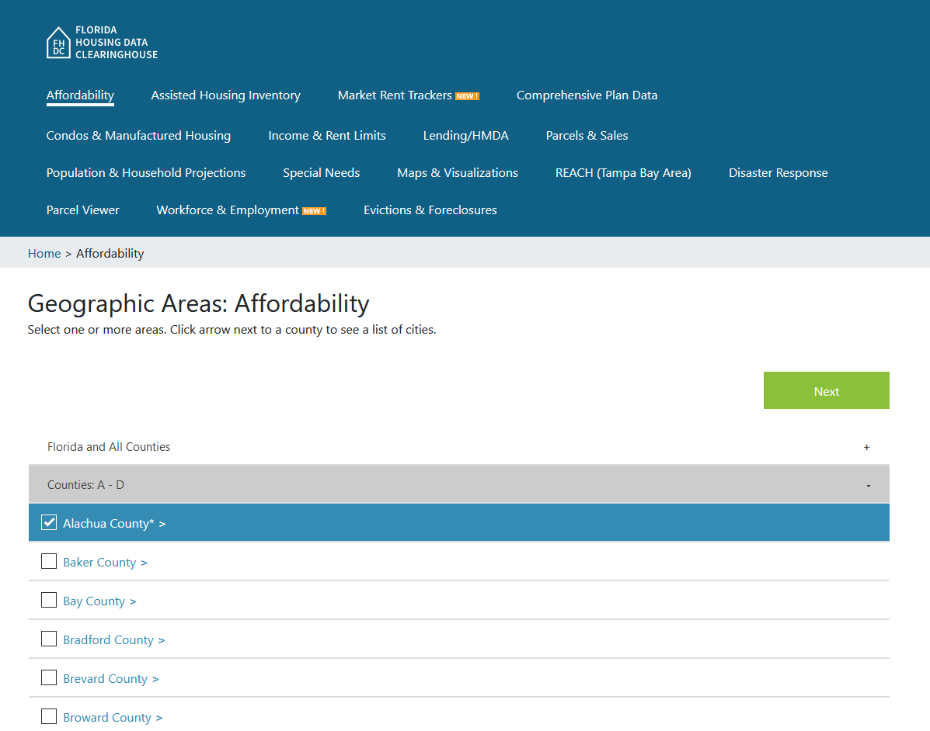
Florida Housing Data Clearinghouse
http://flhousingdata.shimberg.ufl.edu
Choose one city or county and topic from dropdowns on home page
OR
Choose topic from top menu, then choose cities and counties from list

Slide 3
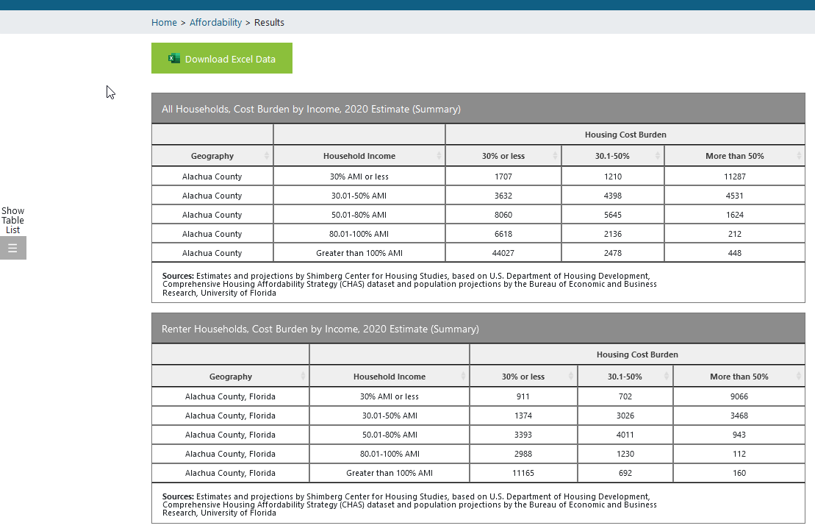
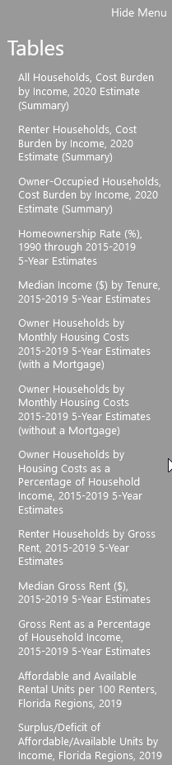
http://flhousingdata.shimberg.ufl.edu
Download all tables into Excel workbook
Jump between tables on the page

Slide 4
Clearinghouse Datasets: The Big 3
  Affordable Housing Needs Assessment
    Housing needs; tenure, income, cost burden, demographics
    Census data on housing supply
  Property Appraiser Parcels and Sales
    20+ year history of tax rolls and property sales
    Owner name & address, homestead status, housing type, year built, value, sales history
  Assisted Housing Inventory
    Property-level database of affordable rental housing subsidized by Florida Housing Finance Corp, HUD, USDA Rural Development, and local housing finance authorities

Slide 5
Other Datasets
  HUD/Florida Housing income and rent limits (% AMI)
  FEMA assistance
  Home Mortgage Disclosure Act (lending)
  Mobile home parks & condo developments
  Wage & housing cost comparisons
  Employment, unemployment & wages
  Homeless individual, families & student counts
  Eviction & foreclosure filings

Slide 6
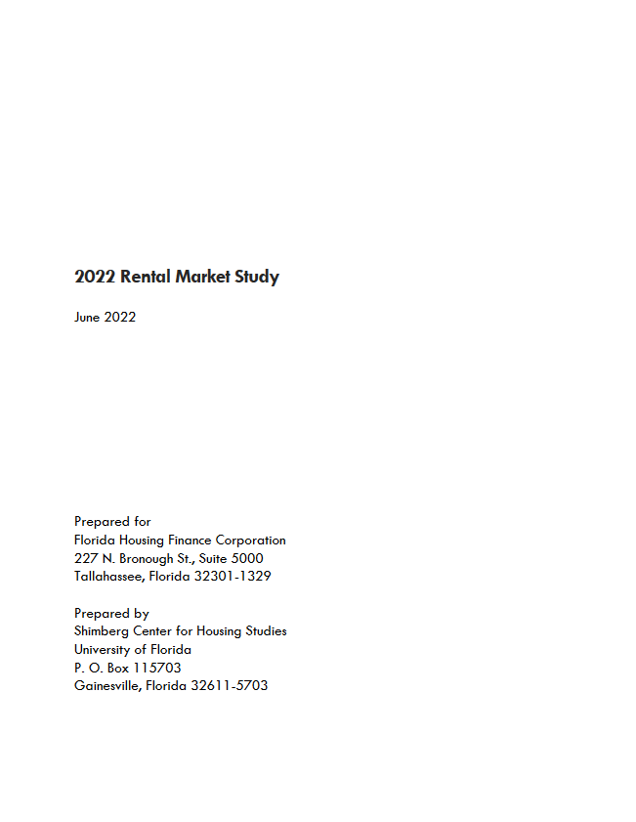
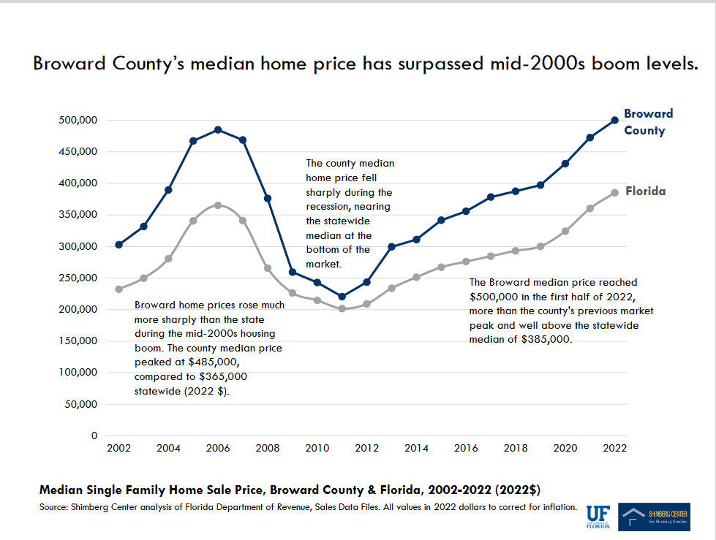
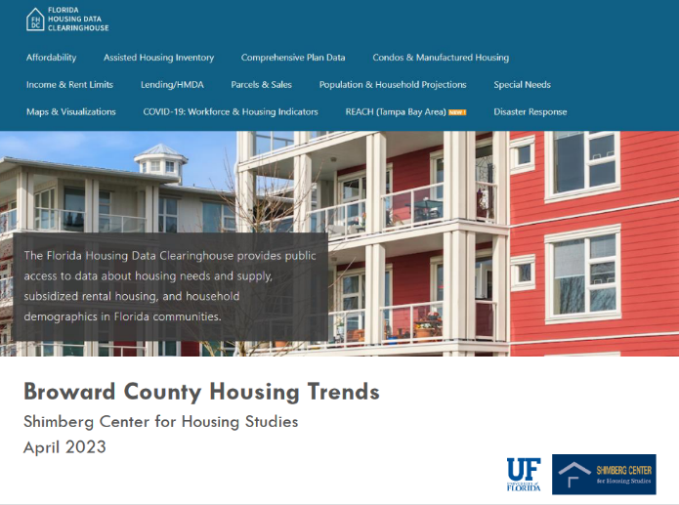
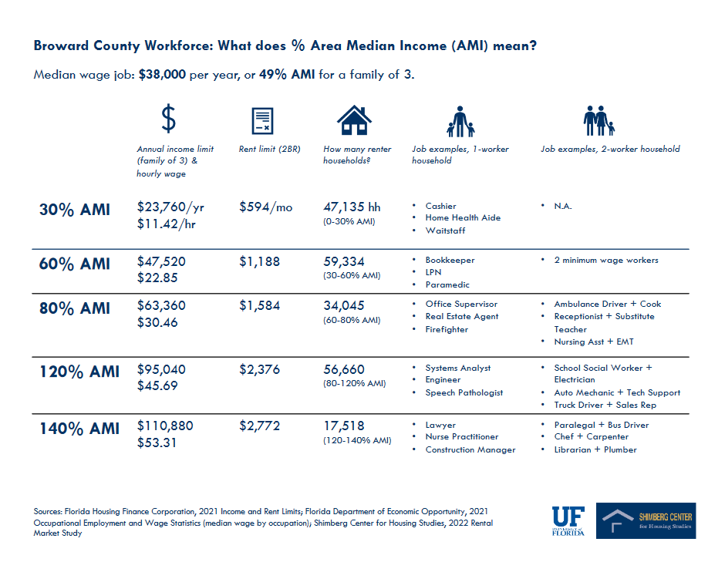
Additional Resources on Shimberg Center Publications page: Rental Market Study, county presentations
http://shimberg.ufl.edu/publications

Slide 7
Anne Ray, Shimberg Center for Housing Studies
352-273-1195 • aray@ufl.edu
Main site: http://www.shimberg.ufl.edu
Data clearinghouse: http://flhousing.data.shimberg.ufl.edu

