Slide 1
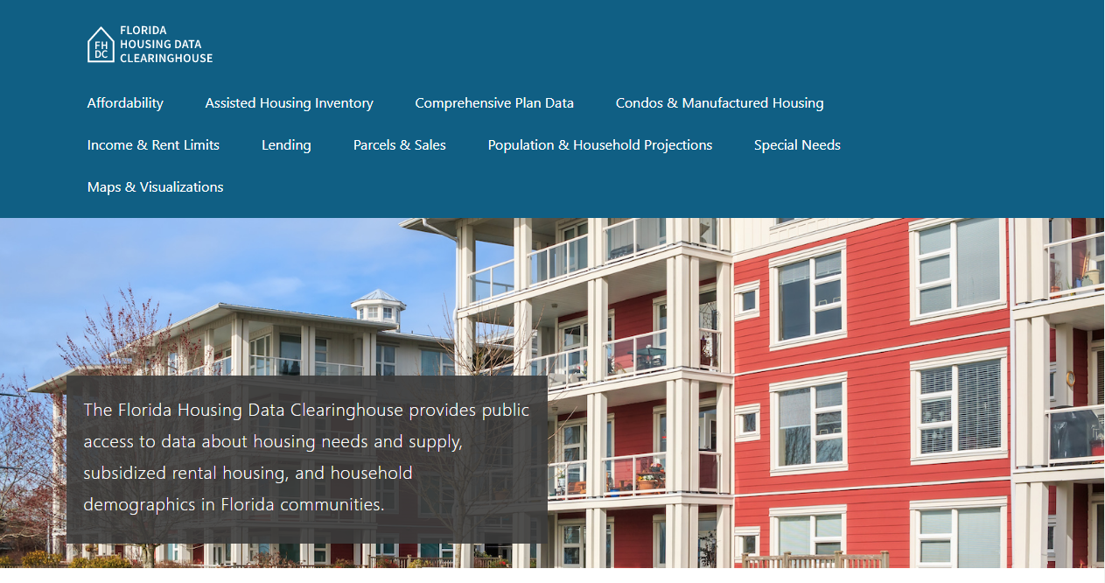
Contact
Housing Affordability in St. Lucie County
Anne Ray
Shimberg Center for Housing Studies
March 12, 2019

Slide 2
St. Lucie County’s Affordable Housing Needs
Low-Income Households by Housing Cost Burden, St. Lucie County, 2017
Housing is usually considered affordable if it costs no more than 30% of household income, including utilities.
Cost burdened: Paying more than 30% of income for housing
Nearly 28,000 low-income households in St. Lucie County are cost burdened, including the majority of renters.
Sources: Shimberg Center analysis of U.S. Census Bureau, 2017 American Community Survey. “Low-Income” refers to households with incomes below 80% of Area Median Income.

Slide 3
St. Lucie County has a shortage of affordable/available rental units. Low-income renters compete with higher income households for limited affordable supply.
Affordable and Available Rental Housing Units Compared to Renters by Income (% AMI), St. Lucie County, 2017
Sources: Shimberg Center analysis of U.S. Census Bureau, 2017 American Community Survey. See http://flhousingdata.shimberg.ufl.edu/income-and-rent-limits/results?nid=5600 for St. Lucie County incomes by AMI.

Slide 4
Housing costs outpace wages for many occupations.
St. Lucie County’s housing wage: $19.85/hour
A full-time worker would need to earn this amount to rent a typical 2BR apartment (HUD Fair Market Rent: $1,032/mo).
Median wage for Port St. Lucie-Fort Pierce MSA workers, 2017: $15.62/hour
Sources: National Low Income Housing Coalition, Out of Reach; Florida Agency for Workforce Innovation, 2017 Occupational Employment Statistics and Wages.

Slide 5
Housing costs outpace wages for many occupations.
How much can St. Lucie County’s workers afford to pay for housing each month?
$425-599
Substitute Teachers
$600-750
Preschool Teachers
$750-900
Pharmacy Technicians
Waitstaff
Home Health Aides
Secretaries
Nursing Assistants
Social Security Retirees
Childcare Workers
Customer Service Reps & Bank Tellers
Cooks
EMTs
Construction Laborers
Truck Drivers
Carpenters
Social Workers
Police, Fire, and Ambulance Dispatchers
Retail Sales & Cashiers
Source: Florida Agency for Workforce Innovation, 2017 Occupational Employment Statistics and Wages. Based on median wage for jobs in the Port St. Lucie-Fort Pierce MSA. Assumes full-time worker, 30% of income spent on housing costs.

Slide 6
St. Lucie County’s home prices have risen since housing crash, but are still more affordable than neighboring counties to the south.
Median Real Single Family Sale Price (2018 $), 2008-2018 (partial)
Source: Florida Department of Revenue, Sales Data File

Slide 7
The Affordable Housing Continuum
Supportive Housing (affordable units + services)
Homeless
Affordable rental housing
Public housing
Subsidized (Florida Housing, HUD, USDA)
Affordable home ownership
Shared equity (e.g. community land trust)
Down payment assistance
Older adults
People with disabilities
Other special needs
NOAH (Naturally Occurring Affordable Housing)
Low-interest loans
Affordable construction
Home rehab and weatherization
Vouchers

Slide 8
The local role in creating the affordable housing continuum
1. Make the rules
Land use & zoning
Reducing regulatory barriers
Inclusionary policies
2. Spend the $
Federal pass-through
State housing trust fund (SHIP)
Raising local funds through taxes or fees
3. Provide the housing
Public housing
Other affordable rental

Slide 9
Contact
Anne Ray
352-273-1195  aray@ufl.edu
Main site: http://www.shimberg.ufl.edu
Data clearinghouse: http://flhousing.data.shimberg.ufl.edu

