Slide 1
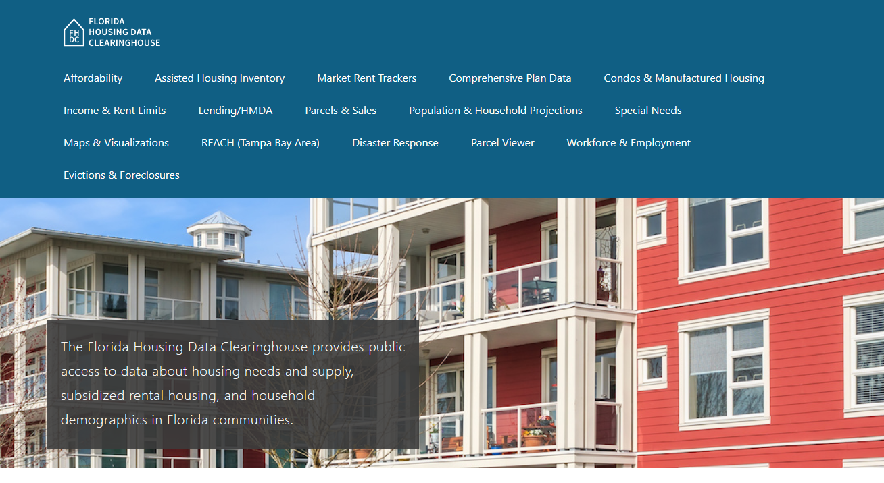
St. Johns County Housing Trends
June 2024

Slide 2
St. Johns County home prices consistently exceed statewide prices. Even adjusted for inflation, the county median home price is well above its mid-2000s boom era peak.
St. Johns County
Florida
Median Single Family Home Sale Price, St. Johns County & Florida, 2003-2023 (2023$)
Source: Shimberg Center analysis of Florida Department of Revenue, Sales Data Files. All values in 2023 dollars to correct for inflation.

Slide 3
The St. Johns-Putnam County region lost units renting for under $1,200 and gained units renting above $1,200 in the past decade (2022 $).
$1,200+ units grew by nearly 3,600
Units at or below $1,200 fell by nearly 4,000
Units by Gross Rent Above/Below $1,200 (2021 $), St. Johns & Putnam Counties, 2012 & 2022
Source: Shimberg Center tabulation of U.S. Census Bureau, 2012 and 2022American Community Survey. Year 2012 rents adjusted to 2022 dollars using Consumer Price Index.

Slide 4
Affordable Housing Terminology
Housing is usually considered to be affordable if it costs no more than 30% of household income.
Cost burdened: Paying more than 30% of income for owner or renter costs
Severely cost burdened: Paying more than 50% of income
Area median income (AMI): Used to create standard income measures across places and household sizes, expressed as % AMI

Slide 5
2024 St. Johns County Income (% AMI) and Housing Cost Limits
Income level | Annual income range (1-4 person household) | Hourly wage, 1 full-time job | Hourly wage, 2 full-time jobs | Max. affordable monthly housing cost (1-3 bedroom unit)
50% AMI | $34,100-$48,650 | $16-$23 | $12 | $912-$1,265
80% AMI | $54,560-$77,840 | $26-$37 | $15-$19 | $1,460-$2,024
120% AMI | $81,840-$116,760 | $39-$56 | $22-$28 | $2,190-$3,036
http://flhousingdata.shimberg.ufl.edu/income-and-rent-limits

Slide 6
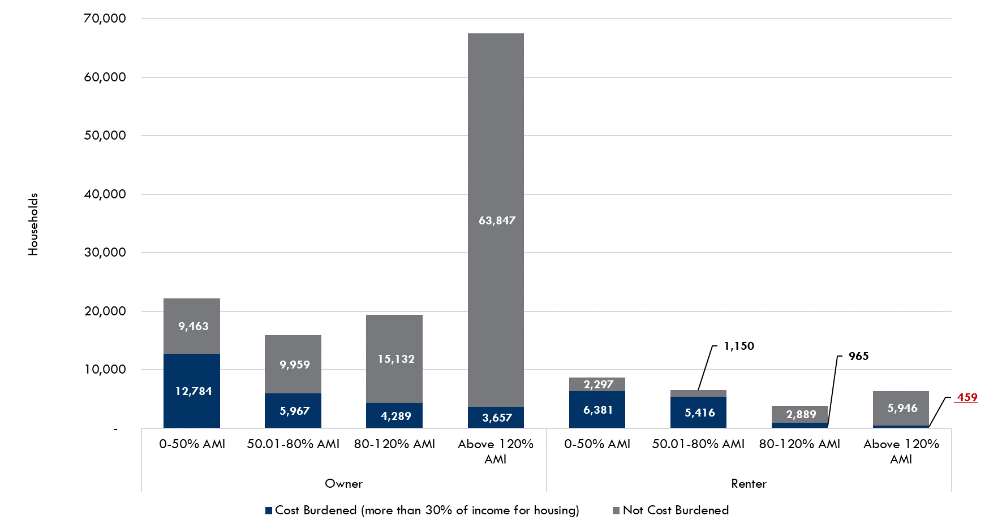
Very low-income homeowners make up the largest group of cost-burdened households in St. Johns and Putnam Counties.
Households by Tenure, Income as a Percentage of Area Median Income (AMI), and Cost Burden, St. Johns and Putnam Counties, 2022
Source: Shimberg Center tabulation of U.S. Census Bureau, 2022 American Community Survey. Values in red are not statistically significant.

Slide 7
Housing costs outpace wages for many occupations.
St. Johns County housing wage: $25.06/hour
A full-time worker would need to earn this amount to rent a typical 2BR apartment (HUD Fair Market Rent 2023: $1,303/mo).
Median wage for St. Johns County, 2023: $21.15/hour. A full-time, year-round worker with this wage can afford $1,100 in rent.
Sources: National Low Income Housing Coalition, Out of Reach; Shimberg Center tabulation of Florida Department of Economic Opportunity, Occupational Employment and Wage Statistics

Slide 8
How much can workers afford to pay for housing each month?
$600-799
$800-999
$1,000-1,200
Auto Techs and Mechanics
Bus Drivers
Bartenders
Carpenters
Child, Family, and School Social Workers
Light Truck Drivers
Median, All Occupations
Roofers
Secretaries and Administrative Assistants
Cashiers
Childcare Workers
Restaurant Cooks
Dishwashers
Farmworkers
Fast Food and Counter Workers
Food Preparation Workers
Hairdressers
Home Health and Personal Care Aides
Hotel, Motel, and Resort Desk Clerks
Janitors and Cleaners
Laundry and Dry-Cleaning Workers
Maids and Housekeeping Cleaners
Preschool Teachers
Retail Salespersons
Security Guards
Waitstaff
Construction Laborers
Customer Service Reps
Landscaping and Groundskeeping Workers
Medical Assistants
Nursing Assistants
Office Clerks
Painters
Pharmacy Techs
Receptionists
Substitute Teachers
Tellers
Veterinary Techs
Source: Shimberg Center tabulation of Florida Department of Economic Security, Occupational Employment Statistics and Wages. Based on median wage for occupations in the Jacksonville MSA. Assumes full-time worker, 30% of income spent on housing costs.

Slide 9
Building a Local Housing System: The Affordable Housing Continuum
Supportive Housing (affordable units + services)
Homeless
Affordable rental housing
Public housing
Subsidized (Florida Housing, HUD, USDA)
Affordable home ownership
Shared equity (e.g. community land trust)
Down payment assistance
Older adults
People with disabilities
Other special needs
NOAH (Naturally Occurring Affordable Housing)
Low-interest loans
Affordable construction
Home rehab and weatherization
Vouchers

Slide 10
Contact
Shimberg Center for Housing Studies
352-273-1192
Main site: http://www.shimberg.ufl.edu
Data clearinghouse: http://flhousing.data.shimberg.ufl.edu

