Slide 1



Storm Events, Climate Change and At-Risk Affordable Housing: Mapping Vulnerability
Shimberg Center for Housing Studies
University of Florida
In collaboration with Enterprise Community Partners

Slide 2
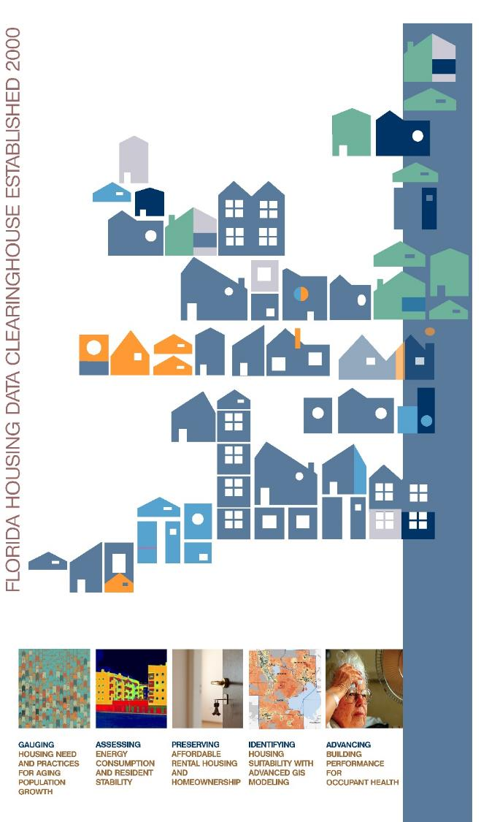
Shimberg Center for Housing Studies
Founded in 1988 by Florida State Legislature;
Mission: To promote safe, decent and affordable housing and related community development throughout the state of Florida;
Produces the Florida Housing Data Clearinghouse (http://flhousingdata.shimberg.ufl.edu), a free source of data on housing supply and demand for Florida cities and counties;
Current research focuses on documenting Florida’s housing market conditions; preserving affordable rental housing; linking affordable housing with land use, transportation and resiliency decisions through GIS modeling; supporting the development of energy efficient and healthy homes; and investigating the impacts of hazard and disaster on affordable housing.

Slide 3

Basic Affordable Housing Terminology
  Conventional or typical affordable housing programs (U.S. HUD):
  Cost burdened: Paying more than 30% of income for housing costs
  Severely cost burdened: Paying more than 50% of income for housing costs
  Area median income (AMI): Used to create standard income measures across places and household sizes, expressed as % AMI
    Extremely low-income: 0-30% AMI
    Very low-income: Up to 50% AMI
    Low-income: Up to 80% AMI
Florida Housing Finance Corp and Tax Credits:
Low-income: below 60% area median income (AMI)
Cost burdened: paying more than 40% of income for rent
Affordable unit: rent does not exceed 40% of a given income threshold (% AMI), adjusted for unit size

Slide 11
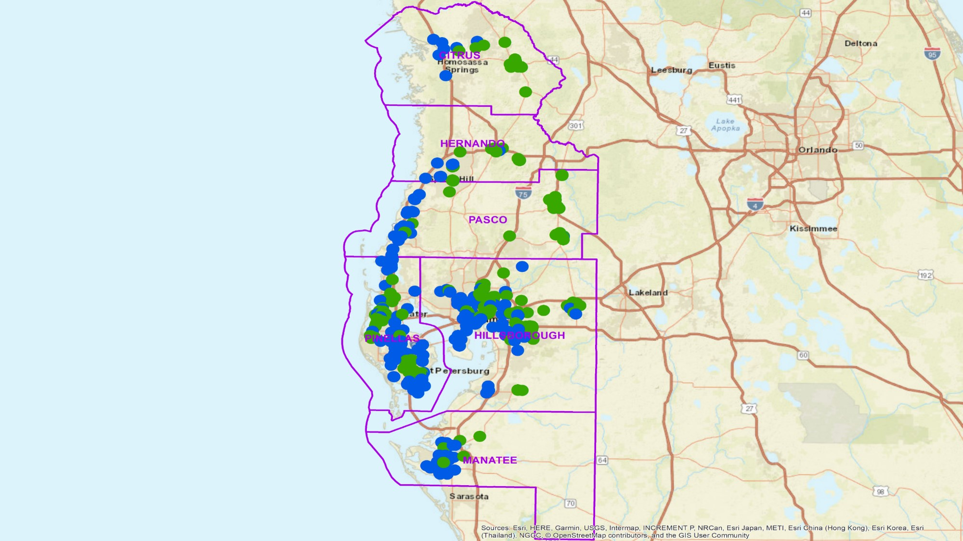
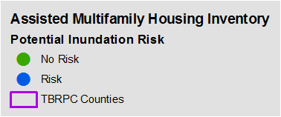

Slide 12
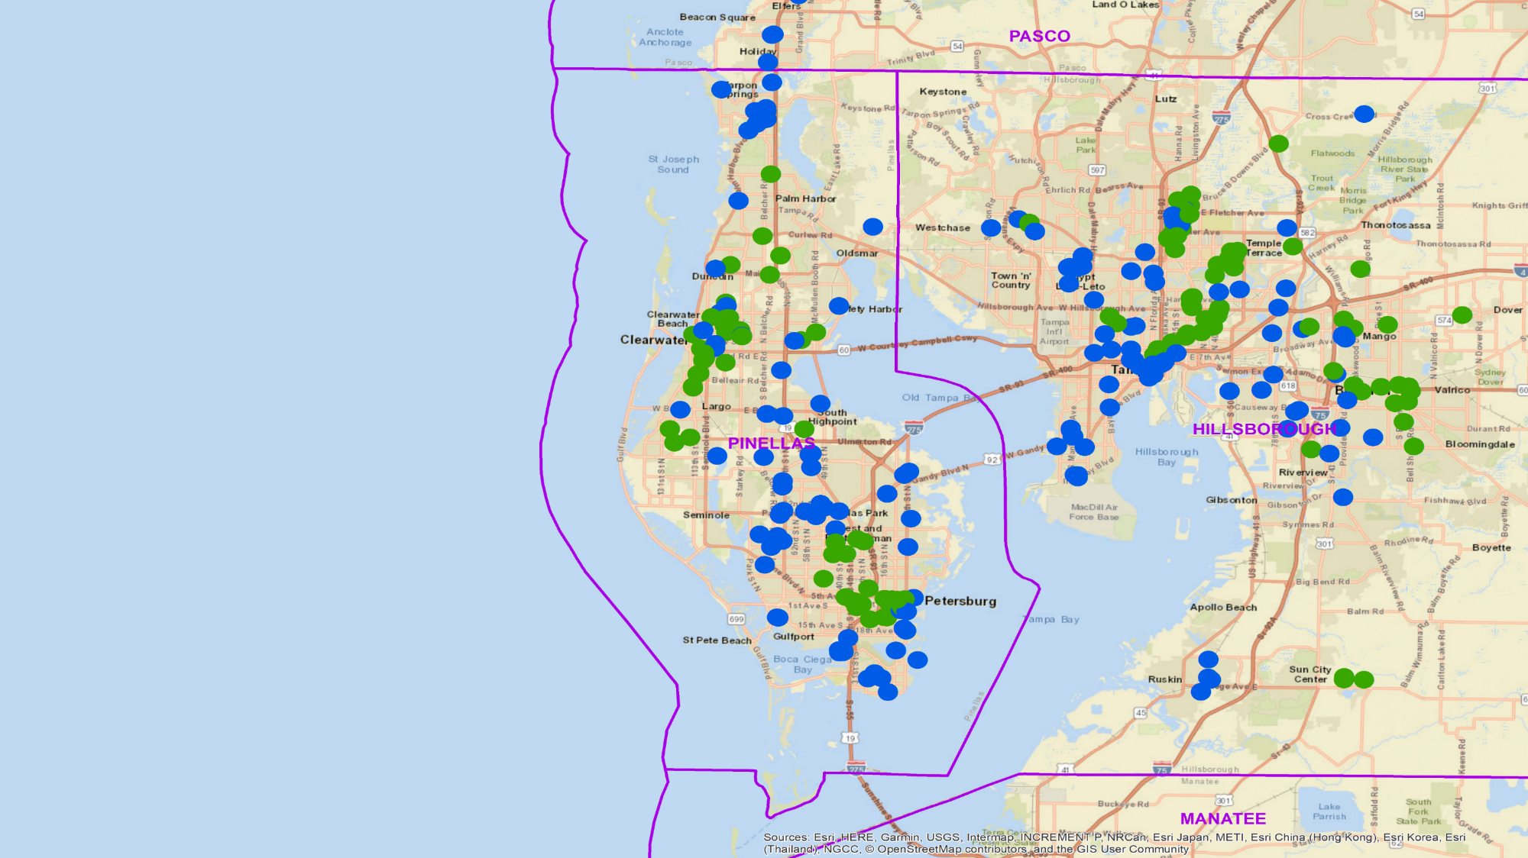
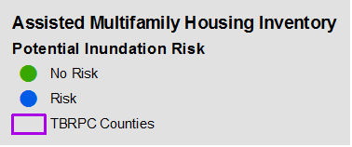

Slide 13
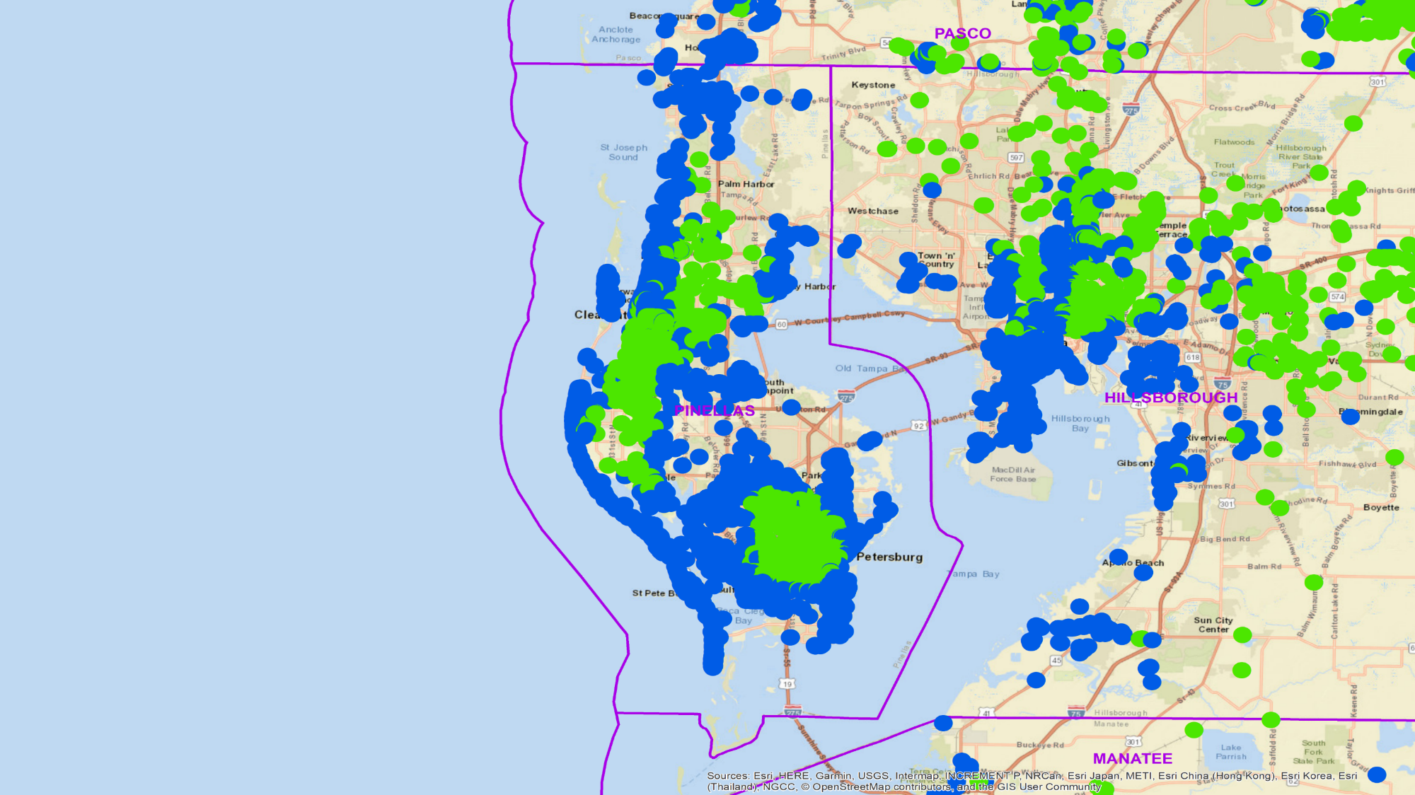
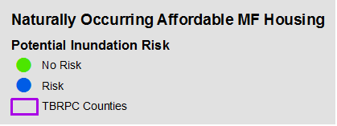

Slide 14
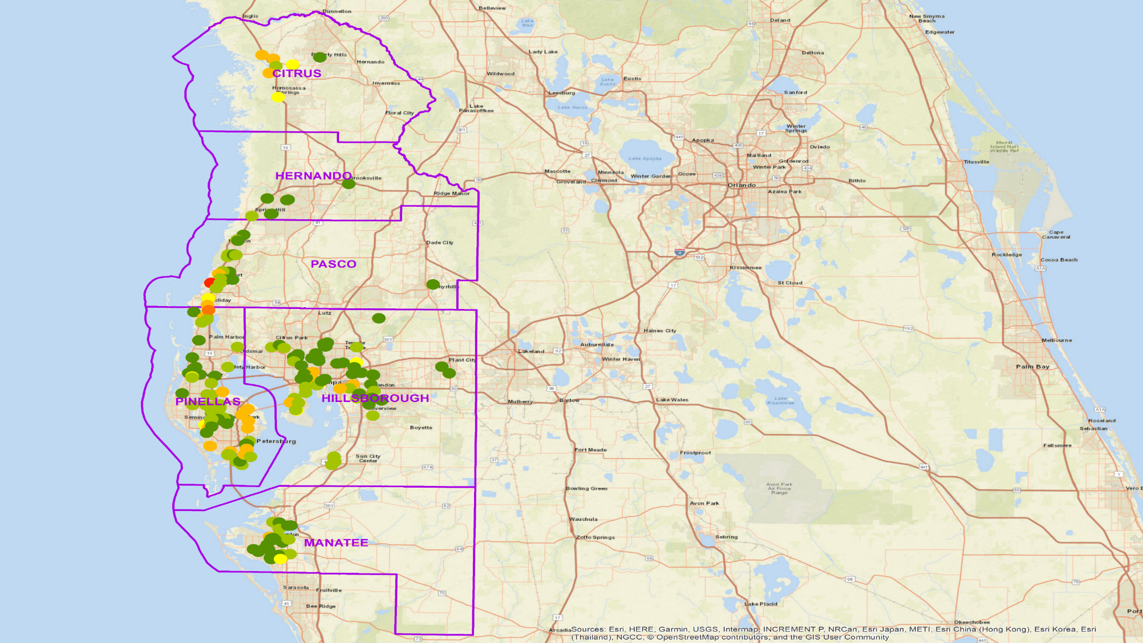
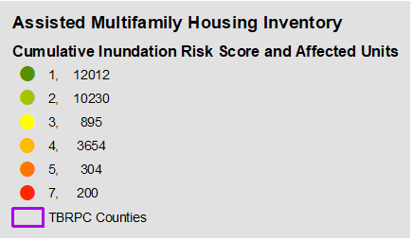

Slide 15
Average Tenant-Paid Rent by Assisted/Public Housing Type, Duval County
Source: HUD, Picture of Subsidized Households 2016; Florida Housing Finance Corporation, Tenant Data System; U.S. Census Bureau, 2016 1-Year American Community Survey. Includes rent to landlord and tenant-paid utilities. Includes tenant-paid portion of rent only; additional subsidies to landlords such as HUD rental assistance payments are not included. Note that “All Duval County Renters” includes residents of subsidized units as well as market rate units, so average rents in market-rate units would be higher.

Slide 16
Strengthening rental market: occupancy, rents rising at FHFC properties
Average Occupancy Rate, Florida Housing Developments, 2008-2017
Excludes homeless developments and properties with federal rental assistance
  Average occupancy rising throughout the county, including in districts with weaker housing markets.
  FHFC previously limited development in Duval County due to soft market; no longer does so.

Slide 17
Strengthening rental market: occupancy, rents rising at FHFC properties
Average % of Maximum Rents Charged, Florida Housing Developments, 2008-2017
Excludes homeless developments and properties with federal rental assistance
  More developments are charging maximum rents allowed under affordability restrictions.
  2017 maximum 60% AMI rents for Duval County: Studio: $676; 1BR $725; 2BR $870; 3BR $1,005; 4BR $1,122

Slide 18
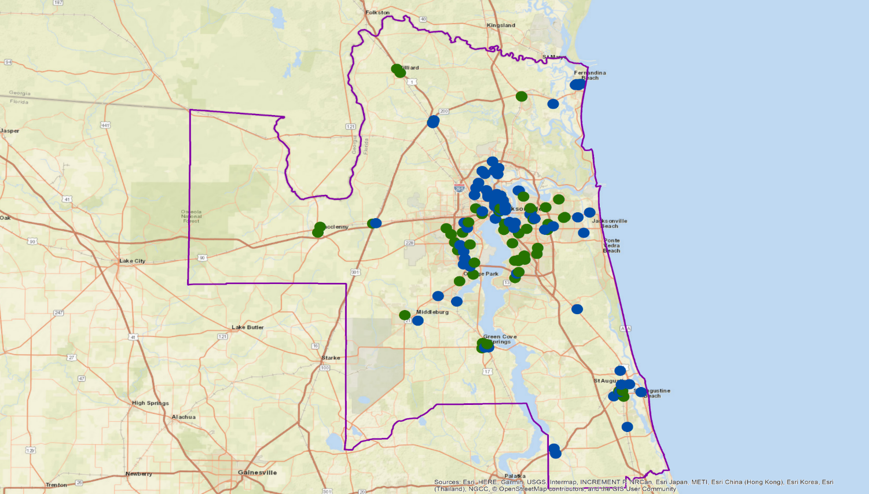
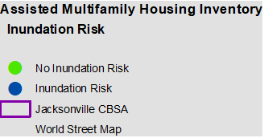
Subsidized Multi-family Housing Inventory
and Inundation Risk – Jacksonville Metro Area

Slide 19
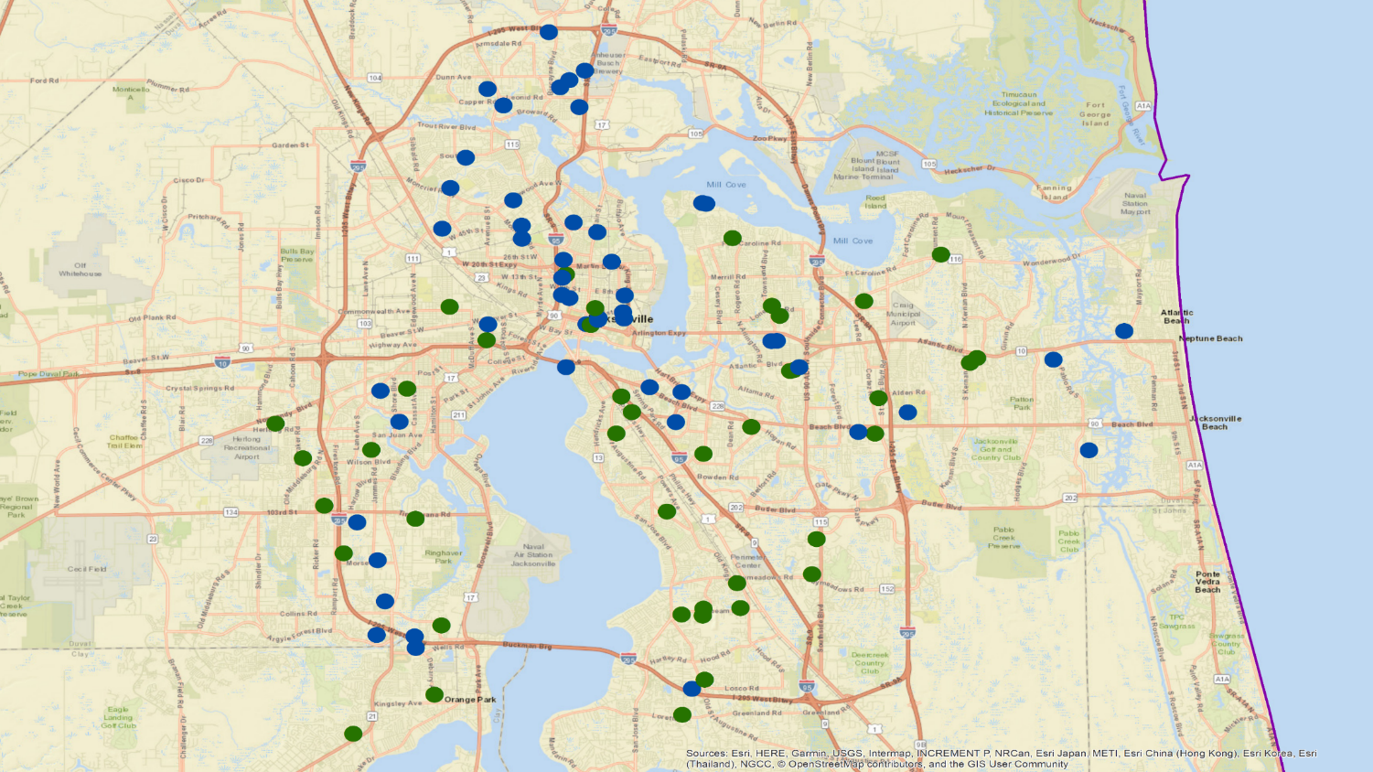
Subsidized Multi-family Housing Inventory
and Inundation Risk – Jacksonville/Duval County

Slide 20
Units at Inundation Risk by Funder
Source: Shimberg Center, Assisted Housing Inventory. Units may be counted under more than one funder.

Slide 21
Florida Housing Finance Corporation
Average tenant income: $21,002
Average rent: $631 (Duval Co. properties)
Households with children: 51%
Households with seniors (62+): 23%
Source: Shimberg Center, Assisted Housing Inventory.

Slide 22
HUD Project-Based Rental Assistance
Average tenant income: $12,601
Average rent: $227 (Duval Co. Properties)
Households with children: 57%
Households with seniors (62+): 22%
Source: Shimberg Center, Assisted Housing Inventory.

Slide 23
USDA Rural Development
Average tenant income: $16,979
Households with seniors (62+): 42%
Source: Shimberg Center, Assisted Housing Inventory. Rent data and % of children unavailable.

Slide 24
Additional data layers
  Demographic data
    Household types, owner/tenant characteristics, etc.
  Economic Data
    Household income
    Rent
    Price
  Examples of measures of Community well-being and opportunity
    Economic Innovation Group Distressed Communities Index (zip code)
    Social Vulnerability Indices
    Naturally Occurring Affordable Housing (NOAH)
  Other data layers??

Slide 25
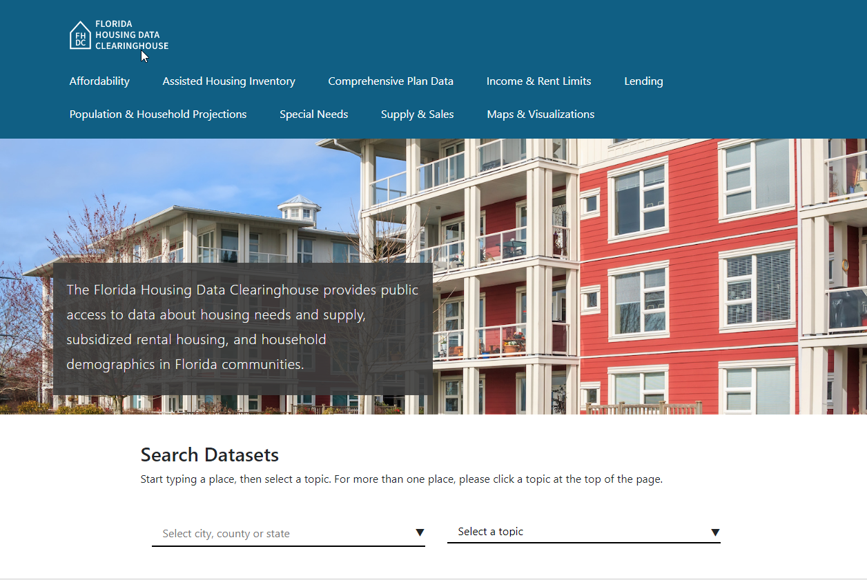
Contact: Bill O’Dell, Russ Watkins, Anne Ray, Shimberg Center for Housing Studies
352-273-1192 Main Office
billo@ufl.edu
Main site: www.shimberg.ufl.edu
Data site: data.shimberg.ufl.edu
Housing Florida’s Older Adults: elderdata.shimberg.ufl.edu

