Slide 1
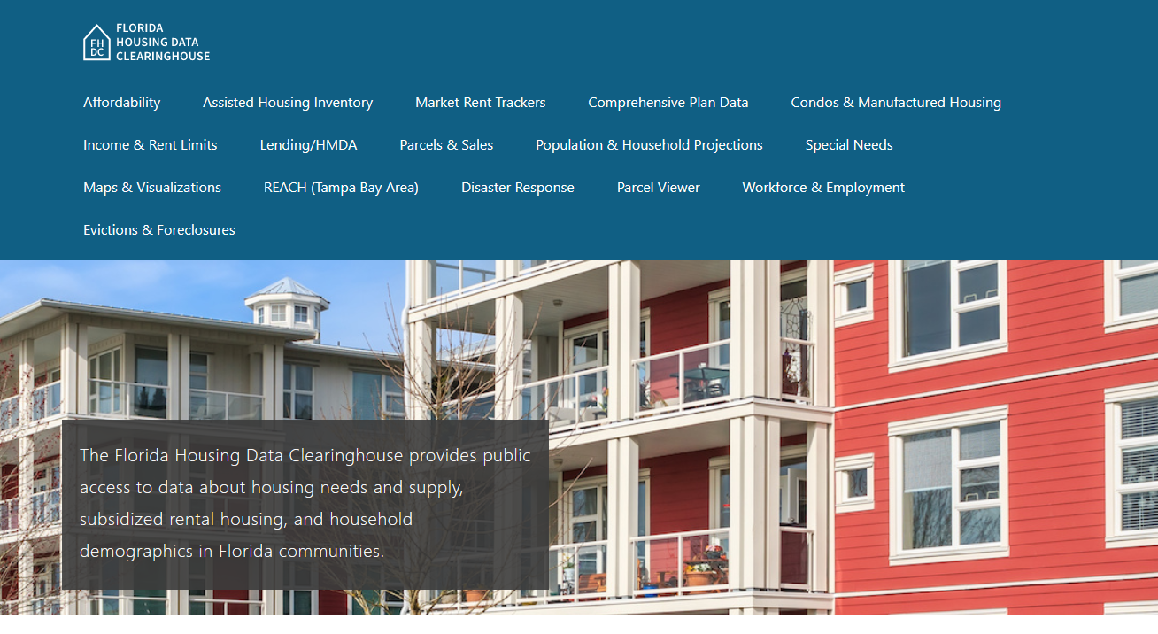
Sumter County Housing Trends
Shimberg Center for Housing Studies
June 2024

Slide 2
Sumter County avoided the boom-bust cycle that affected most of Florida’s single family home markets in the 2000s and 2010s. Home prices now exceed previous peaks.
Florida
Sumter County
Median Single Family Home Sale Price, Sumter County & Florida, 2003-2023 (2023$)
Source: Shimberg Center analysis of Florida Department of Revenue, Sales Data Files. All values in 2023 dollars to correct for inflation.

Slide 3
Affordable Housing Terminology
Housing is usually considered to be affordable if it costs no more than 30% of household income.
Cost burdened: Paying more than 30% of income for owner or renter costs
Severely cost burdened: Paying more than 50% of income
Area median income (AMI): Used to create standard income measures across places and household sizes, expressed as % AMI

Slide 4
2024 Sumter County Income (% AMI) and Housing Cost Limits
Income level | Annual income range (1-4 person household) | Hourly wage, 1 full-time job | Hourly wage, 2 full-time jobs | Max. affordable monthly housing cost (1-3 bedroom unit)
50% AMI | $30,650-$43,800 | $15-$21 | - | $821-$1,139
80% AMI | $49,040-$70,080 | $24-$34 | $14-$17 | $1,314-$1,823
120% AMI | $73,560-$105,120 | $35-$51 | $20-$26 | $1,971-$2,734
http://flhousingdata.shimberg.ufl.edu/income-and-rent-limits

Slide 5
Very low-income homeowners make up the largest group of cost-burdened households in Sumter County.
Cost Burdened Households by Income as a Percentage of Area Median Income (AMI), Sumter County, 2022
Source: Shimberg Center tabulation of U.S. Census Bureau, 2022 American Community Survey
Note: Red/Underlined numbers indicate values that are not statistically significant

Slide 6
Housing costs outpace wages for many occupations.
Sumter County housing wage: $21.02/hour
A full-time worker would need to earn this amount to rent a typical 2BR apartment (HUD Fair Market Rent 2023: $1,093/mo).
Median wage for Sumter County, 2023: $19.28/hour. A full-time, year-round worker with this wage can afford $1,003 in rent.
Sources: National Low Income Housing Coalition, Out of Reach; Shimberg Center tabulation of Florida Department of Economic Opportunity, Occupational Employment and Wage Statistics

Slide 7
How much can workers afford to pay for housing each month?
$600-799
$800-999
$1,000-1,200
Carpenters
Auto Techs and Mechanics
Bartenders
Dental Assistants
Firefighters
Heavy and Tractor-Trailer Truck Drivers
Median, All Occupations
Secretaries and Administrative Assistants
Cashiers
Childcare Workers
Restaurant Cooks
Dishwashers
Fast Food and Counter Workers
Food Preparation Workers
Hairdressers
Home Health and Personal Care Aides
Hotel, Motel, and Resort Desk Clerks
Janitors and Cleaners
Landscaping and Groundskeeping Workers
Maids and Housekeeping Cleaners
Receptionists
Retail Salespersons
Security Guards
Waitstaff
Construction Laborers
Customer Service Reps
Light Truck Drivers
Medical Assistants
Nursing Assistants
Office Clerks
Pharmacy Techs
Tellers
Source: Shimberg Center tabulation of Florida Department of Economic Security, Occupational Employment Statistics and Wages. Based on median wage for occupations in Sumter County. Assumes full-time worker, 30% of income spent on housing costs.

Slide 8
Eviction & foreclosure fell sharply in Q2 2020 during state moratorium, then increased when filings were permitted again. Filings have been volatile recently but generally are returning to historic levels.
Eviction & Foreclosure Filings, Sumter County
Source: Shimberg Center tabulation of filing data from Florida Clerks & Comptrollers and Office of the State Courts Administrator.

Slide 9
Building a Local Housing System: The Affordable Housing Continuum
Supportive Housing (affordable units + services)
Homeless
Affordable rental housing
Public housing
Subsidized (Florida Housing, HUD, USDA)
Affordable home ownership
Shared equity (e.g. community land trust)
Down payment assistance
Older adults
People with disabilities
Other special needs
NOAH (Naturally Occurring Affordable Housing)
Low-interest loans
Affordable construction
Home rehab and weatherization
Vouchers

Slide 10
Contact
Shimberg Center for Housing Studies
352-273-1192
Main site: http://www.shimberg.ufl.edu
Data clearinghouse: http://flhousing.data.shimberg.ufl.edu

